Slide 1

Using Computational Toxicology to Enable Risk-Based Chemical Safety Decision Making
Richard Judson
U.S. EPA, National Center for Computational Toxicology
Office of Research and Development
CSS Communities of Practice
November 17 2016
The views expressed in this presentation are those of the author and do not necessarily reflect the views or policies of the U.S. EPA

Slide 2
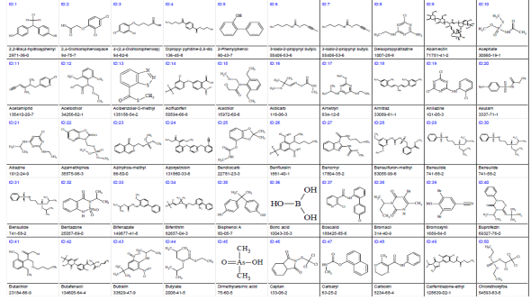
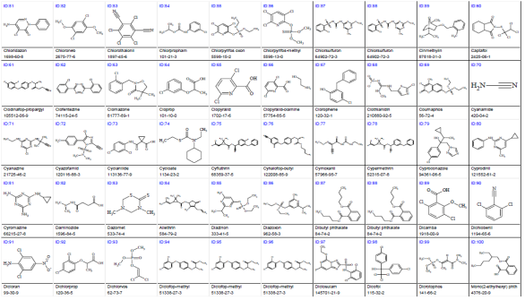
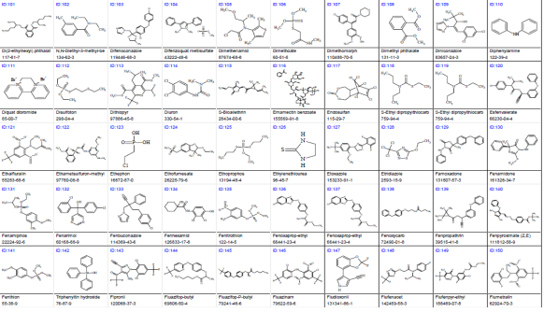

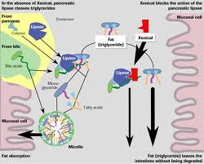
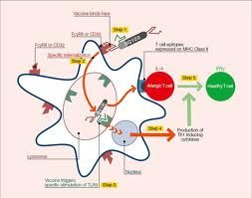
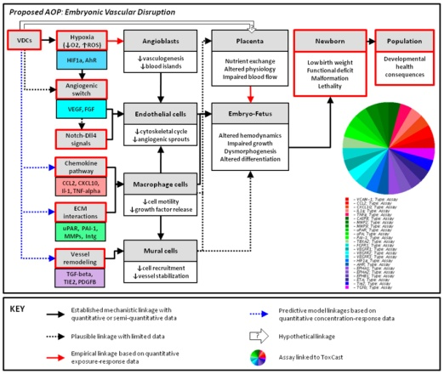
Problem Statement
Too many chemicals to test with standard animal-based methods
  Cost, time, animal welfare
Need for better mechanistic data
- Determine human relevance
- What is the Adverse Outcome Pathway (AOP)?

Slide 3
Risk-based Prioritization
Hazard + Exposure
mg/kg BW/day
Semi-quantitative
In Vitro to In Vivo
Approach
Potential Hazard:
In Vitro + HTTK
Potential Exposure:
ExpoCast
Low
Priority
Medium
Priority
High
Priority

Slide 4
Computational Toxicology
Identify biological pathways of toxicity (AOPs)
Develop high-throughput in vitro assays
  Test “Human Exposure Universe” chemicals in the assays
Develop models that link in vitro to in vivo hazard
  Use pharmacokinetic models to predict activating doses
Develop exposure models
Add uncertainty estimates
Create high-throughput risk assessments

Slide 5
Zebrafish and Developmental Toxicology
Goal: Use zebrafish as an in vivo model of vertebrate developmental toxicity
Build in vitro to in vivo models using ~700 human assays
~1000 Chemicals
  pharmaceuticals, pesticides, industrial chemicals, personal care product chemicals and food ingredients
Padilla et al., 2015, 2016, in preparation

Slide 6
Zebrafish Imaging and scoring
Deal et al. J Applied Tox. 2016

Slide 7
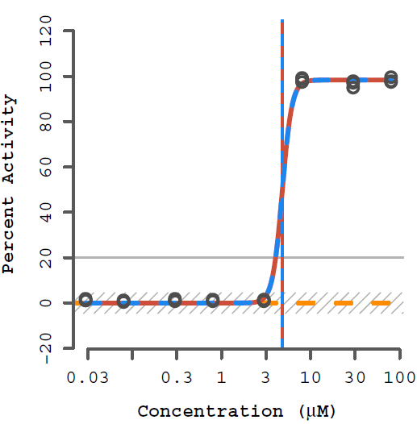
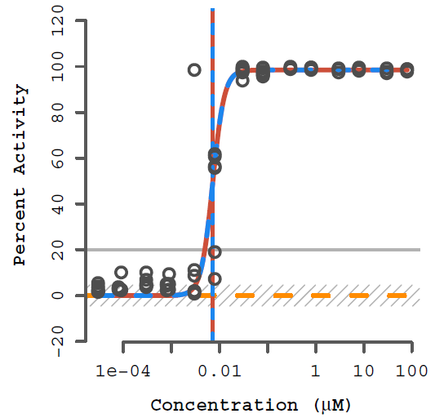
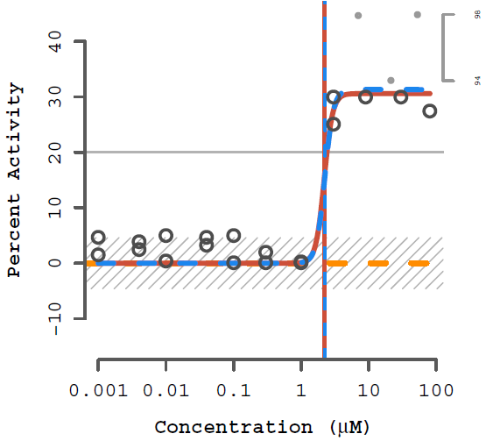
Example chemicals
DES
Lovastatin
Permethrin
100% = death
<100% = malformations

Slide 8
Most chemicals display a “burst” of potentially non-selective bioactivity near cell-stress / cytotoxity conc.
Concentration Space
Z- Space
Tested Concentration Range
Cytotoxicity
Range
3 MAD
Burst
Region
Cytotoxicity
Range
3 MAD
Burst
Region
Number of Hits
Number of Hits
0.1
1
10
100
1000
21 18 15 12 9 6 3 0 -3 -6 -9
AC50 (μM)
Bioactivity inferred
Z
Judson et al. Tox.Sci. (2016)

Slide 9
Schematic explanation of the burst
Specific
Non-specific
Oxidative Stress
DNA Reactivity
Protein Reactivity
Mitochondrial stress
ER stress
Cell membrane disruption
Specific apoptosis
…

Slide 10
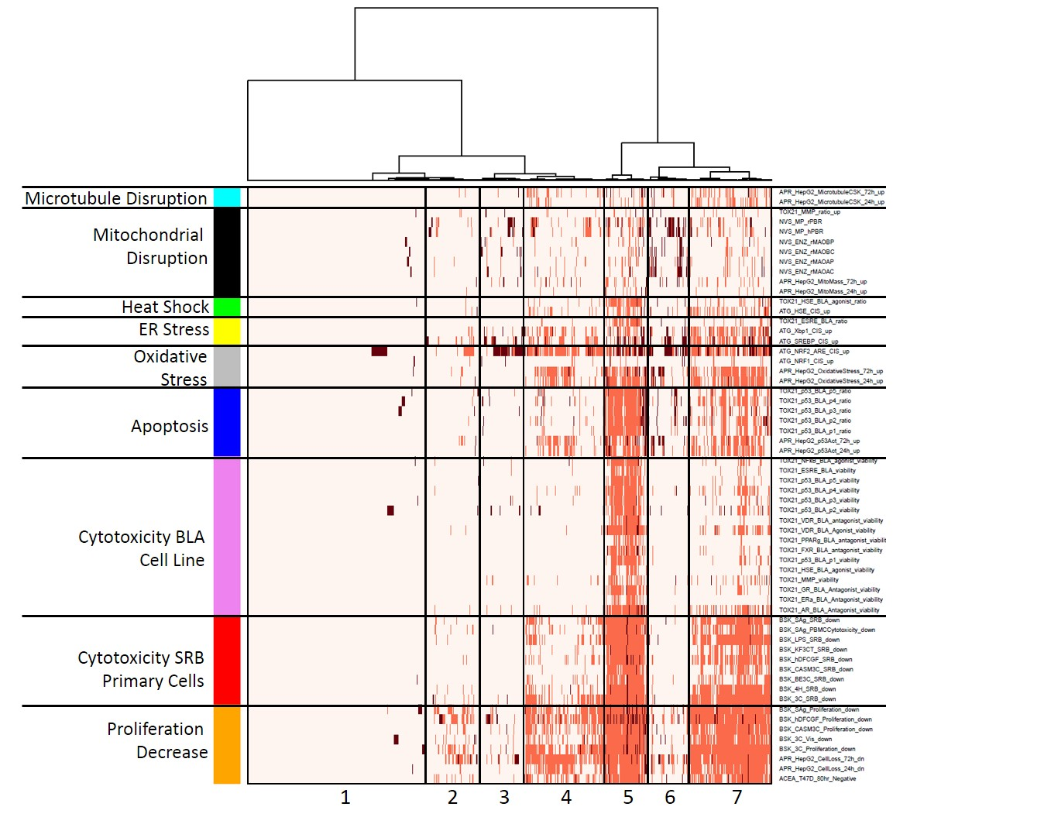
Heatmap of stress and cytotoxicity assays in 1000 chemicals
Chemicals
Judson et al. ToxSci (2016)

Slide 11
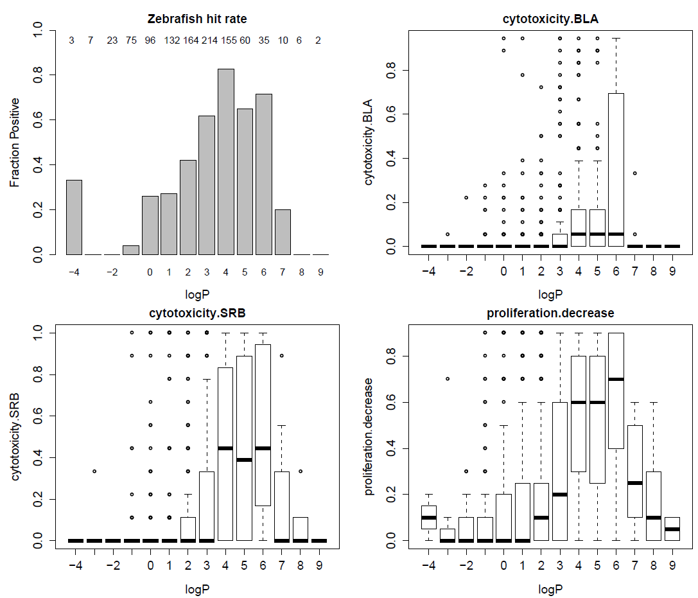
Observation about logP
Human in vitro cell stress behaves ~ zebrafish toxicity

Slide 12
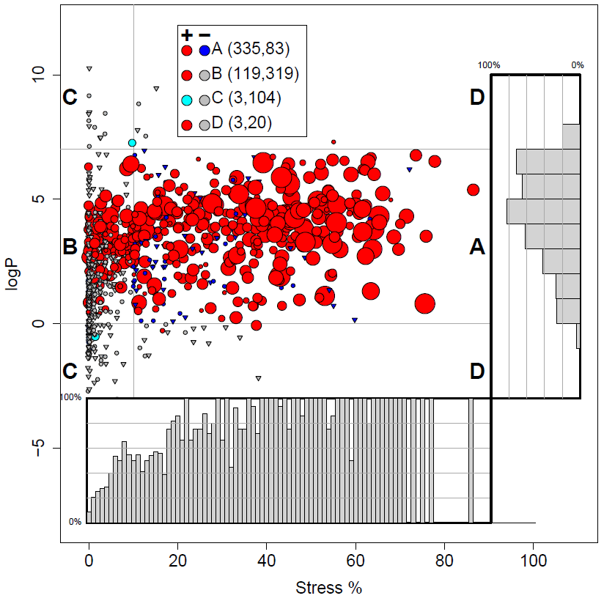
Stress, logP explains ~80% of ZF activity
ZF positive in conc-response
ZF negative in conc-response
ZF negative in single conc
83 negatives in region A
  Blue triangles
  “false positives”?
50 “failed” single screen test?
Judson et al. In preparation

Slide 13
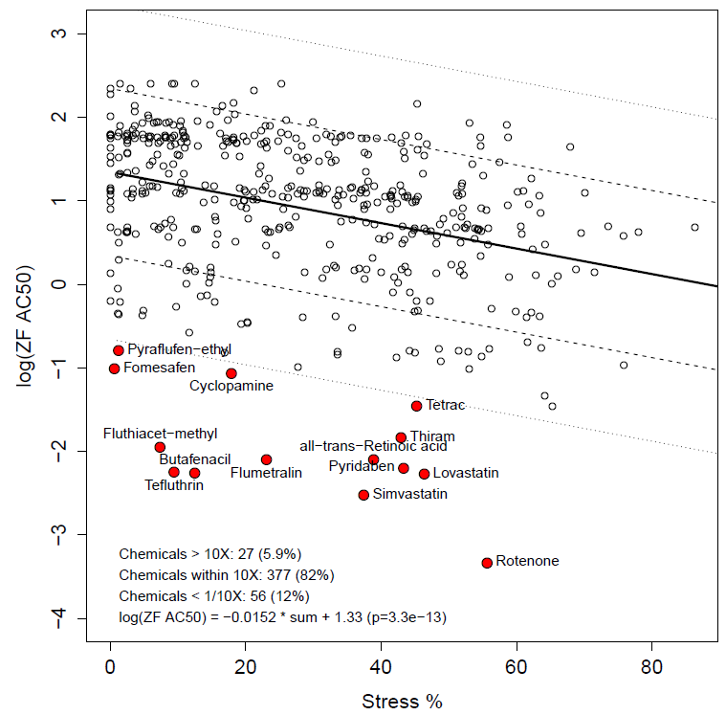
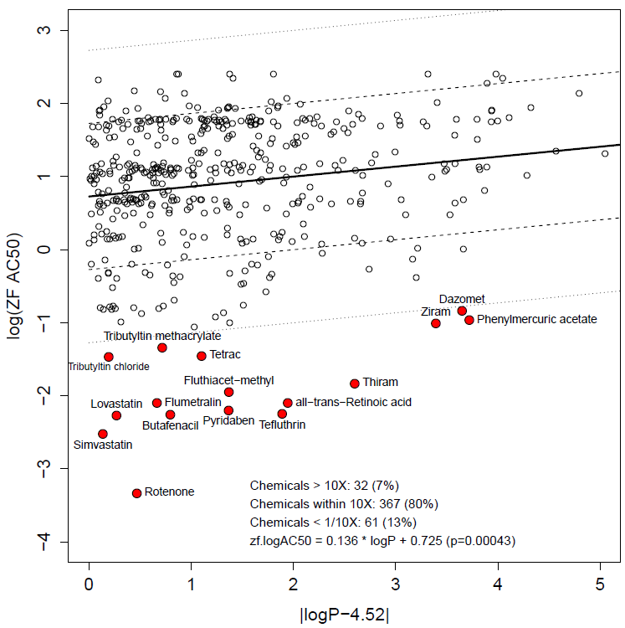
“Excess Toxicity” points to specific target activity

Slide 14
Chemicals with excess toxicity tend to fall in a few target MOA classes
ACHE
Ion channel blockers
HMGCR
Mitochondrial disruptors
PPO inhibitors (disrupts plant cell membranes)
Chemicals reacting with protein SH groups
Thyroid hormone receptor blockers
Some of these classes are over-represented in overall hit predictivity and in excess potency for hits

Slide 15
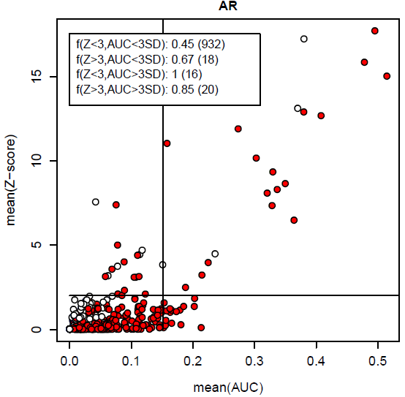
Look for specific targets by controlling for stress-related assay confounding
Are potent actives against specific targets more likely than chance to be ZF-active?
Filter on Z-score (AC50 relative to cytotoxicity)
Red: ZF active
White: ZF inactive
Filter on AUC (potency x efficacy)
Measure of reproducibility across multiple assays

Slide 16
class | Gene group | annotation | assays | TP | FP | FN | TN | Sens | Spec | BA | OR | PPV | p-value
endocrine | AR | Androgen receptor | 11 | 17 | 3 | 443 | 523 | 0.04 | 0.99 | 0.52 | 6.7 | 0.85 | 0.0005
endocrine | CYP19A1 | Aromatase | 2 | 24 | 2 | 436 | 524 | 0.05 | 1.00 | 0.52 | 14.4 | 0.92 | 9E-07
endocrine | ESR | Estrogen receptor | 17 | 29 | 6 | 431 | 520 | 0.06 | 0.99 | 0.53 | 5.8 | 0.83 | 2E-05
endocrine | NR3C1 | Glucocorticoid receptor | 4 | 14 | 4 | 446 | 522 | 0.03 | 0.99 | 0.51 | 4.1 | 0.78 | 0.0084
endocrine | PGR | Progesterone receptor | 2 | 15 | 3 | 445 | 523 | 0.03 | 0.99 | 0.51 | 5.9 | 0.83 | 0.0016
ER stress | SREBF1 |  | 1 | 36 | 10 | 424 | 516 | 0.08 | 0.98 | 0.53 | 4.4 | 0.78 | 1E-05
ER stress | XBP1 |  | 1 | 10 | 1 | 450 | 525 | 0.02 | 1.00 | 0.51 | 11.7 | 0.91 | 0.0039
GPCR | LTD4 |  | 1 | 11 | 1 | 449 | 525 | 0.02 | 1.00 | 0.51 | 12.9 | 0.92 | 0.002
growth factor | EGR1 |  | 1 | 19 | 1 | 441 | 525 | 0.04 | 1.00 | 0.52 | 22.6 | 0.95 | 8E-06
hypoxia | HIF1A |  | 1 | 24 | 3 | 436 | 523 | 0.05 | 0.99 | 0.52 | 9.6 | 0.89 | 5E-06
inflammation | CEBPB |  | 1 | 30 | 6 | 430 | 520 | 0.07 | 0.99 | 0.53 | 6.0 | 0.83 | 5E-06
inflammation | CREB3 |  | 1 | 23 | 1 | 437 | 525 | 0.05 | 1.00 | 0.52 | 27.6 | 0.96 | 5E-07
inflammation | PTGER2 |  | 1 | 29 | 7 | 431 | 519 | 0.06 | 0.99 | 0.52 | 5.0 | 0.81 | 3E-05
inflammation | TNF |  | 1 | 30 | 13 | 430 | 513 | 0.07 | 0.98 | 0.52 | 2.8 | 0.70 | 0.0026
ion channel | KCNH2 |  | 1 | 13 | 2 | 447 | 524 | 0.03 | 1.00 | 0.51 | 7.6 | 0.87 | 0.0026
oncogene | JUN |  | 1 | 18 | 6 | 442 | 520 | 0.04 | 0.99 | 0.51 | 3.5 | 0.75 | 0.0062
oxidative stress | NFE2L2 | NRF2, ROS Sensor | 2 | 34 | 5 | 426 | 521 | 0.07 | 0.99 | 0.53 | 8.3 | 0.87 | 1E-07
transcription factor | POU2F1 |  | 1 | 17 | 4 | 443 | 522 | 0.04 | 0.99 | 0.51 | 5.0 | 0.81 | 0.0016
transcription factor | SMAD1 |  | 1 | 21 | 5 | 439 | 521 | 0.05 | 0.99 | 0.52 | 5.0 | 0.81 | 0.0005
transcription factor | SOX1 |  | 1 | 16 | 5 | 444 | 521 | 0.03 | 0.99 | 0.51 | 3.8 | 0.76 | 0.0072
transcription factor | SP1 |  | 1 | 18 | 2 | 442 | 524 | 0.04 | 1.00 | 0.52 | 10.7 | 0.90 | 6E-05
transporter | DAT |  | 1 | 18 | 6 | 442 | 520 | 0.04 | 0.99 | 0.51 | 3.5 | 0.75 | 0.0062
xenobiotic metabolism | CYP1A | cytochrome P450 | 4 | 18 | 3 | 442 | 523 | 0.04 | 0.99 | 0.52 | 7.1 | 0.86 | 0.0003
xenobiotic metabolism | CYP2A | cytochrome P450 | 3 | 25 | 5 | 435 | 521 | 0.05 | 0.99 | 0.52 | 6.0 | 0.83 | 5E-05
xenobiotic metabolism | CYP2B | cytochrome P450 | 2 | 25 | 2 | 435 | 524 | 0.05 | 1.00 | 0.53 | 15.1 | 0.93 | 4E-07
xenobiotic metabolism | CYP2C | cytochrome P450 | 8 | 24 | 0 | 436 | 526 | 0.05 | 1.00 | 0.53 | 1E+06 | 1.00 | 8E-09
xenobiotic metabolism | CYP2D | cytochrome P450 | 3 | 15 | 3 | 445 | 523 | 0.03 | 0.99 | 0.51 | 5.9 | 0.83 | 0.0016
xenobiotic metabolism | CYP2J | cytochrome P450 | 1 | 21 | 1 | 439 | 525 | 0.05 | 1.00 | 0.52 | 25.1 | 0.95 | 2E-06
xenobiotic metabolism | CYP3A | cytochrome P450 | 4 | 19 | 1 | 441 | 525 | 0.04 | 1.00 | 0.52 | 22.6 | 0.95 | 8E-06
xenobiotic metabolism | NR1I2 | PXR | 3 | 30 | 9 | 430 | 517 | 0.07 | 0.98 | 0.52 | 4.0 | 0.77 | 0.0001
Endocrine pathways
Largely stress activity:
more potent than cytotoxicity
Largely due to conazoles

Slide 17
The ideal in vitro to in vivo model
Zebrafish, rat, mouse, human, …
Read off the causal mechanisms from the diagonal
Cytotoxicity
Target X
Other targets
In Vivo Concentration Equivalent
Human In Vitro Concentration Equivalent
Failure so far – concentration equivalents require better understanding of relative kinetics, bioavailability
Also concentration uncertainty on both axes is ~1 log unit (95% CI)

Slide 18
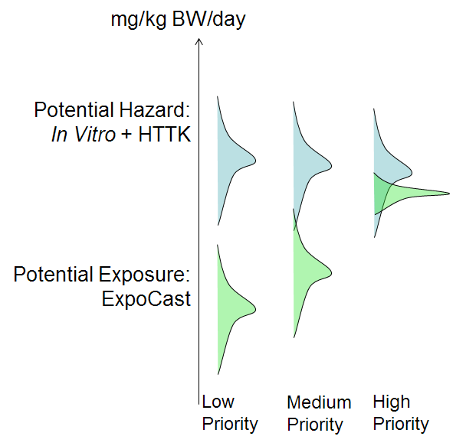
Modeling with Uncertainty
Our first goal is prediction
  What is the highest safe dose of a chemical?
  What types of harm would a chemical cause above that dose?
Predictions are based on models
  Computational, statistical, “mental”, in vitro, in vivo
All models are based on data
Data is always subject to noise, variability
Therefore, all predictions are subject to uncertainty
Our second goal is estimating prediction uncertainty
Watt, Kapraun et al. In preparation

Slide 19
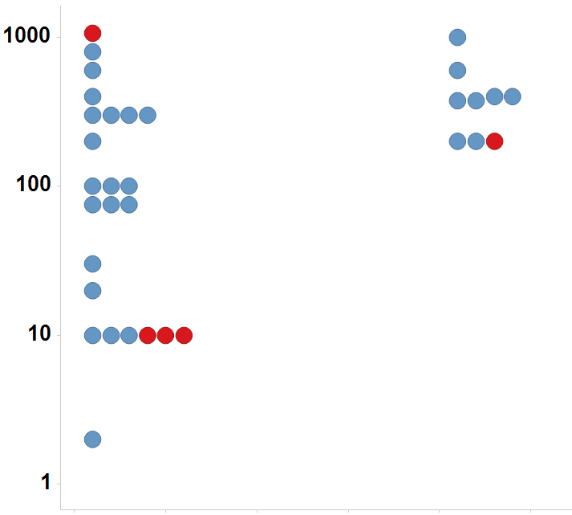
In vivo guideline study uncertainty
26% of chemicals tested multiple times in the uterotrophic assay gave discrepant results
Anemia Reproducibility
Immature Rat: BPA
species / study 1 | species / study 2 | Reproduce | Does Not Reproduce | Fraction Reproduce
rat SUB | rat CHR | 18 | 2 | 0.90
rat CHR | dog CHR | 13 | 2 | 0.87
rat CHR | rat SUB | 18 | 4 | 0.82
rat SUB | rat SUB | 16 | 4 | 0.80
rat SUB | dog CHR | 11 | 4 | 0.73
mouse CHR | rat CHR | 11 | 4 | 0.73
mouse CHR | rat SUB | 13 | 7 | 0.65
dog CHR | rat SUB | 11 | 6 | 0.65
dog CHR | rat CHR | 13 | 8 | 0.62
rat CHR | mouse CHR | 11 | 11 | 0.50
mouse CHR | dog CHR | 6 | 6 | 0.50
rat SUB | mouse CHR | 13 | 14 | 0.48
dog CHR | mouse CHR | 6 | 8 | 0.43
mouse CHR | mouse CHR | 2 | 3 | 0.40
LEL or MTD (mg/kg/day)
Uterotrophic
Active
Inactive
Injection
Oral
Kleinstreuer et al. EHP 2015
Judson et al. In Preparation

Slide 20
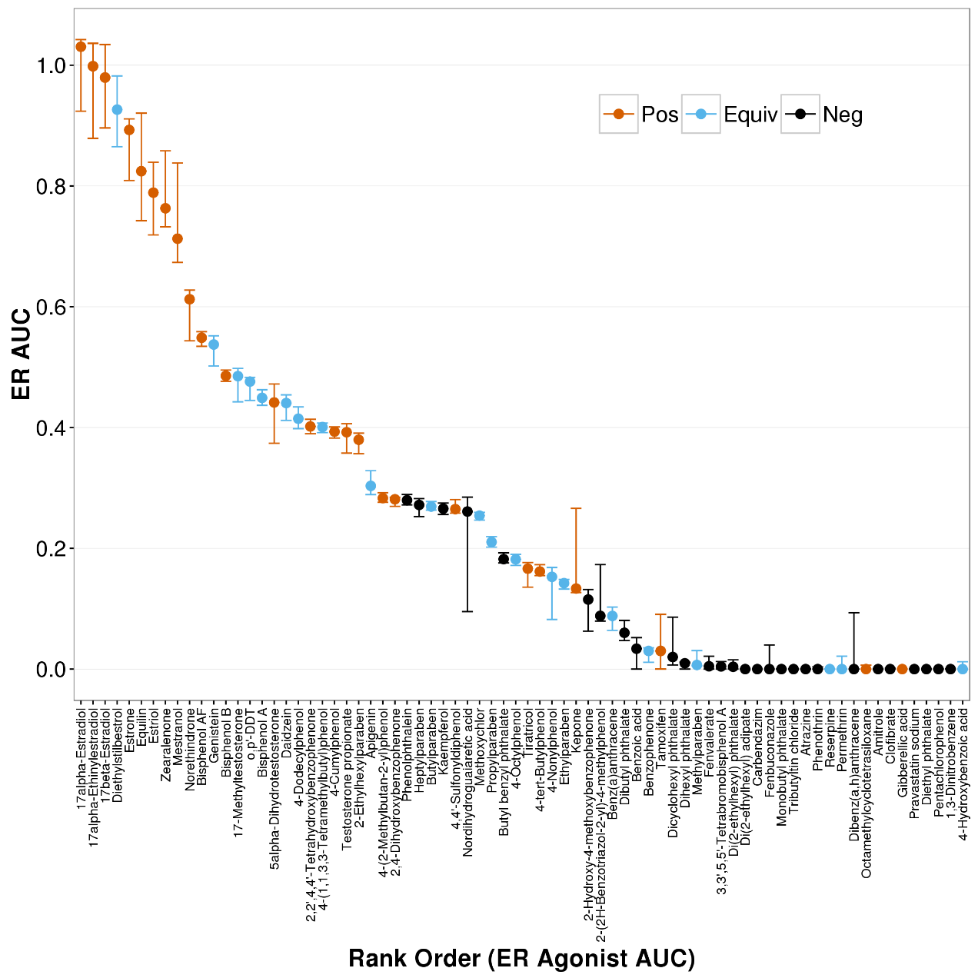
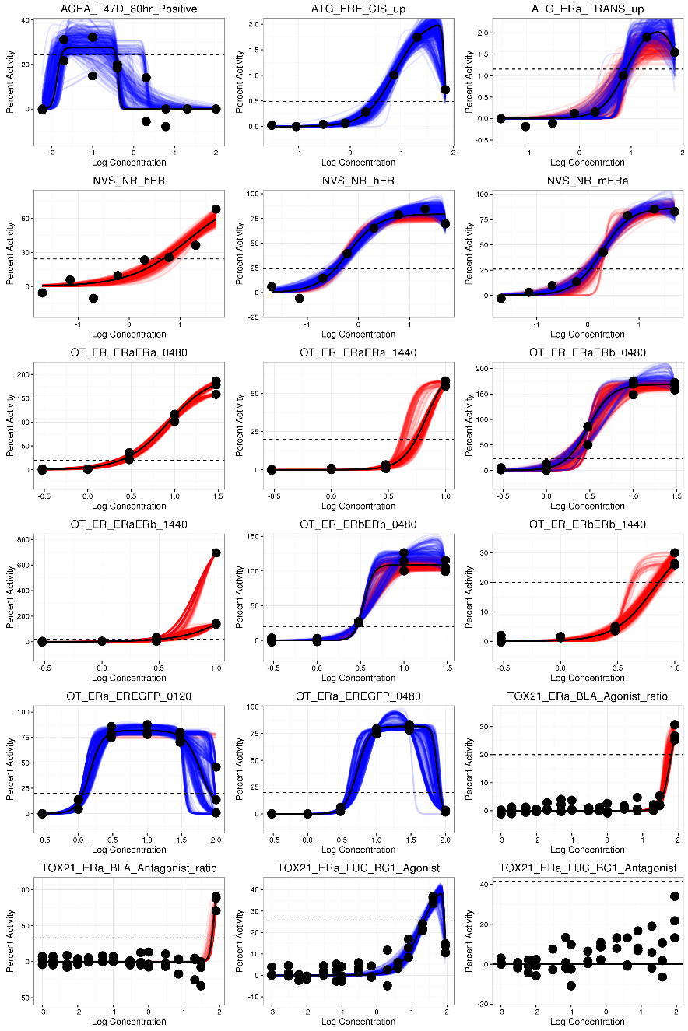
In Vitro Assay Data is also subject to uncertainty
See Eric Watt poster
Watt et al. (in prep)

Slide 21
Uncertainty in data has big impact on model performance
As greater consistency is required from literature sources, QSAR consensus model performance improves
Source: CERAPP project, Mansouri et al. EHP 2015
Community development of estrogen receptor models tested against thousands of experimental data points

Slide 22
Given all the uncertainty, is modeling futile?
Not in risk assessment
  What’s important is the difference between hazard and exposure
Hazard Model:
  In vitro IC50 (μM) with uncertainty
  Use toxico / pharmacokinetic model to convert to mg/kg/day (with added uncertainty)
Exposure model
  Based on NHANES, other biomonitoring data
  Add uncertainty
Compare ranges for margin of exposure

Slide 23
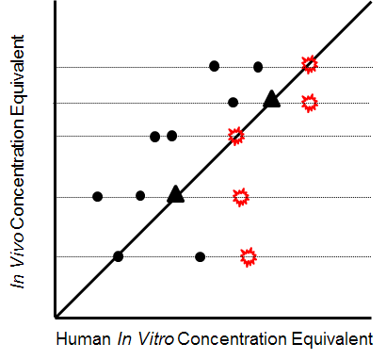
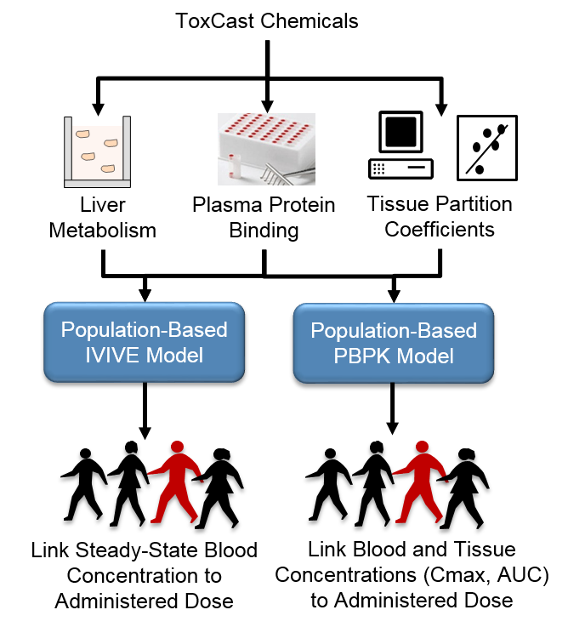
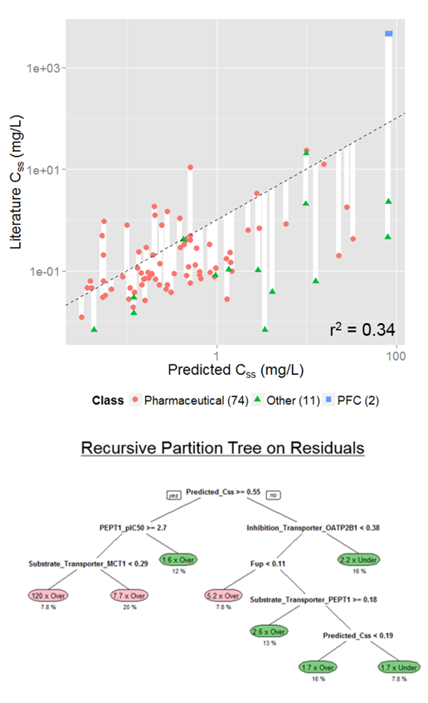
Toxicokinetics Modeling
Incorporating Dosimetry and Uncertainty into In Vitro Screening
Wetmore, Rotroff, Wambaugh et al., 2013, 2014, 2015
Notes:
I think we have heard yesterday, how important TK is in interpreting the results from NAMs. This includes both read across and the in vitro testing. However, first, we need to have an in vitro and in silico approach to generate the TK data that we need and we need to be rigorous in characterizing the uncertainty around whatever approach we develop.

Slide 24
Population and Exposure Modeling
Estimating Exposure and Associated Uncertainty with Limited Data
(Bio) Monitoring
e.g., CDC NHANES study
Calibrate models
Inferred Exposures
Pharmacokinetic Models
Dataset 1
Dataset 2
…
Estimate Uncertainty
Inferred Exposure
Predicted Exposures
Use
Production Volume
Predicted Exposure
…
Wambaugh et al., 2014
Notes:
I know that this workshop is primarily focused on NAMs in relation to hazard characterization, but I think that if we are talking more holistically about applying NAMs for regulatory decision making, we also need to incorporate approaches to estimate exposure in order to put the NAM data into context.

Slide 25
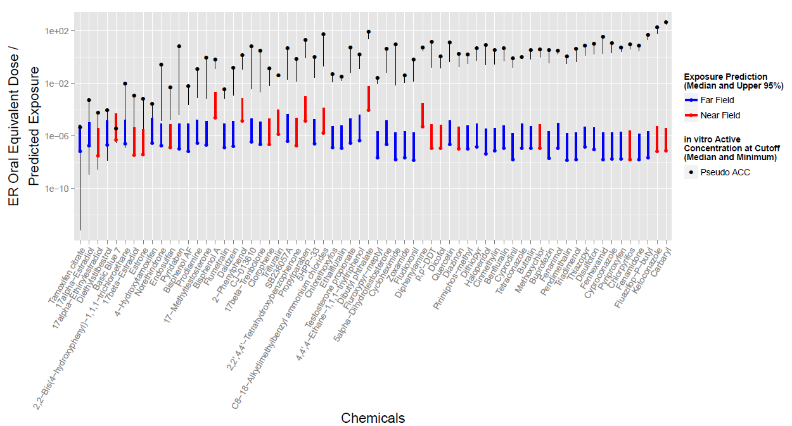
High-throughput Risk Assessment for ER
290 chemicals with ER bioactivity

Slide 26
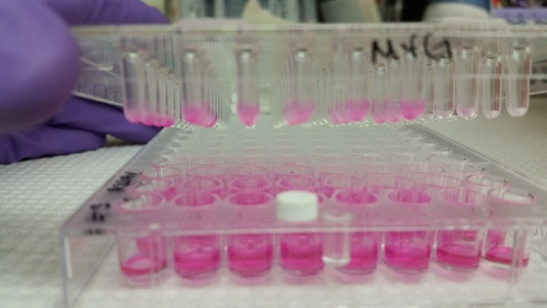
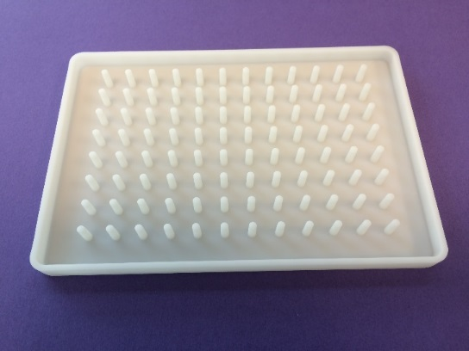
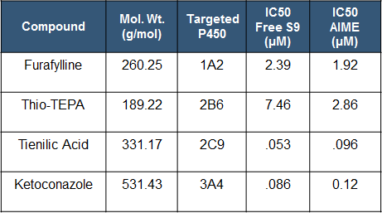
Retrofitting Assays for Metabolic Competence – Extracellular Approach
Alginate Immobilization of Metabolic Enzymes (AIME)
Amount of XME Activity in Microspheres
Prototype Lids
Small Molecule Inhibition of XME Activity
DeGroot et al. 2016 SOT poster #3757

Slide 27
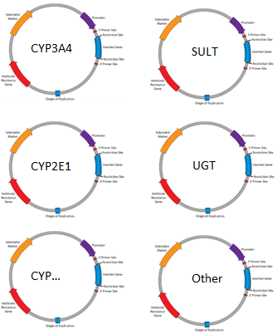
Retrofitting Assays for Metabolic Competence – mRNA Intracellular Strategy
Linear Response of CYP3A4 Activity in HepG2 Cells with Increasing CYP3A4 mRNA
293T cells 21.5 h post transfection with 90 ng of EGFP mRNA using TransIT reagent
Pool in vitro transcribed mRNAs chemically modified with pseudouridine ad 5-methylcytidine to reduce immune stimulation
Efficiency of CYP3A4 Transfection in HepG2 Cells Begins to Decline Above 90 ng mRNA
Advantage of transfecting with mRNA
Titrate different CYPs to match different ratios in different tissues
Notes:
Notes: Detection of CYP3A4 activity was performed with a P450-Glo kit using a pro-luciferin substrate specific for CYP3A4 (luciferin-IPA). Luciferin-IPA was added to the cells post-transfection and is converted to luciferin via the activity of CYP3A4. Light is produced when the luciferin reacts with luciferase in a subsequent step.
Top Graph: A linear response indicates that the components required for the CYP reaction (i.e. P450 reductase, cytochrome b5, etc) are not saturated.
Bottom Graph: Above about 100 ng mRNA, the efficiency of the transfection begins to decline (this may be due to cytotoxicity, but I haven’t tested this directly).

Slide 28
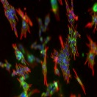
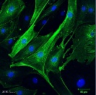

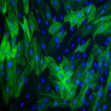
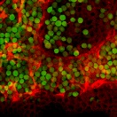
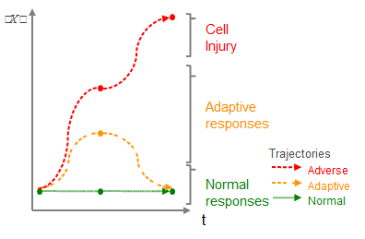
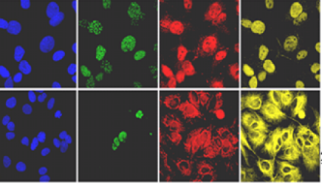
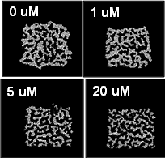
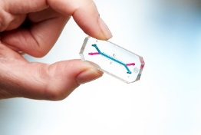
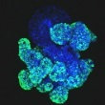
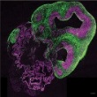
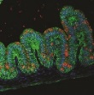
Developing Approaches for Tiered Testing
Comprehensive Transcriptomic Screening
Multiple Human Cell Types
Comprehensive Characterization
Verification of Affected Processes/ Pathways and Temporal Evaluation
Focused ToxCast/Tox21 Assays
Time Course High Content Assays
Computational and Statistical Modeling
Interpretation of Affected Process/ Pathways and Population Variability
Organs-on-a-Chip
Organotypic and Organoid Models
Notes:
Technologies from human genome project have become so cheap and efficient, now just beginning to be deployed at a scale that allows evaluating perturbation in all genes of the genome in multiple tissues, and at multiple concentrations
Point out crypts in stomach organoid model

Slide 29
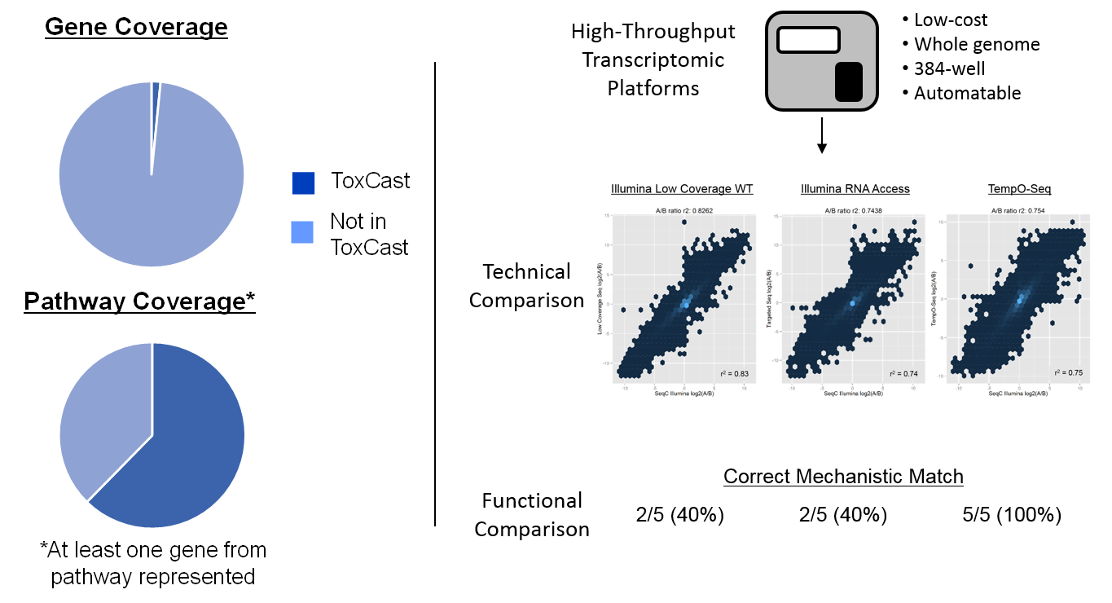
Planning for HT Transcriptomics
New Approaches to Comprehensively Assess Potential Biological Effects
Karmaus and Martin, Unpublished
Notes:
Yesterday, there was a lot of discussion about the merits of the top-down (Ben’s metabolomics) vs bottom up (ToxCast) approaches. Part of the reason is covered in the left hand side. and how the top-down omic based approaches would be better at more comprehensively capturing potential toxicological MOAs. I think it was also recognized that the most ideal solution is a combination of both. At the EPA, we are working towards augmenting ToxCast with a top-down platform, in our case transcriptomics.

Slide 30

Requirements and Potential Platforms for HT Transcriptomics
Requirements
Measure or infer transcriptional changes across the whole genome (or very close to it) (e.g. not subsets of 1000, 1500, 2500 genes)
Compatible with 96- and 384-well plate formats (maybe 1536?) and laboratory automation
Work directly with cell lysates (no separate RNA purification)
Compatible with multiple cell types and culture conditions
Low levels of technical variance and robust correlation with orthogonal measures of gene expression changes
Low cost ($30 - $45 per sample or less)
Low coverage whole transcriptome RNA-seq (3 – 5 million mapped reads)
Targeted RNA-seq (e.g., TempO-seq, TruSeq, SureSelect)
Microarrays (e.g., Genechip HT)
Bead-based (e.g., L1000)
Potential Platforms

Slide 31
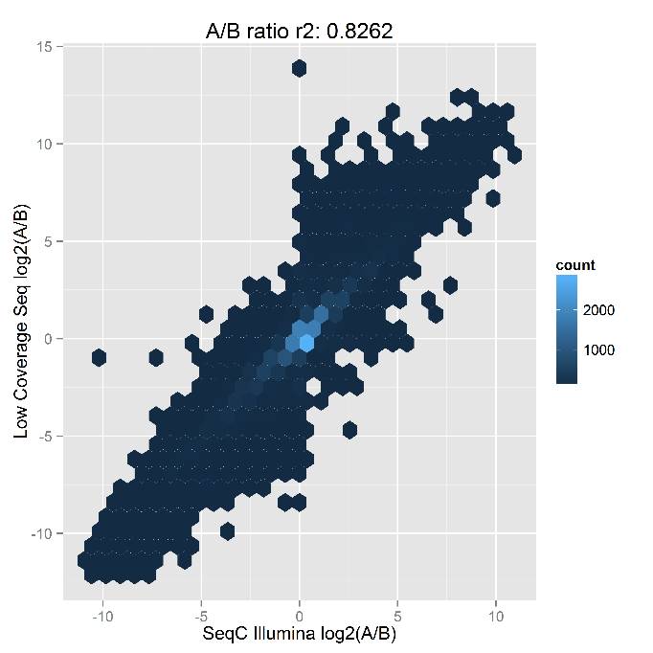
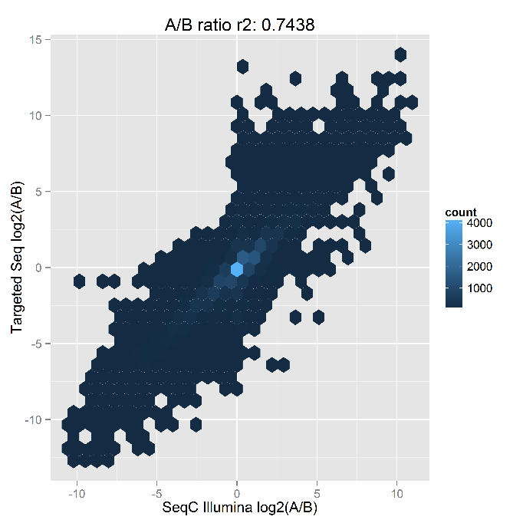
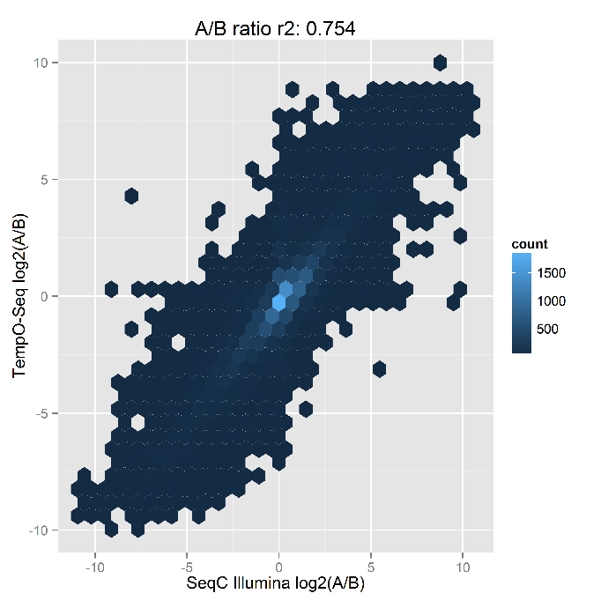
Technical Performance of the Three Sequencing Platforms
Low Coverage
r² 0.83
TruSeq
r² 0.74
TempO-Seq
r² 0.75
Data from MAQC II Samples
Notes:
Planned –
Need a primary screen that comprehensively covers biological space
Metabolic competence
Fill critical toxicological targets (e.g., thyroid) and organotypic assays that can be used to assess which molecular changes manifest in adverse phenotypic responses

Slide 32
HT Transcriptomics Next Steps
Perform pilot study (Summer) to validate workflow and refine experimental design
Initiate large scale screen (Fall/Winter)
    Cell type: MCF7
    Compounds: 1,000 (ToxCast Phase I/II)
    Time Point: Single
    Concentration Response: 8 (?)
Perform secondary pilot study looking at cell type selection/ pooling strategies (Fall/Winter)
Integrate HT transcriptomic platform with metabolic retrofit solution to allow screening +/- metabolism (FY17)
Explore partnerships to build community database of common chemical set across multiple cell types/lines

Slide 33
Other Ongoing Efforts
  Curated chemical structure database of >1 million unique substances
  Capability to retrofit high-throughput in vitro assays for metabolic competence
  Software infrastructure to manage, use and share big data in toxicology
  Methods to quantify uncertainty in all quantities
  Read-across approaches that quantitatively include uncertainty
  Pharmacokinetic models for hundreds of chemicals while understanding which chemical classes are well predicted and which ones have greater uncertainty
  High-throughput exposure models for thousands of chemicals with estimates of uncertainty
  Non-targeted analytical measurements of chemical constituents in hundreds of consumer products
  Framework for streamlined validation of high-throughput in vitro assays
Notes:
Surprising number of errors in linking chemical structures to CAS number and other identifiers

Slide 34
Challenges
  Technical limitations/obstacles associated with each technology (e.g., metabolism, volatiles, etc.)
  Moving from an apical to a molecular paradigm and defining adversity
  Predicting human safety vs. toxicity
  Combining new approaches to have adequate throughput and sufficiently capture higher levels of biological organization
  Systematically integrating multiple data streams from the new approaches in a risk-based, weight of evidence assessment
  Quantifying and incorporating uncertainty and variability
  Dealing with the validation
    Defining a fit-for-purpose framework(s) that is time and resource efficient
    Performance-based technology standards vs. traditional validation
    Role of in vivo rodent studies and understanding their inherent uncertainty
  Legal defensibility of new methods and assessment products

Slide 35
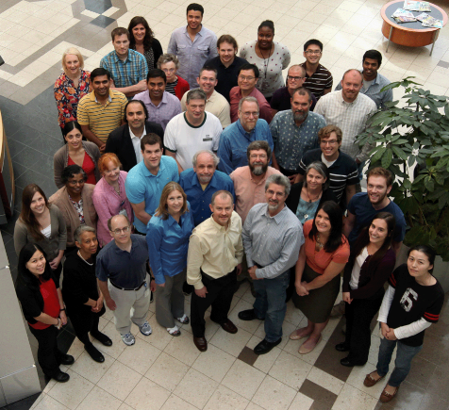
Acknowledgements
NCCT Staff Scientists
Rusty Thomas
Kevin Crofton
Keith Houck
Ann Richard
Richard Judson
Tom Knudsen
Matt Martin
Grace Patlewicz
Woody Setzer
John Wambaugh
Tony Williams
Steve Simmons
Chris Grulke
Jeff Edwards
NCCT Postdocs
Todor Antonijevic
Audrey Bone
Swapnil Chavan
Danica DeGroot
Jeremy Fitzpatrick
Jason Harris
Dustin Kapraun
Max Leung
Kamel Mansouri
LyLy Pham
Prachi Pradeep
Eric Watt
Stephanie Padilla
Tamara Tal
Eric Watt
Matt Martin
Rusty Thomas
Agnes Karmaus
Steve Simmons
Danica DeGroot
Keith Houck
John Wambaugh
Woody Setzer
NCCT Contractors
Nancy Baker
Dayne Filer
Parth Kothiya
Doris Smith
Jamey Vail
Sean Watford
Indira Thillainadarajah
Tommy Cathey
NIH/NCATS
Menghang Xia
Ruili Huang
Anton Simeonov
NTP
Warren Casey
Nicole Kleinstreuer
Mike Devito
Dan Zang
https://www.epa.gov/chemical-research/toxicity-forecasting

