Slide 1
Food-Use Chemicals in ToxCast: Identification, Curation, and Evaluation
Agnes Karmaus, PhD
akarmaus@ils-inc.com
EPA Computational Toxicology Communities of Practice - September 22, 2016

Slide 2
Goals
Compile a comprehensive inventory of food-use chemicals in the USA
Evaluate the chemical landscape
Evaluate bioactivity in ToxCast

Slide 3
Overview
Identification of food-relevant chemicals
Compilation of a comprehensive inventory
Cheminformatics evaluation of chemical diversity
Categorization of chemicals based on use
Food-relevant chemicals in ToxCast
Coverage of food-use chemicals in ToxCast
Activity of food-use chemicals across ToxCast
Cytotoxicity elicited by food-use chemicals

Slide 4
Chemical Inventories
Inventory Source | Entries in Inventory | CASRN in Inventory | Use Category | CASRN in Use Category | CASRN in ToxCast
FDA EAFUS | 3968 | 3277 | Direct Food Additives | 3888 | 616
FDA SCOGS | 378 | 320
FDA GRAS Notices | 603 | 349
FEMA GRAS | 2796 | 2659
FDA Effective FCS | 1205 | 715 | Food Contact Substances | 3039 | 371
FDA Indirect in FCS | 3229 | 2555
FDA TOR | 50 | 56
Alan Wood Pesticides | 1813 | 1808 | Pesticides | 1732 | 543
TOTAL | 14,042 | 11,733 |  | 8,659 | 1530
Chemicals were grouped into
“Use Categories” based on the database of origin

Slide 5
Chemical Inventories
Chemicals were restricted to only one use category, with the hierarchy:
direct food additive
↑
food contact substance
↑
pesticide
Inventory Source | Entries in Inventory | CASRN in Inventory | Use Category | CASRN in Use Category | CASRN in ToxCast
FDA EAFUS | 3968 | 3277 | Direct Food Additives | 3888 | 616
FDA SCOGS | 378 | 320
FDA GRAS Notices | 603 | 349
FEMA GRAS | 2796 | 2659
FDA Effective FCS | 1205 | 715 | Food Contact Substances | 3039 | 371
FDA Indirect in FCS | 3229 | 2555
FDA TOR | 50 | 56
Alan Wood Pesticides | 1813 | 1808 | Pesticides | 1732 | 543
TOTAL | 14,042 | 11,733 |  | 8,659 | 1,530

Slide 6
Chemical Fingerprinting
Two sources for substructure and physchem property descriptors (fingerprint bits) used:
881 PubChem fingerprints
166 MACCS fingerprints
Example of PubChem Fingerprints:

Slide 7
Chemical Fingerprinting
Fingerprint (substructure/physchem bits)
 | 1 | 2 | 3 | 4 | 5 | . | . | . | . | . | . | . | . | . | . | . | .
Chem 1 | 1 | 0 | 0 | 0 | 1 | 0 | 0 | 1 | 0 | 1 | 1 | 0 | 0 | 0 | 0 | 0 | 0
Chem 2 | 1 | 0 | 0 | 1 | 1 | 0 | 0 | 0 | 0 | 0 | 0 | 0 | 1 | 0 | 1 | 0 | 0
Chem 3 | 1 | 0 | 0 | 0 | 0 | 0 | 0 | 0 | 1 | 1 | 0 | 0 | 1 | 0 | 0 | 0 | 0
Chem 4 | 0 | 0 | 0 | 0 | 0 | 0 | 0 | 0 | 0 | 1 | 0 | 0 | 0 | 1 | 0 | 0 | 0
Chem 5 | 1 | 0 | 0 | 0 | 0 | 0 | 0 | 0 | 0 | 0 | 0 | 1 | 0 | 0 | 0 | 1 | 1
.
.
.
.
Chemicals in Inventory

Slide 8
Self Organizing Map (SOM)
Algorithm trained
using unsupervised learning where samples are grouped based on similarity into bins.
Bins are then laid out so that those most alike are nearest one another.
Number of bins is defined by the user
Similarity was based on chemical fingerprints
Notes:
BMU: best matching unit (a measure of how well the groupings achieve optimal separation and layout distribution of like fingerprints)

Slide 9
SOM Results for Food-Use Chemicals
20 x 24 bin layout used, aiming for an average of 10 chemicals per bin
Notes:
BMU: Best Matching Unit

Slide 10
SOM Results for Food-Use Chemicals
Direct Food Additives
12 bins had zero chemicals (white)
Highlighted to visualize the proportion of chemicals in the bin that are direct food additives

Slide 11
SOM Results for Food-Use Chemicals
Proportion of chemicals per bin
obtained from direct additive vs. pesticide resource
Clear separation between bins comprised solely of
direct food additives
versus
pesticides
Direct Food Additives
Food Contact Substances
Pesticides

Slide 12
SOM Results for Food-Use Chemicals
Direct Food Additives
Food Contact Substances
Pesticides

Slide 13
ToxCast Activity for Food-Use Chemicals

Slide 14
Evaluating Cytotoxicity Across ToxCast
All chemicals were evaluated in ≥14 of 35 cytotoxicity assays,
Chemicals had to elicit cytotoxicity in ≥3 assays for calculation
10% Direct Additives
29% Food Contact Substances
40% Pesticides

Slide 15
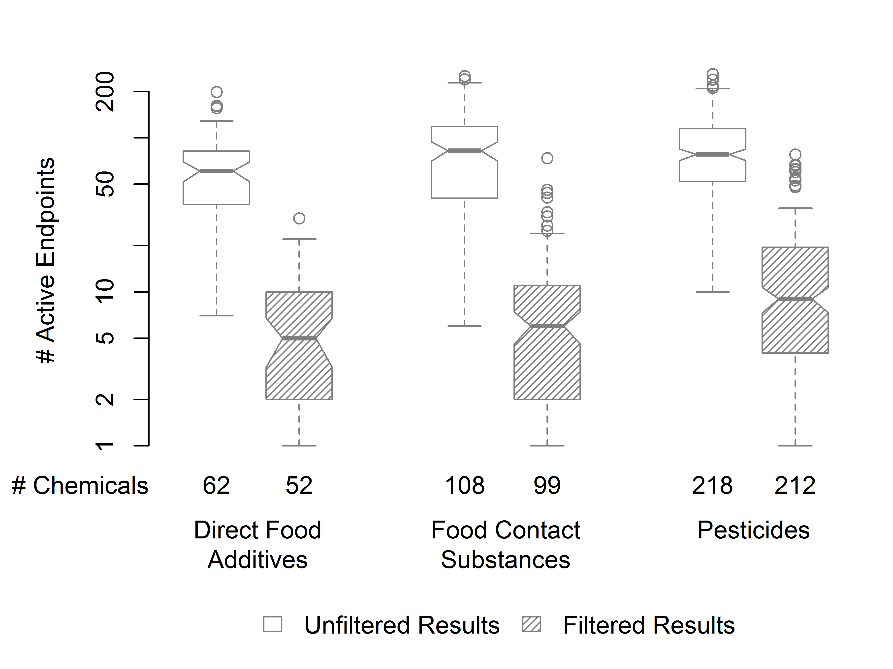
Evaluating Activity Across ToxCast

Slide 16
Summary of Chemical Inventory so far…
Identified food-relevant chemicals by mining publicly available databases
Chemicals were categorized based on database, assuming comparable usage
Observations:
Some chemicals from databases are no longer allowed for use in food
Some chemicals have multiple uses or were mis-classified (ie. GRAS chemicals)

Slide 17
Manual Curation of Food-Use Chemicals in ToxCast
Focus on chemicals that are of relevance for food in current-day US
Eliminate chemicals that are no longer approved for food-use in the US
Eliminate chemicals that are only foreign use and have no importation tolerance
Confirm categorization based on use and exposure likelihood

Slide 18
Refining ToxCast Food-Relevant Chemical Categorization
former 616 direct additives category
non-food
(28 chemicals)
pesticide residue
(39 chemicals)
Manual curation evaluated:
Current registration or tolerance status in the USA
Exposure likelihood from food in the USA
Allowed chemicals in >1 category
indirect additive
(54 chemicals)
direct additive
(550 chemicals)

Slide 19
Manual Curation Results
formerly 616
direct additives
formerly 371
food contact substances
formerly 543
pesticides
non-food
(28 chemicals)
direct additive
(6 chemicals)
indirect additive
(4 chemicals)
pesticide residue
(39 chemicals)
non-food
(72 chemicals)
indirect additive
(54 chemicals)
non-food
(219 chemicals)
pesticide residue
(46 chemicals)
pesticide
residue
(321 chemicals)
direct additive
(550 chemicals)
indirect additive
(281 chemicals)
Refined: 556
direct additives
Refined: 339
indirect additives
Refined: 406
pesticides & residues
1,211 Manually Curated Food-Use Chemicals in ToxCast
Notes:
Old curation had only one category allowed per chemical, new category allows multiple (90 chems have two category designations)

Slide 20
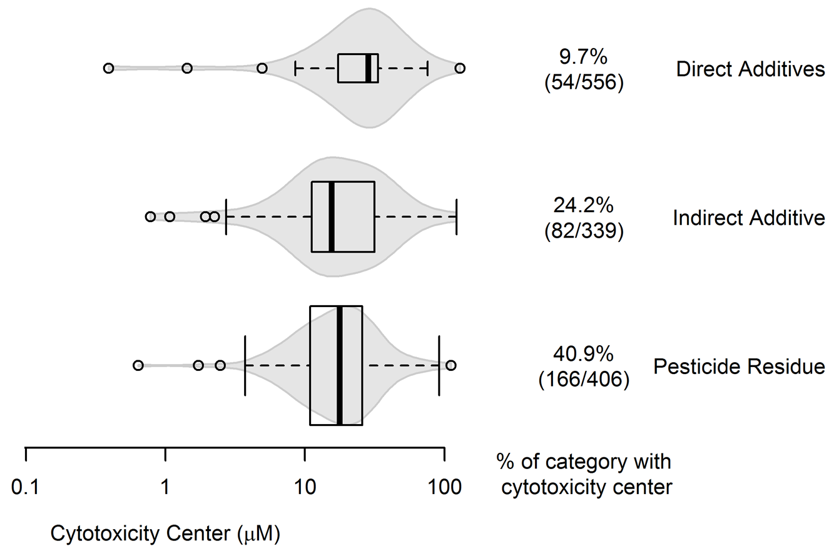
Curated Chemical Categories: Cytotoxicity Across ToxCast

Slide 21
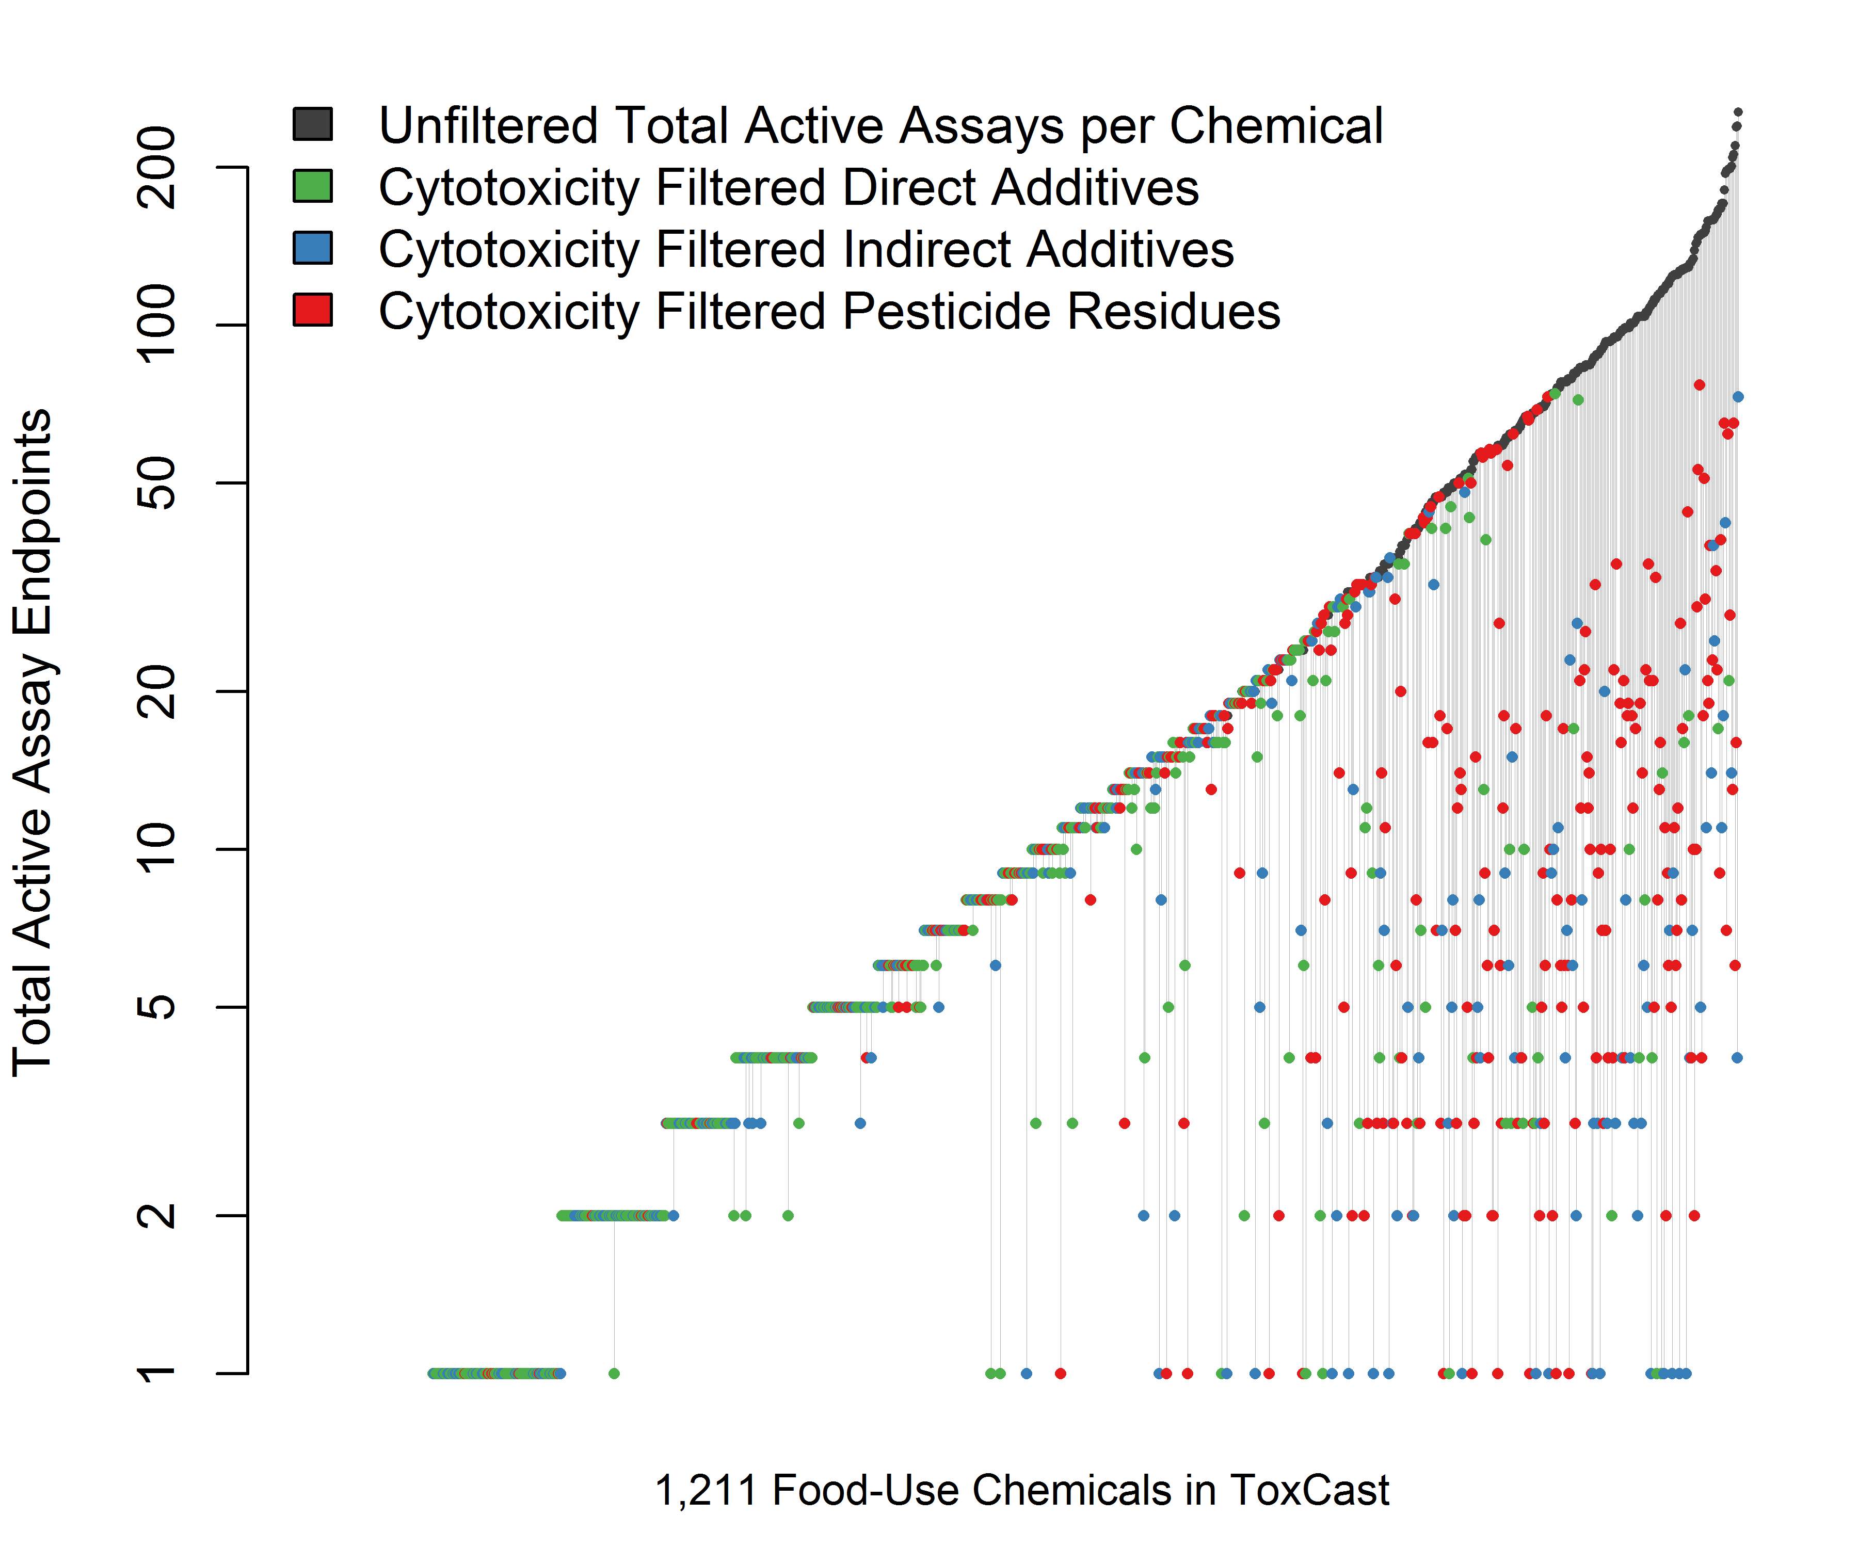

Slide 22
Summary
Identified 8,659 unique food-use chemicals
Chemical fingerprints confirm grouping based on “use”
ToxCast includes 1,211 food-use chemicals after manual curation to confirm current-day use in the USA
556 Direct food additives
339 Indirect food additives
406 Pesticides/residues
Direct food additives are overall less cytotoxic compared to indirect food additives and pesticides/residues

Slide 23
Next Steps…
Compare food-use chemical inventory to chemicals identified from the Chemcal and Product Categories (CPCat) Database

Slide 24
Next Steps…

Slide 25
Acknowledgements
ILSI North America
Technical Committee for Food and Chemical Safety
Alison Kretser and Dr. Mansi Krishan
Dr. Tom Trautman (retired, General Mills)
Dr. Lori Fix (Unilever)
EPA/NCCT
Dr. Matt Martin, Dr. Keith Houck, Dayne Filer
Karmaus et al. 2016. Food Chem Tox. 92: 188-196.

