Slide 1
Adverse Outcome Pathway Knowledge Base
Stephen Edwards
US EPA National Health & Environmental Effects Research Laboratory

Slide 2
A New Paradigm: Activation of Toxicity Pathways
Toxicity Pathway: A cellular response pathway that, when sufficiently perturbed, is expected to result in an adverse health effect.
Exposure
Tissue Dose
Biologic Interaction
Perturbation
Biologic
Inputs
Normal
Biologic
Function
Early Cellular
Changes
Adaptive Stress
Responses
Morbidity
and
Mortality
Cell
Injury
Dan Krewski & National Research Council
Committee on Toxicity Testing in the 21st Century

Slide 3
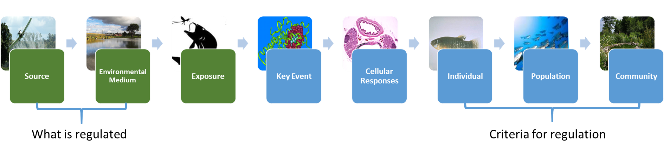
Application of Research to Levels of Organization Based on Source to Outcome
Toxicity Pathway, NRC 2007
Mode of Action, IPCS/EPA/ILSI 2001-2008
Aggregate Exposure Pathway, Teeguarden 2016
Adverse Outcome Pathway, Ankley 2010, Villeneuve 2014

Slide 4
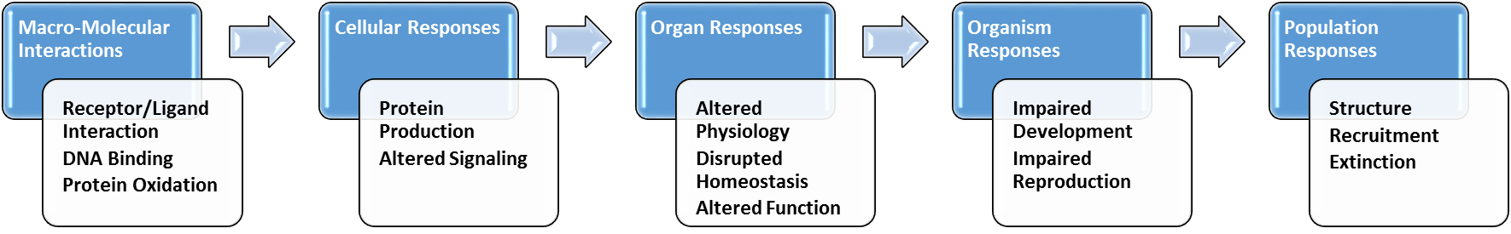
AOP Components
Key Events (KEs) - nodes
  Change in biological state
  Measurable and essential for progression
  Molecular Initiating Event (MIE): Initial point of chemical interaction
  Adverse Outcome (AO): Adverse outcome of regulatory significance
Key Event Relationships (KERs) - edges
  Connections between two key events
  Critical for assembling evidence in support of the AOP
Does not explicitly include chemicals
Villeneuve, et al. Tox Sci., 2014, 142:312-320

Slide 5
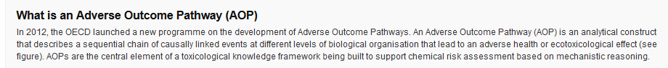
OECD AOP Development Programme
Extended Advisory Group for Molecular Screening & Toxicogenomics (EAGMST)
Guidance & Training
  Guidance, User Handbook, many training options
International Knowledgebase to capture information
  >100 AOPs at various stages of development
http://www.oecd.org/chemicalsafety/testing/adverse-outcome-pathways-molecular-screening-and-toxicogenomics.htm

Slide 6





AOP Wiki
Collaborative development of AOP descriptions & evidence
Effectopedia
Detailed development of structured & computational
AOPs
AOP Xplorer
Visualize attribute networks to discover & explore AOPs
in a broader
context
e.AOP.portal
Intermediate Effects DB
Put
chemical-related
AOP components
in a regulatory
context
AOP-KB
Third party Applications, plugins
AOP-XML

Slide 7
Five Principles of AOP Development
AOPs are not chemical specific
AOPs are modular (consisting of KEs and KERs)
An individual AOP is a pragmatic unit of development and evaluation
For most real-world applications, AOP networks are the functional unit of prediction
AOPs are living documents
Villeneuve, et al. Tox Sci., 2014, 142:312-320

Slide 8
Five Principles of AOP Development
AOPs are not chemical specific
AOPs are modular (consisting of KEs and KERs)
An individual AOP is a pragmatic unit of development and evaluation
For most real-world applications, AOP networks are the functional unit of prediction
AOPs are living documents
Villeneuve, et al. Tox Sci., 2014, 142:312-320

Slide 9
Factors Determining Predictivity of Early Key Events
Time between exposure and effect increases
Evidence supporting the KERs between that KE and the AO
Quantitative understanding of the downstream KERs
Modifying factors that influence downstream KEs & KERs

Slide 10
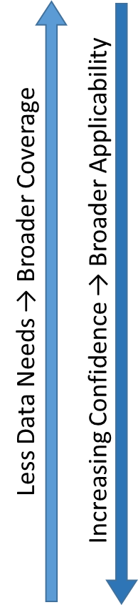
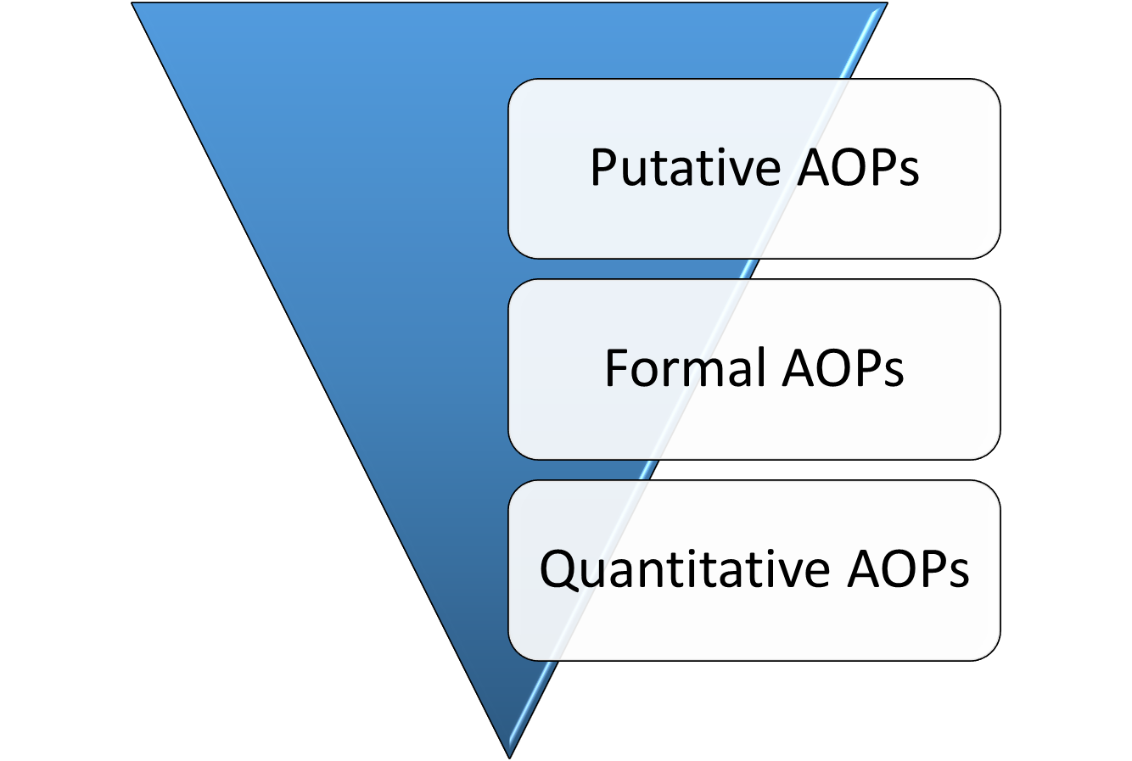
Overlapping Phases of AOP Development
Define the AOP
Evaluate the AOP
Quantitatively describe the AOP

Slide 11
AOP Wiki
Collaborative development of AOP descriptions & evidence
Effectopedia
Detailed development of structured & computational
AOPs
AOP Xplorer
Visualize attribute networks to discover & explore AOPs
in a broader
context
e.AOP.portal
Intermediate Effects DB
Put
chemical-related
AOP components
in a regulatory
context
AOP-KB
Third party Applications, plugins
AOP-XML

Slide 12
Section 5b – MIE, KE, and AO descriptions
OECD Handbook
Step by step guide to AOP development
https://aopkb.org/
common/
AOP_Handbook.pdf
AOP-Wiki
Provides consistent structure based on the OECD handbook and facilitates collaborative AOP development
http://aopwiki.org/
AOP Page
MIE Page
KE Pages
AO Page
Section 1 – Title
Section 2 – Authors
Section 3 - Status
Chemical initiator(s)
Description
Measurement/ detection
Taxonomic applicability
Regulatory relevance
Description
Measurement/ detection
Taxonomic applicability
Evidence for chemical initiation
Description
Measurement/ detection
Taxonomic applicability
Section 4 – Abstract
Background (Optional)
Section 5a – Summary of the AOP
MIE
KEs
AO
Linkage table
Section 6 – Scientific evidence supporting the
linkages in the AOP
Key Event Relationships
KER Pages
Title
Description
Biological plausibility
Empirical support
Inconsistencies and uncertainties
Quantitative understanding
Applicability domain(s) of the AOP
Life-stage
Taxonomic
Sex
Section 7 – Overall Assessment of the AOP
Modified Bradford Hill Considerations
Section 8 – Considerations for Potential Applications of the AOP

Slide 13
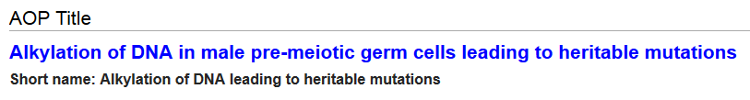
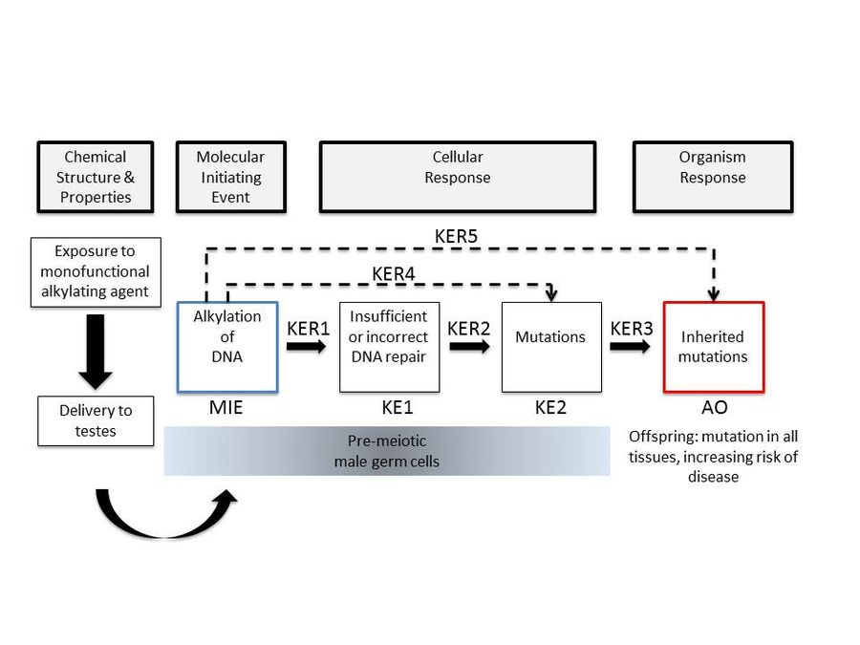
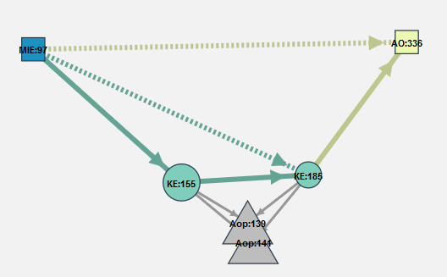
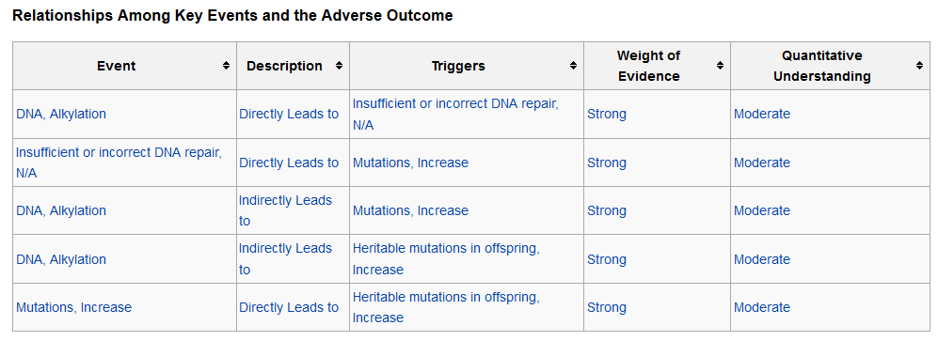
Carole Yauk –
https://aopwiki.org/wiki/index.php/Aop:15

Slide 14
AOP Provides Understanding & Scaffold for Data
Toxicity Pathways
Regulatory Endpoints

Slide 15
AOP Provides Understanding & Scaffold for Data
Toxicity Pathways
Regulatory Endpoints
High Throughput Tox
Guideline Studies
Mechanistic Toxicology Data
Bioindicators (e.g. Molecular Epi)
Epidemiology
Eco Field Studies

Slide 16
AOP Wiki
Collaborative development of AOP descriptions & evidence
Effectopedia
Detailed development of structured & computational
AOPs
AOP Xplorer
Visualize attribute networks to discover & explore AOPs
in a broader
context
e.AOP.portal
Intermediate Effects DB
Put
chemical-related
AOP components
in a regulatory
context
AOP-KB
Third party Applications, plugins
AOP-XML

Slide 17

In-Vitro
Tox21 Aromatase Inhibition
Fadrozole
In-Silico
Petko Petkov’s model
Applicability domain
Executable source code
In-vivo
Radio Immuno Assay
Fathead minnow
Fadrozole
Pathway Elements and quantitative information
f(x)
f(x)
f(x)
Fadrozole
Aromatase Inhibition
amphioxus vertebrates
Reduced E2 synthesis
amphioxus vertebrates
Sex
mixed
f(x)
f(x)
f(x)
f(x)
In-Vitro
H295R
human cells
Fadrozole
In-Vivo Aromatase inhibition in primary tissue
Fathead minnow
Fadrozole
Ex-Vivo
Aromatase inhibition
Fathead minnow
Fadrozole
In-Silico
Model
Applicability domain
Executable source code
Effectopedia
Hristo Aladjov
molecular
organelle
cellular
Level of Biological Organisation

Slide 18
Pathway elements – test response mapping
In vivo effect,
% Bound ERs
In vivo Concentration, [Log M]
Test response mapping / set
of transformation function(s)
^{Measured Effect}
Chem
³H-E₂ Binding %
E2
Effectopedia
Hristo Aladjov
Concentration,
[log M]
Notes:
These transformation function describe how the measured test results can be mapped to the observed in vivo effects

Slide 19
Five Principles of AOP Development
AOPs are not chemical specific
AOPs are modular (consisting of KEs and KERs)
An individual AOP is a pragmatic unit of development and evaluation
For most real-world applications, AOP networks are the functional unit of prediction
AOPs are living documents
Villeneuve, et al. Tox Sci., 2014, 142:312-320

Slide 20
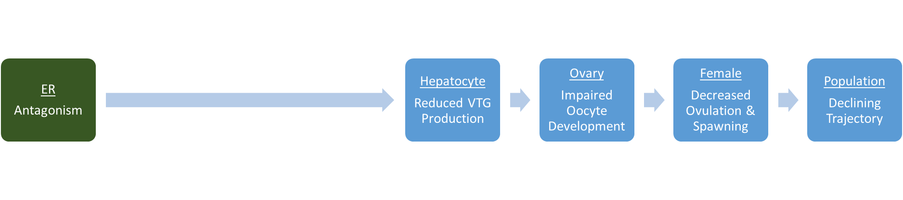
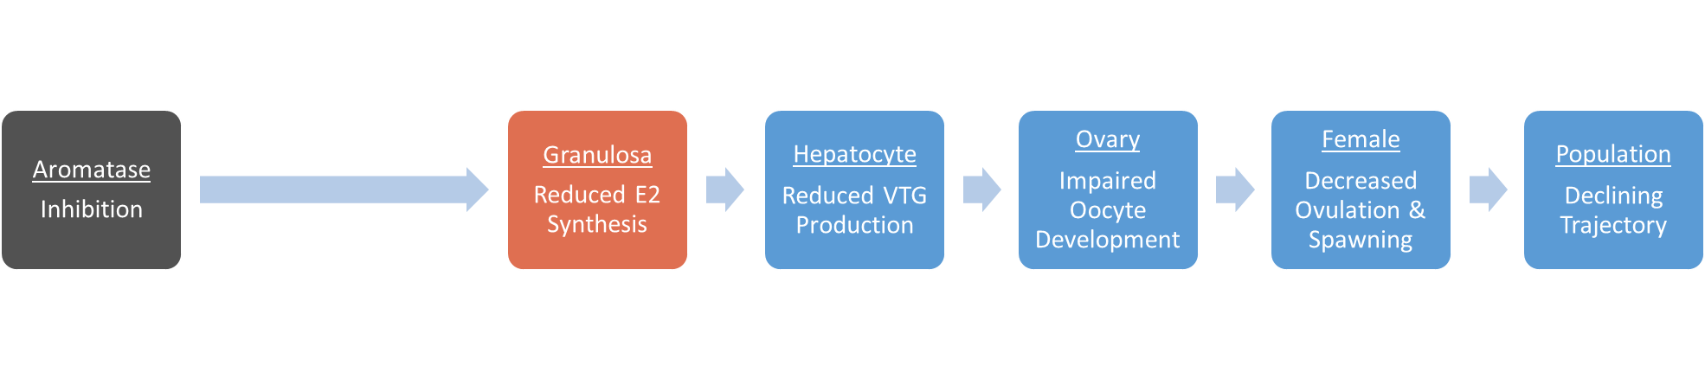
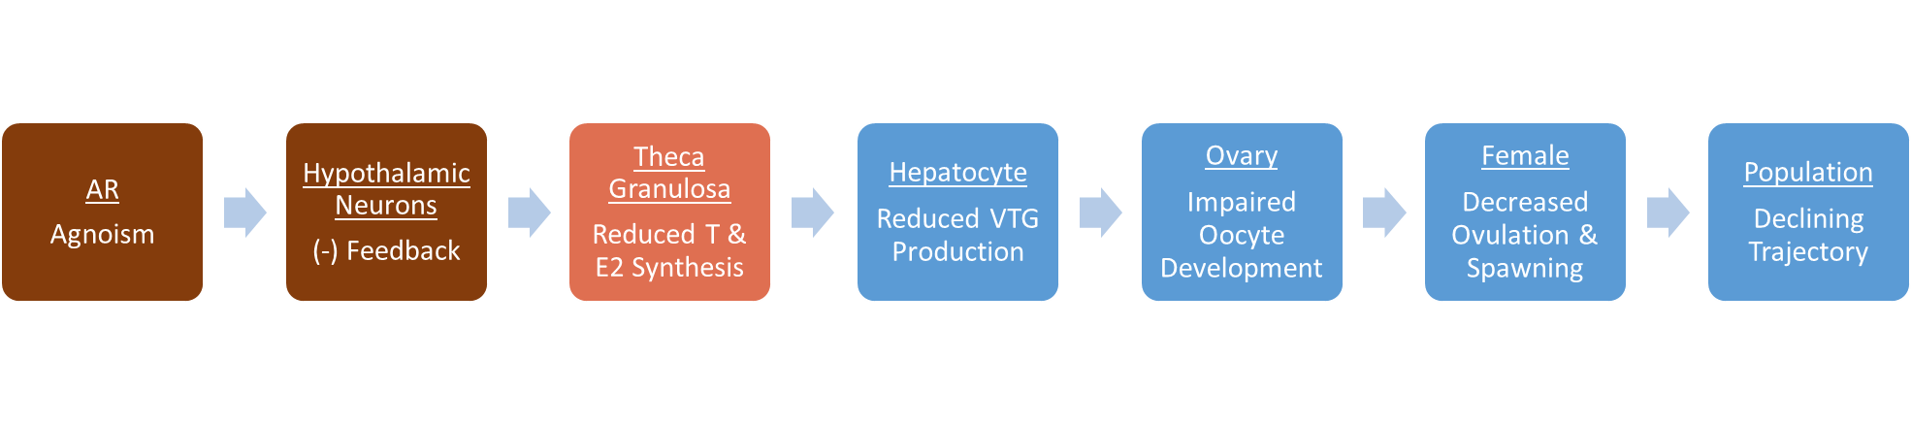
AOP networks emerge as AOPs are entered into the AOP-Wiki
Key Events Shared by Multiple AOPs
AOP:30
AOP:25
AOP:23
Linkages Shared by Multiple AOPs
Courtesy of Dan Villeneuve

Slide 21
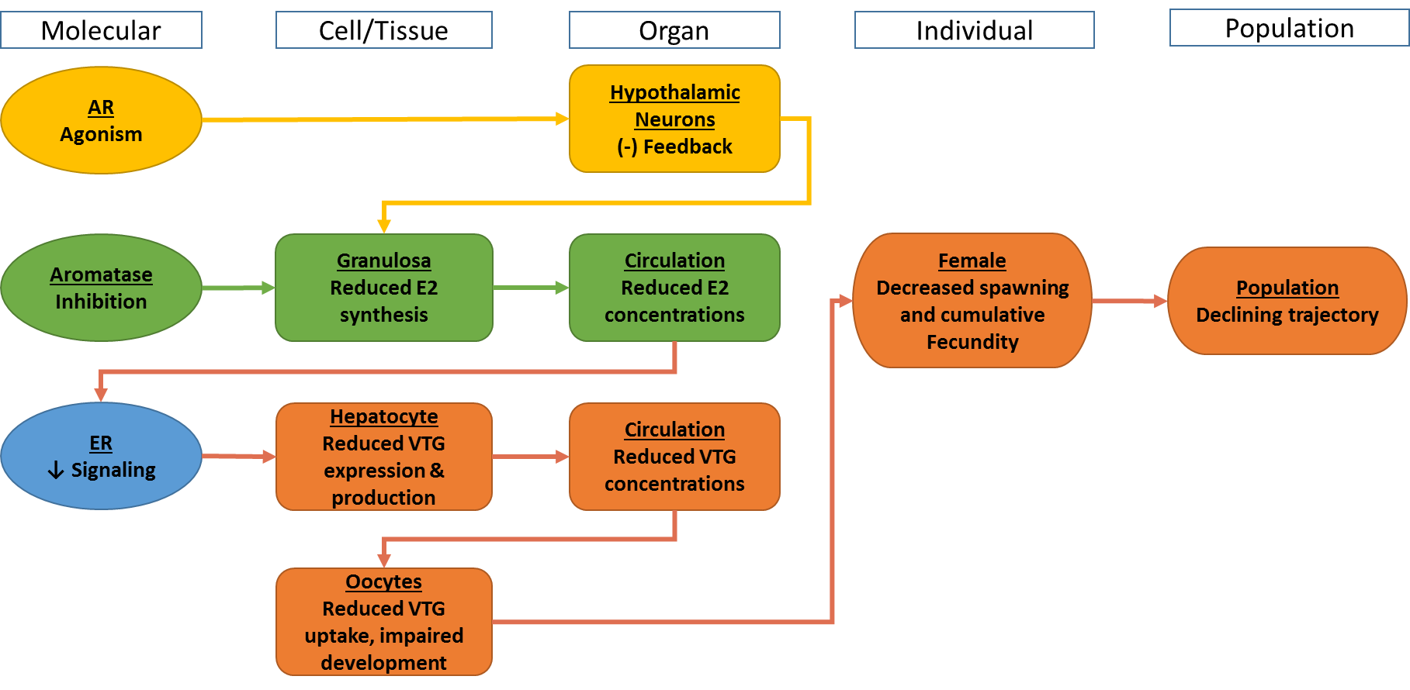
AOP Network as Stored in the AOP-Wiki

Slide 22

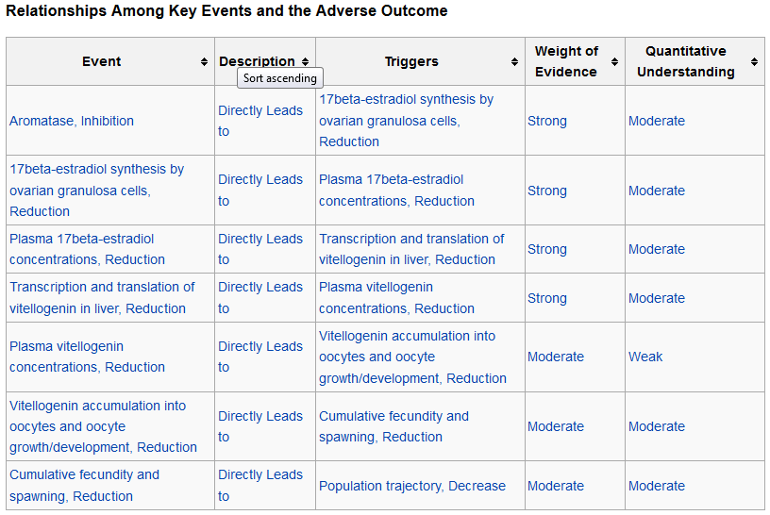
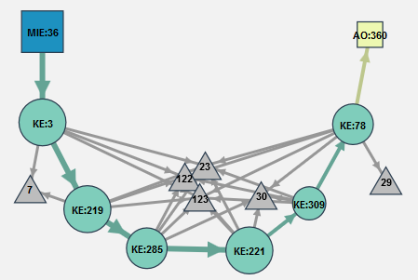

Slide 23
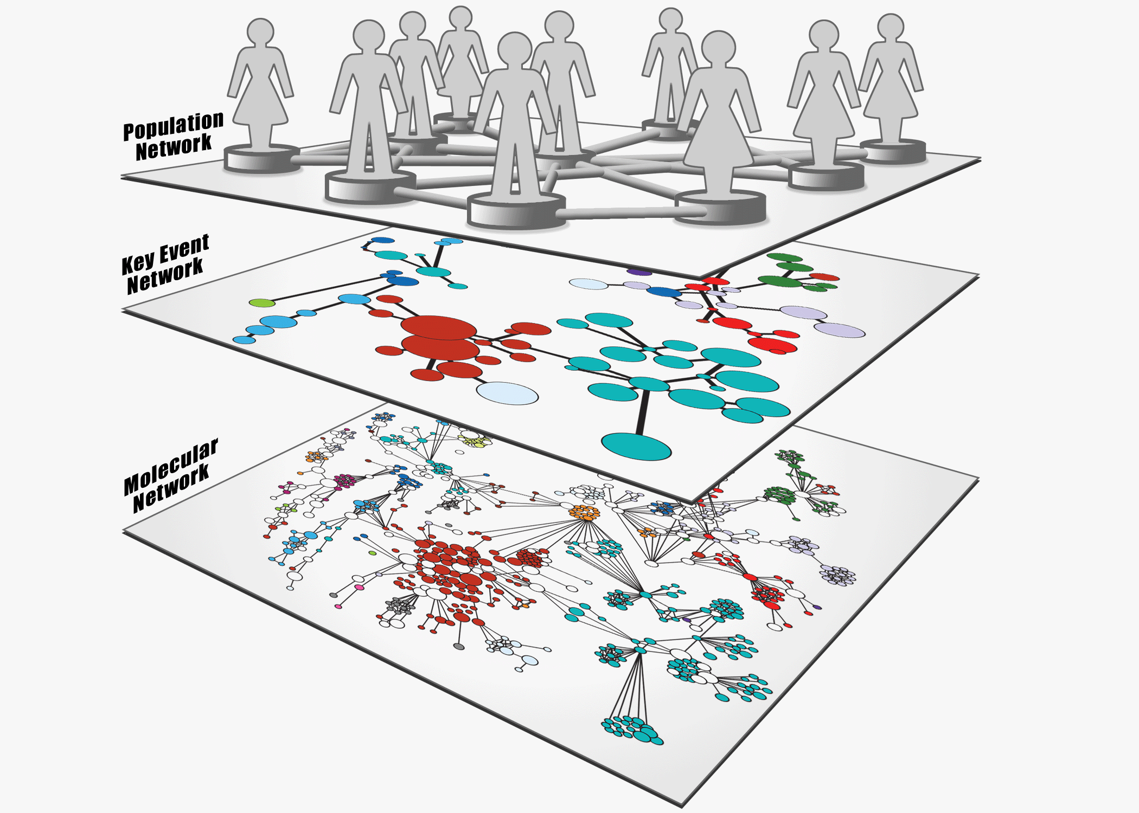
AOPs in a Systems Biology Context

Slide 24
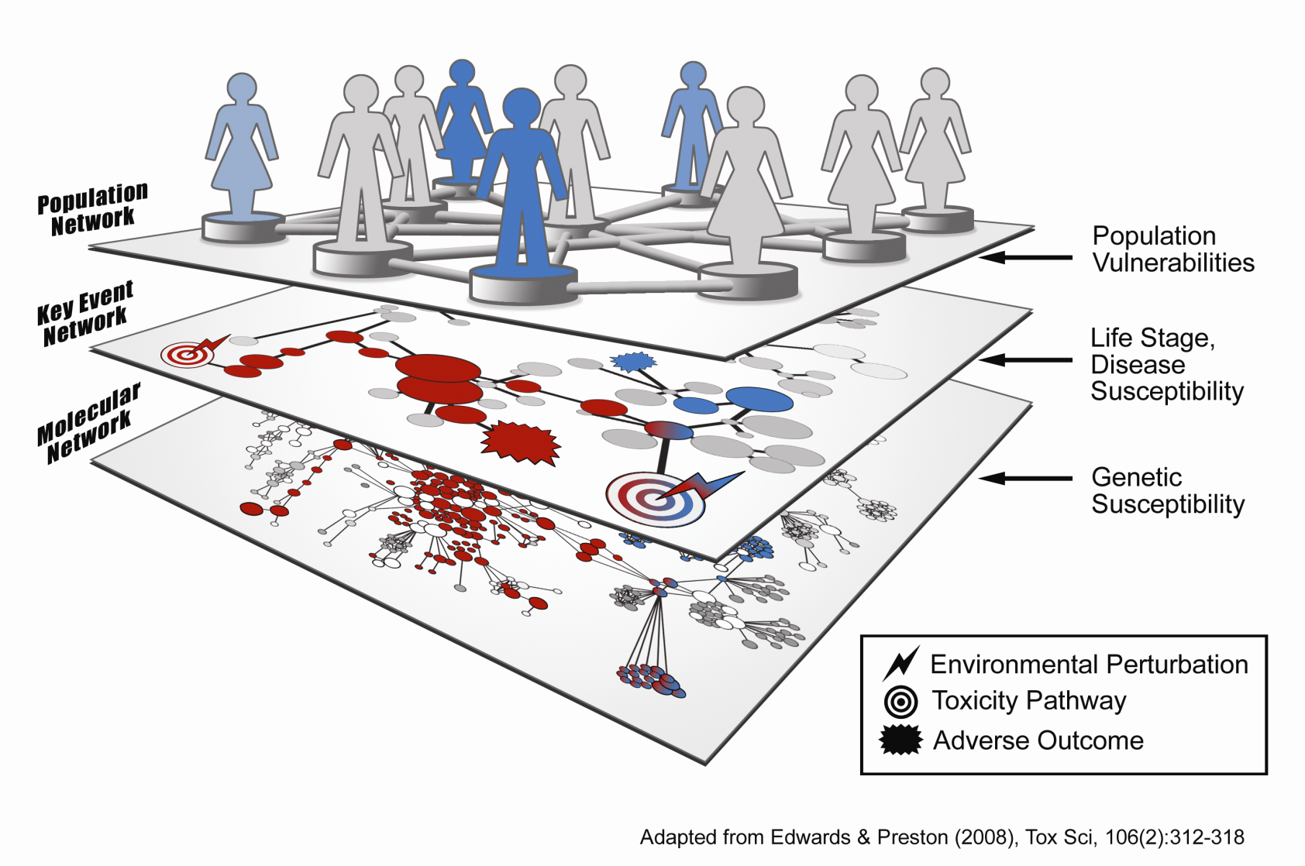
Chemical Interactions Emerge from AOP Networks

Slide 25
Modifying Factors Emerge from AOP Networks

Slide 26
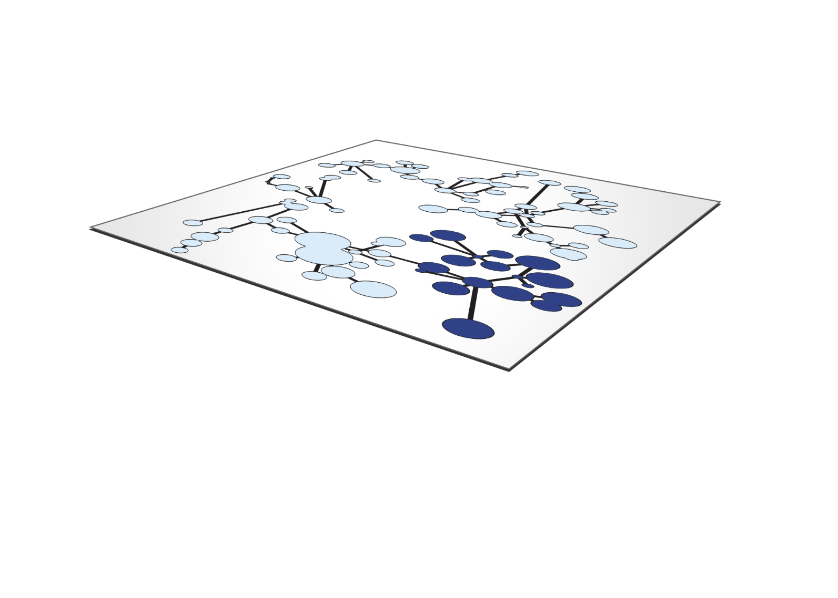
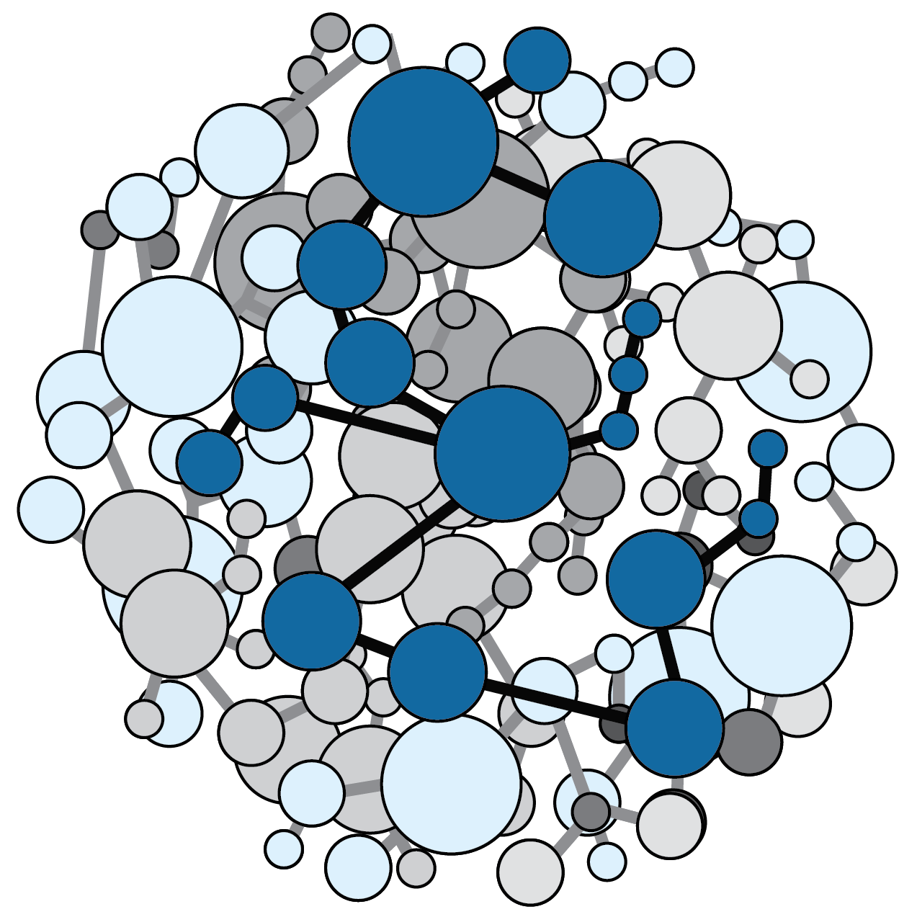
Too many AOPs, too little time…

Slide 27

Accelerating AOP Development

Slide 28
AOP Wiki
Collaborative development of AOP descriptions & evidence
Effectopedia
Detailed development of structured & computational
AOPs
AOP Xplorer
Visualize attribute networks to discover & explore AOPs
in a broader
context
e.AOP.portal
Intermediate Effects DB
Put
chemical-related
AOP components
in a regulatory
context
AOP-KB
Third party Applications, plugins
AOP-XML

Slide 29
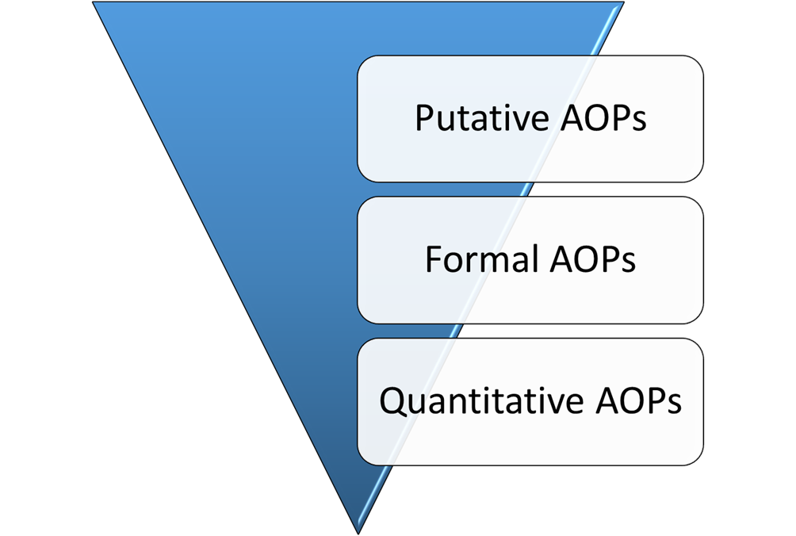
Current Status of AOP Development
> 100 putative AOPs in the AOP-Wiki
(Most not under active development)
13 formal AOPs undergoing OECD review
& 6 endorsed
Increasing number of quantitative AOPs under development

Slide 30
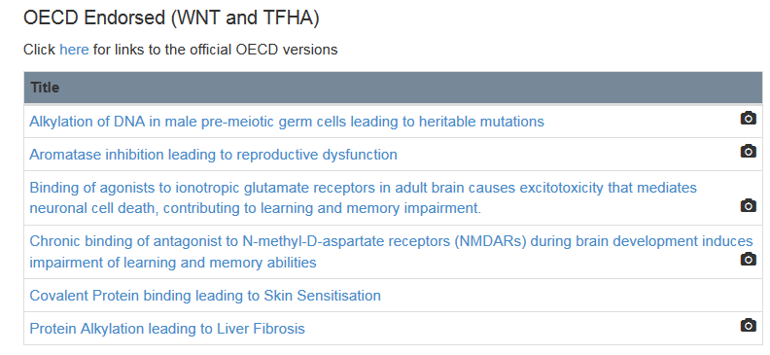
OECD Endorsed AOPs
Working Group of the National Coordinators for the Test Guidelines (WNT)
Task Force on Hazard Assessment (TFHA)

Slide 32
AOP-Wiki 2.0 Release – November 2016
Ability to provide more information through web services
  Most new web services will come online in 2017
Will incorporate ontologies to better characterize key events
Improved snapshots for OECD reviews
Improved help
Will include better handling of chemicals
  Connection with the EPA CompTox Dashboard (https://comptox.epa.gov/dashboard)
Test version available in September

Slide 33
Core AOP Ontology
Describes AOP components only
AOP
MIE
AO
Chemical Initiator
Key Event
Key Event
Key Event
KER
KER
AOP Ontology Developed & Maintained by Lyle Burgoon:
https://github.com/DataSciBurgoon/aop-ontology
Lyle Burgoon
Kyle Painter
Notes:
Components contained in the existing AOP-Ontology are in red.
AOP-Ontology- an ontology for managing data on AOP’s
Provide a unified vocabulary for AOP components

Slide 34
Extending the Core AOP Ontology
Core AOP Ontology is extended by incorporating existing chemical and biological ontologies
US ACE – Extending core ontology to illustrate proof of concept for reasoners in risk assessment
US EPA – Extending core ontology to capture AOP-Wiki information
EC JRC – Extending core ontology to inform OECD 201 and the Intermediate Effects Database
OECD Ontology Working Group – Oversees efforts and ensures compatibility with other related ontology efforts

Slide 35
AOP-Wiki Extensions
Initial Focus on
Key Events
Level of Organization
Molecular
Cellular
Tissue
Organ
Individual
Population
Event
Title
Level of Org
Component(s)
Context
Process
GO, etc.
Event Component
Process
Object
Action
Object
GO, etc.
Action
Increased
Decreased
Altered
Accelerated
Delayed
Context
Cellular (CL)
Organ (Uberon)
Species (NCBI)
Cataia Ives

Slide 36
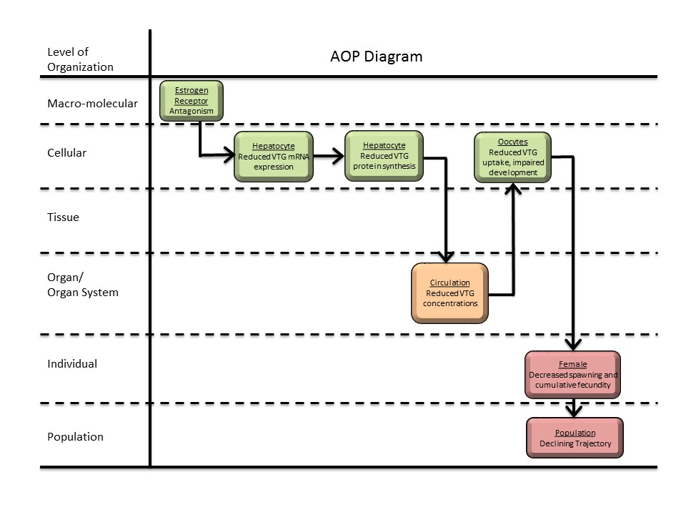
Context changes across levels of biological organization
Cellular
Organ
Taxonomy/
Sex/
Life Stage
Cataia Ives
Notes:
Provide read-across across datasets at higher levels of biological organization
Address data gaps for AOP development

Slide 37
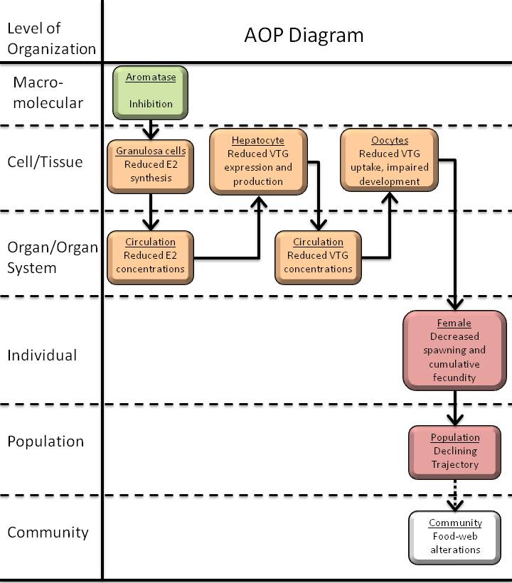

Using ontology to tag existing wiki entry
Cataia Ives
Notes:
Aromatase activity in females
Fish
Cumulative fecundity- apical endpoint as measured by assay
Identify chemicals that inhibit aromatase, which catalyzes conversion of androgens to estrogens

Slide 38
    AOP: “Aromatase inhibition leading to reproductive dysfunction (in fish)”
    KE: Title “Transcription and Translation of Vitellogenin in Liver, Reduction”
Level of Organization
Cellular
Process
GO
“gene expression and translation”
Event
Title
Level of Org
Component(s)
Context
Event Component
Process
Object
Action
Object
PR “vitellogenins”
Context
CL
“hepatocyte”
Action
Decreased
Cataia Ives

Slide 39
Cataia Ives

Slide 40
Ontologies that describe key events in existing AOPs
AOP
Stressor
(MIE)
(AO)
AOP
Components
Key Event
Key Event
Key Event
KER
KER
Level of Organization
Molecular
Cellular
Tissue
Organ
Individual
Population
Event
Title
Level of Org
Event(s)
Tissue
Event Component
Process
Object
Action
Process
GO, etc
Object
GO, etc.
Context
Cellular (CL)
Organ (Uberon)
Species (NCBI)
Action
PATO
Lyle Burgoon
Cataia Ives

Slide 41


OECD AOP Ontology Efforts
AOP-KB Ontology Effort
  Stephen Edwards
  Cataia Ives
  Clemens Wittwehr
  Ivana Campia
  Brigitte Landesmann
  Ahmed Abdelaziz
  Hristo Aladjov
  Magda Sachana
  Lyle Burgoon
OECD Ontology WG
  Richard Currie (chair)
  Annamaria Colacci
  George Fotakis
  Ignacio Tripodi
  Nikolai Georgiev Nikolov
  Nina Jeliazkova
  Olga Tcheremenskaia
  AOP-KB Representatives
Cataia Ives
Rong-Lin Wang
Lyle Burgoon
Kyle Painter

Slide 42
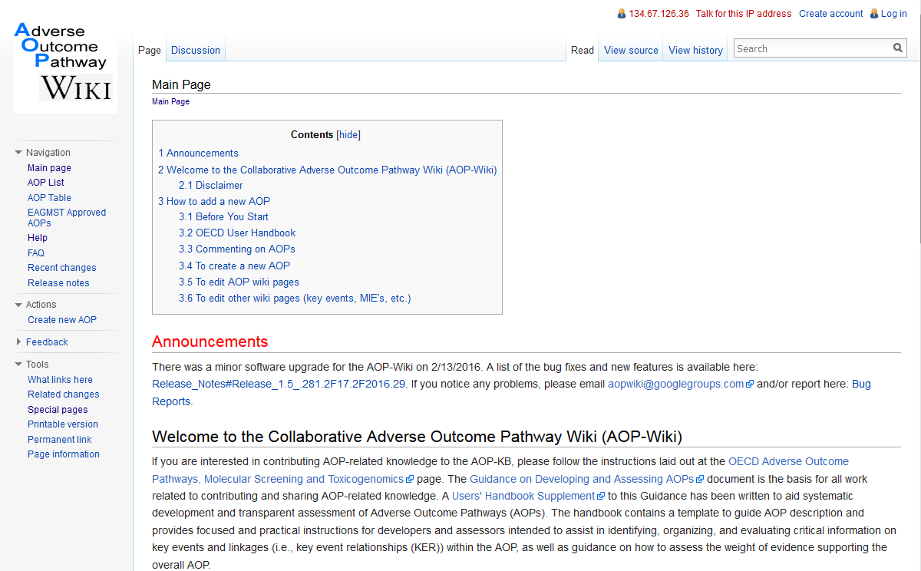

Slide 43
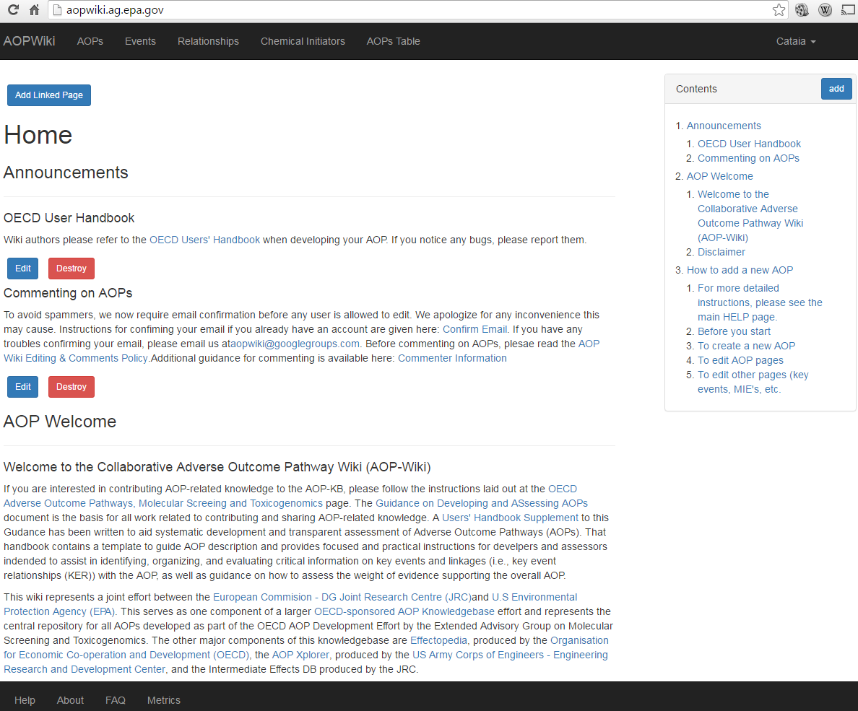

Slide 44
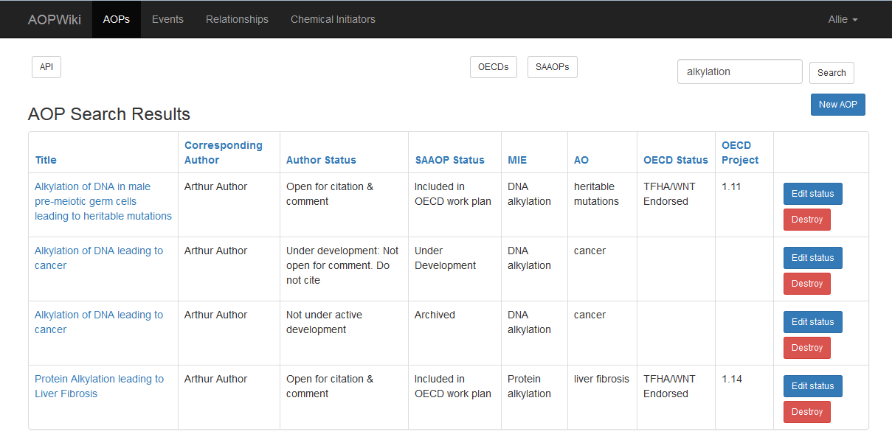
Links to OECD & SAAOP AOP Pages:

Slide 45
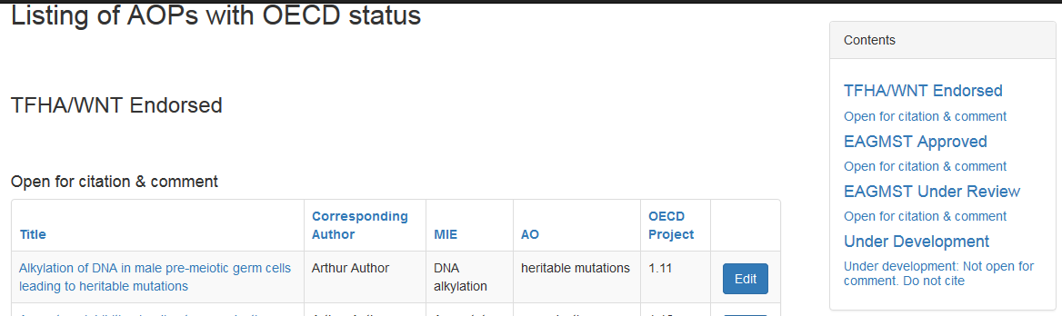
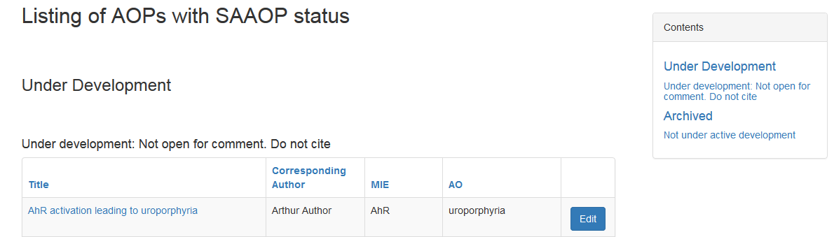

Slide 46
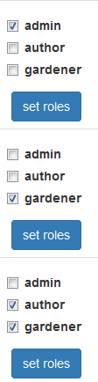
User Roles
Gardener
  Experienced AOP developers to help ensure consistency with published principles and OECD guidelines
Author
  Can create new AOPs and edit AOP components
Authenticated User (self created account)
  Can comment on AOPs, KEs, & KERs
Anonymous
  Read only

Slide 47
Edited on AOP page
by Authors
Edited on this page
by Gardeners
Gardeners
only

Slide 48
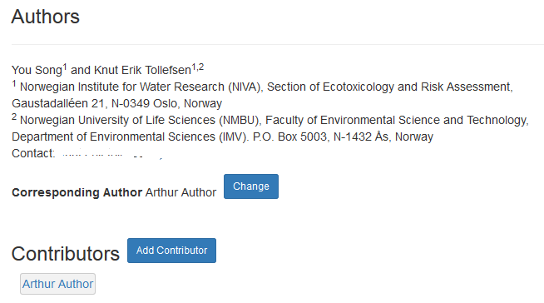
AOP Authors
Corresponding author
  Controls access
  Point of contact for questions/comments
Contributors
  Able to edit the AOP
Author list
  Free text field as in current wiki

Slide 49
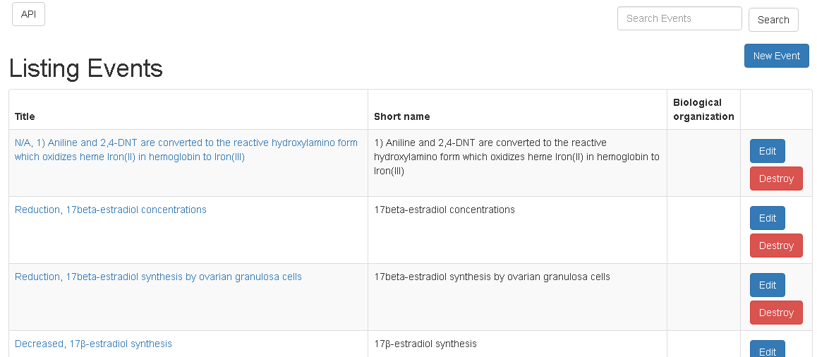
Authors
&
Gardeners
Gardeners
Only

Slide 50
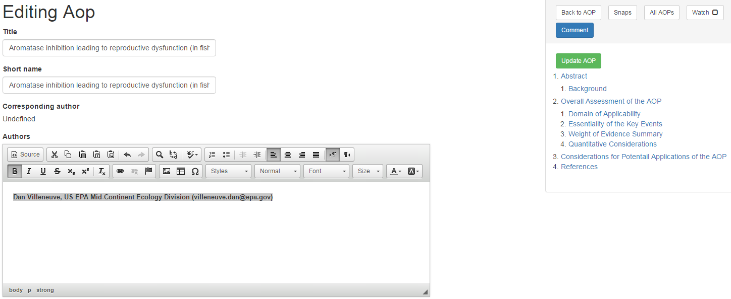
Edit all text sections
from a single page
Save changes to all
sections with one click
WYSIWYG
Easily create tables and add images

Slide 51
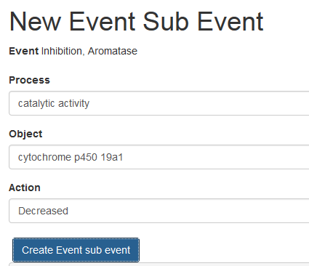
Ontology Tags for Key Events
Event Components
  Process
  Object
  Action
Event Context
  Tied to level of organization
  Cellular, Organ, Taxonomy
All terms driven by biological ontologies

Slide 52
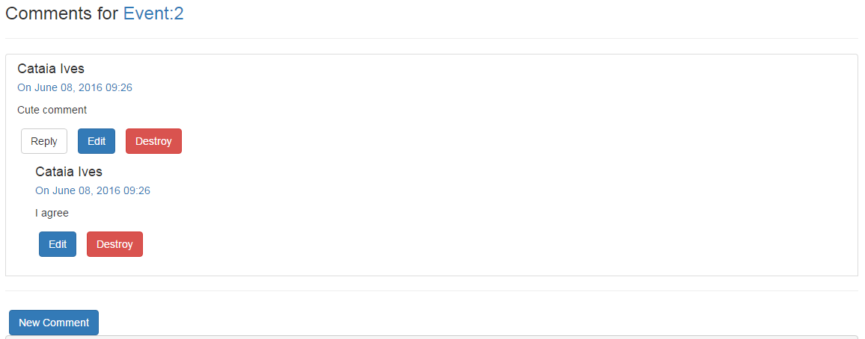
Comments
Modern look & feel
Allows comments on comments

Slide 53
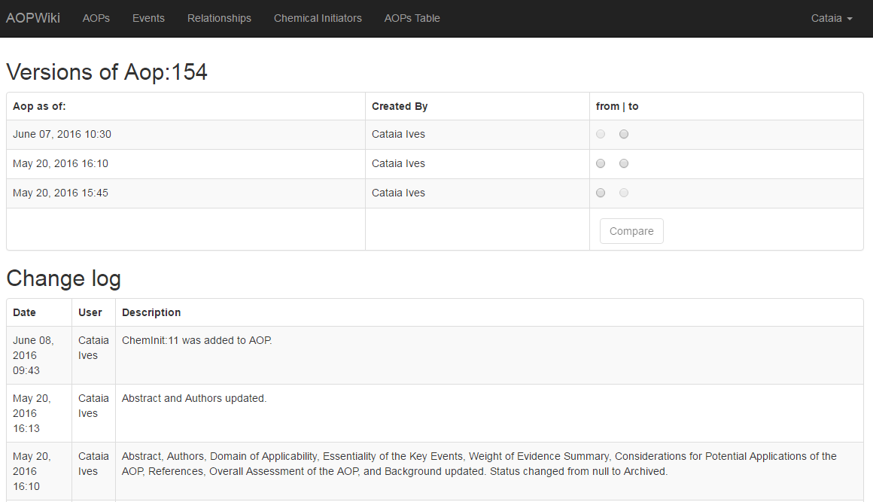

Slide 54
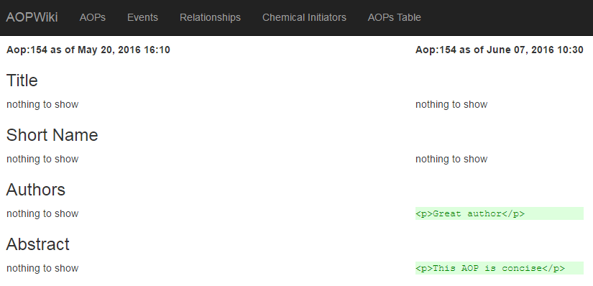

Slide 55
Acknowledgements
Rose Combs
Landon Grindheim
Cataia Ives
Brendan Ferreri-Hanberry
Evgeniia Kazymova

Slide 56
AOP Wiki
Collaborative development of AOP descriptions & evidence
Effectopedia
Detailed development of structured & computational
AOPs
AOP Xplorer
Visualize attribute networks to discover & explore AOPs
in a broader
context
e.AOP.portal
Intermediate Effects DB
Put
chemical-related
AOP components
in a regulatory
context
AOP-KB
Third party Applications, plugins
AOP-XML

Slide 57
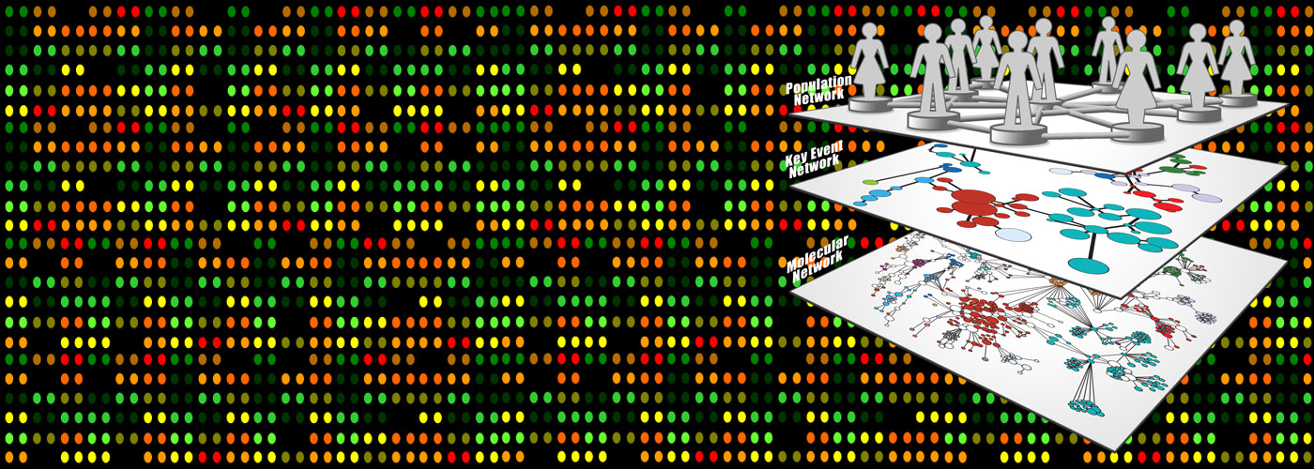
Questions?
SYSTEMS TOXICOLOGY

