Slide 1
Climate Change and the Health of Occupational Groups

Slide 2
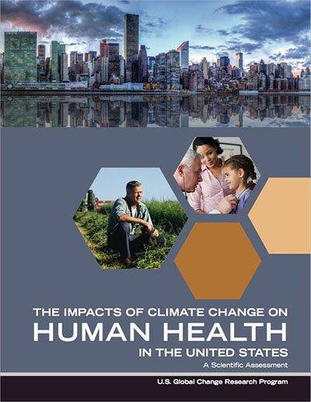
The US Climate Health Assessment
What is it?
An assessment of the risks climate change poses to human health in the United States
An Interagency product of the US Global Change Research Program (USGCRP)
Part of the ongoing National Climate Assessment (NCA) process
Who wrote it?
A team of ~100 Federal employees, contractors, and grantees from eight U.S. Federal agencies: HHS (NIH, CDC, NIOSH, ASPR, FDA, SAMHSA), NOAA, EPA, USDA, NASA, USGS, DOD (USUHS), VA.
Health2016.globalchange.gov
“Climate change is a significant threat to the health of the American people.”
Notes:
All of the information in this power point is taken from this Assessment Where does the information in the assessment come from?
The assessment information comes from the peer-reviewed scientific literature, and the report itself was also peer-reviewed.
What is the geographic and timescale focus? The assessment focuses on observed and current health impacts in the United States as well as the future projections of impacts. Where possible, the report presents quantitative estimates of future impacts for the years 2030, 2050, and 2100. How is the assessment organized?
The report assesses the scientific literature in eight focus areas:
Temperature Related Death and Illness; Air Quality Impacts; Extreme Weather; Vectorborne Disease; Water- Related Illnesses; Food Safety, Nutrition, and Distribution; Mental Health and Well-Being; and Populations of Concern

Slide 3
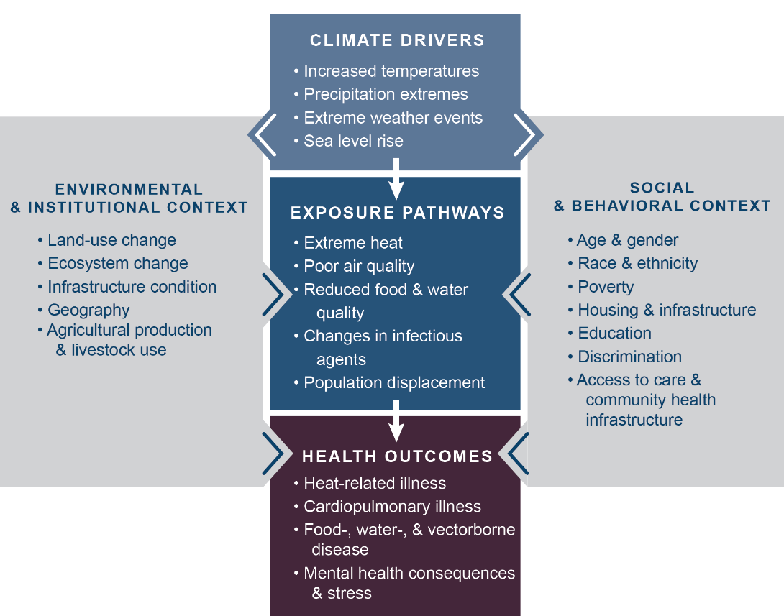
How Climate Change Can Impact Health
Notes:
This figure illustrates a pathway of how changes in Earth’s climate directly and indirectly affect human health. Examples listed in the center boxes show these key connections, such as increased temperatures due to climate change leading to more people experiencing or coming into contact with extreme heat, thus increasing the risk of heat-related illnesses. The gray side boxes indicate other factors that can positively or negatively influence a person’s risk of exposure and health outcomes, like access to healthcare, the physical environment (buildings, infrastructure, etc.) in which that person lives, and individual factors including race, gender, and age. These factors contribute to social and environmental disparities that make some communities particularly vulnerable to the health impacts of climate change.

Slide 4
Vulnerability
Vulnerability is the tendency or predisposition
to be adversely affected by climate-related health effects, and encompasses three elements:
exposure
sensitivity or susceptibility to harm
the capacity to adapt to or respond to a climate change threat.
While all Americans are affected by climate change, some groups are disproportionately vulnerable to climate health impacts.
Notes:
The assessment identifies eight populations disproportionately affected by climate change—communities with environmental justice concerns, indigenous peoples, children, pregnant women, older adults, occupational groups, people with disabilities, and people with pre-existing medical conditions.

Slide 5
Work Settings and Climate Change
Climate change is likely to affect the health of outdoor workers through increases in temperature, poor air quality, extreme weather, diseases transmitted by ticks and mosquitoes, industrial exposures, and damage to infrastructure.
Outdoor workers affected by climate change include:
farmers, ranchers, and other agricultural workers
commercial fishermen
construction workers
paramedics, firefighters, police, and other first responders
transportation workers

Slide 6
Work Settings and Climate Change
Workers exposed to hot indoor work environments (such as steel mills, dry cleaners, manufacturing facilities, warehouses, and other areas that lack air conditioning) are also at risk for climate change impacts such as extreme heat exposure or indoor air pollutants.

Slide 7
Extreme Heat
Extreme heat may result in more cases of heat-related illnesses, like heat stroke, heat exhaustion, and fatigue among workers, especially among physically demanding occupations.
Heat stress and fatigue can reduce alertness and work capacity, leading to safety lapses that can increase the risk of injury.
Higher temperatures can also worsen air pollution, raising the risk of respiratory illness for workers.

Slide 8
Extreme Events
As extreme events such as floods, storms, droughts, and wildfires become more frequent and intense as a result of climate change, they create risky conditions for workers involved in disaster response, rescue, and cleanup.
Firefighters battling wildfires are exposed to hazards such as being overrun by fire, heat-related illnesses and injuries, smoke inhalation, and other air pollutants.
First responders and other emergency workers face greater health and safety risks when working in conditions with infrastructure disruptions, communication interruptions, and social unrest or violence following floods and storms.

Slide 9
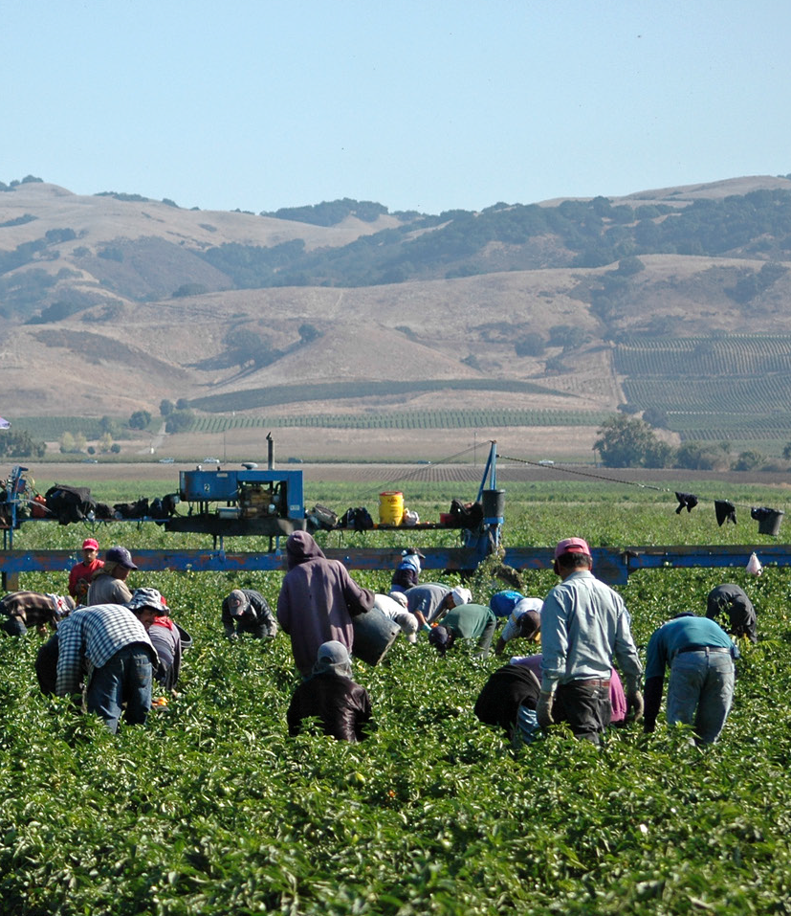
Other Outdoor Health Hazards
Other climate change related health hazards for outdoor workers include increased exposure to:
Waterborne and foodborne illness
Allergens
Mosquitoes or ticks carrying diseases such as West Nile virus or Lyme disease.
The health effects of climate change can be cumulative for migrant workers and day laborers as they may be affected by both work-related exposures and exposures associated with poorly insulated housing and lack of air conditioning.

Slide 10
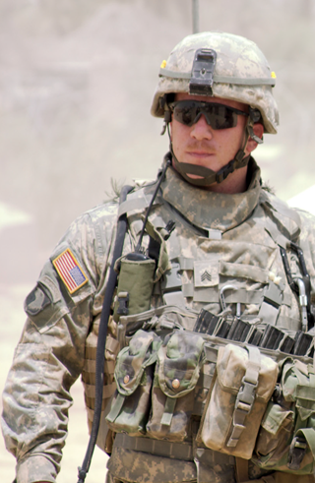
Members of the Military
Military personnel who train and conduct operations in hot environments are at risk for heat-related illness.
Members of the U.S. Armed Forces are also at increased risk of exposure to diseases carried by mosquitoes and ticks, as well as exposure to respiratory hazards like air pollution.
Military personnel are often stationed and deployed globally, which exposes them to climate-related infections that are relatively rare in the U.S., such as dengue fever and malaria.

Slide 11
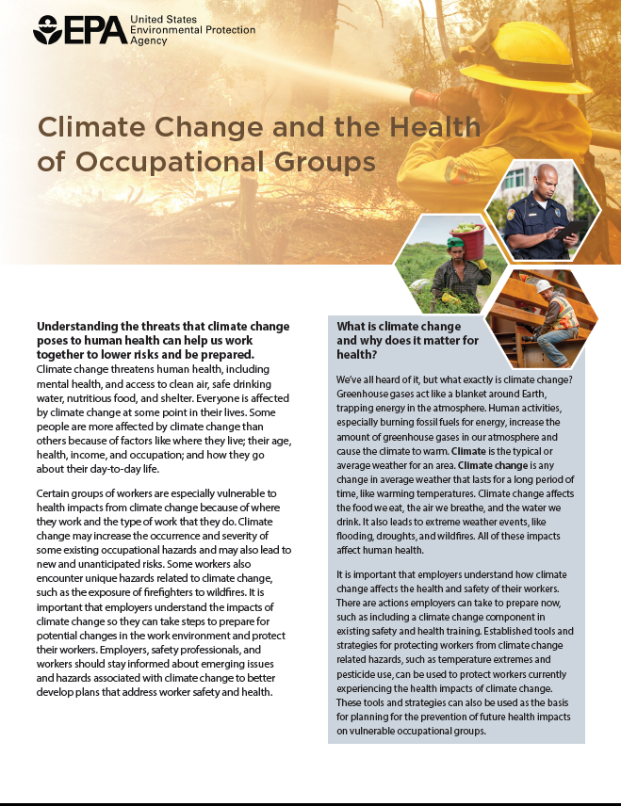
For More Information
Factsheet: Climate Change and
the Health of Occupational Groups
www.epa.gov/climate-impacts/communicating-vulnerabilities-climate-change-occupational-groups
Notes:
See communications materials for other populations of concern:
www.epa.gov/climate-impacts/climate-change-health-and-populations-concern

Slide 12
Additional Resources
EPA Resources:
www.epa.gov/climate-impacts
USGCRP Climate and Health Assessment: health2016.globalchange.gov

