Slide 1
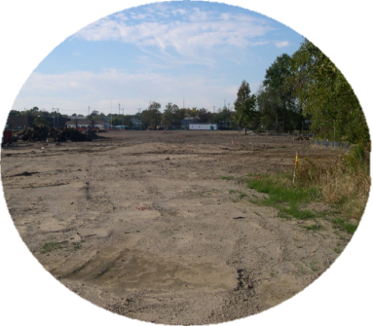
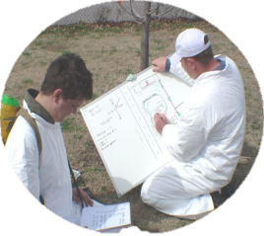
ACRES Area-Wide Planning Training for Cooperative Agreement Recipients
May 6, 2015
Notes:
INSTRUCTOR NOTES
- Introduce course – for EPA Project Officers
- Hand out ACRES business cards
- Presenter introductions (establish your credibility as a trainer giving them information about Brownfields/ACRES)
Name & organization
Role & number of years with Brownfields Program
Role & number of years with ACRES
- Distribute sign-in sheet
- Ask where the attendees come from, what their roles are within ACRES. This is a good way to see if PO’s are in the audience, familiar names, etc.

Slide 2
Agenda
Your role as a Brownfields Area-Wide Planning Cooperative Agreement Recipient (CAR)
Associating properties to your cooperative agreement
Adding Area-Wide Planning leveraged funding
Resources

Slide 3
Why is my role important to ACRES?
Whose job is it anyway?
Cooperative Agreement Recipients (CARs): Responsible for entering and updating ACRES information for AWP grants.
EPA Project Officers (POs): Responsible and accountable for data quality in their regions. POs ensure that the data meets our data quality standards.
For AWP grants, it is especially important that POs work closely with their grantee and provide assistance/oversight to the ACRES data, so that property records and leveraging are properly associated, with no double counting of properties or funds
EPA Headquarters: Responsible for overall data quality and system maintenance, enhancements, and improvements.

Slide 4
Why is my role so important for ACRES?
Accurate & complete data are very important because:
EPA needs a clear understanding of how communities are using their BF AWP grants to
1) build upon other brownfield site assessments or cleanups, and
2) quantify the range of other investments in the BF AWP project area that communities are able to leverage
EPA needs to rely on data reported in ACRES to help establish and measure success of the AWP program
Results are frequently reported to Congress
Data entered into ACRES are available to any requesting party through FOIA
Incomplete or inaccurate data negatively skews the data set
Audit trail

Slide 5
Data Organization in ACRES
Each Cooperative Agreement is one record in ACRES
A single property will have its own ACRES Property ID, and may be associated to more than one grant
Many assessments/cleanups have happened in AWP project areas, so these connections need to be reflected
Area-wide
planning grant
Cleanup grant
57 Chestnut Street
Dondra’s Drycleaner

Slide 6
How to search for an existing property in ACRES

Slide 7
How to search for an existing property in ACRES
The most effective way to search for existing property is by city
Once you find your property, take note of the ACRES Property ID!!
Notes:
Using the filters, can reduce the search for a number of criteria. In this example, Region 8 assessment grant recipients. See who has reported properties. Older, closed out CAs should have at least one property associated with it. This function can help with tracking whether sufficient progress is being made or making sure CAs have reported accomplishment data when they are near close out.

Slide 8
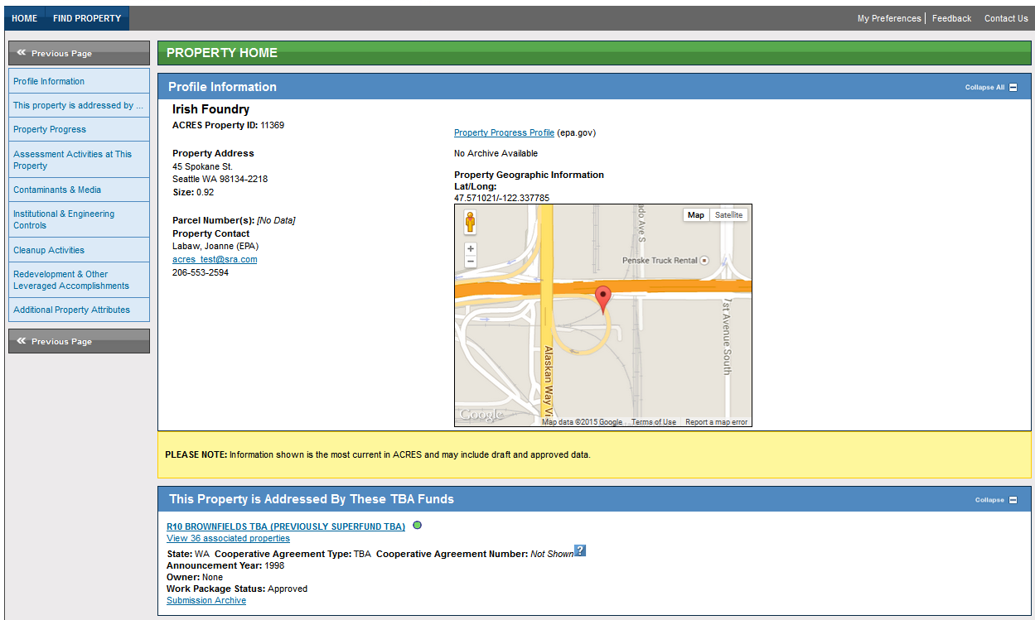
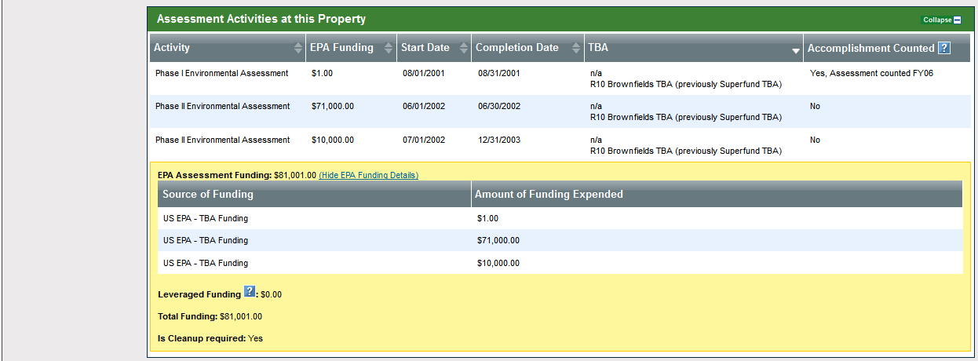
How to view previously entered leveraged funding
The property home page allows you to view what data, including leveraged funding, has already been entered under the property.
This is a great way to make sure you are not double-counting leveraged funding under your AWP grant

Slide 9
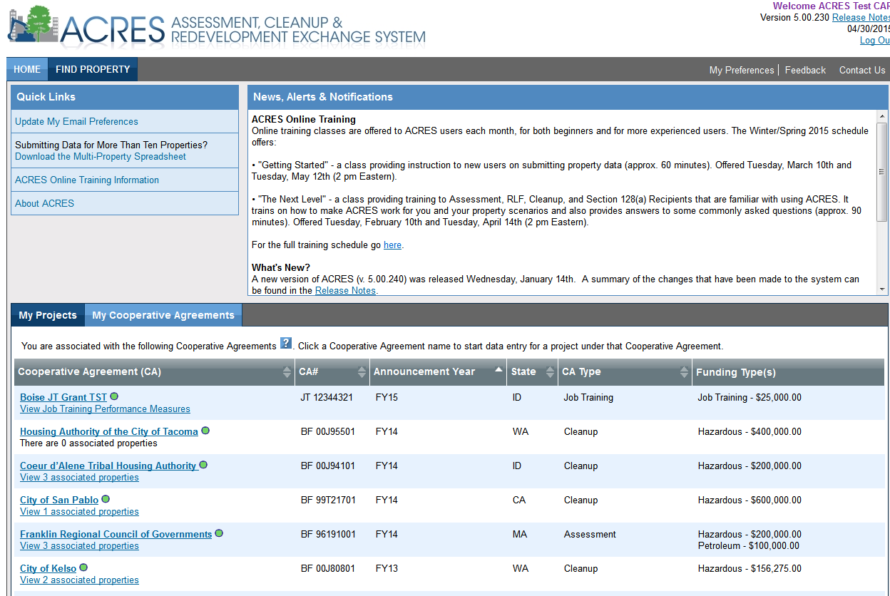
Associating a property to your AWP grant
Click the ‘My Cooperative Agreements’ tab on your ACRES home page
The Cooperative Agreement recipient link will direct you to the CA home page

Slide 10
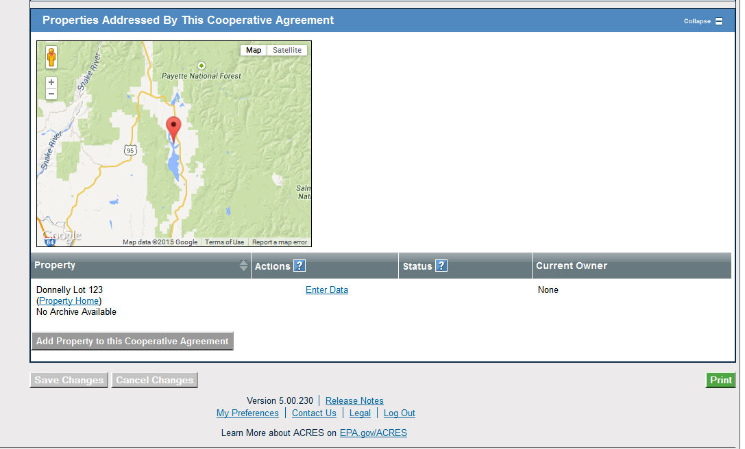
Associating a property to your AWP grant
At the bottom of your area-wide Cooperative Agreement Home page, you
can view properties already associated to your grant and can use the ‘Add
Property to this Cooperative Agreement’ button to associate a new or existing
property to your CA.

Slide 11
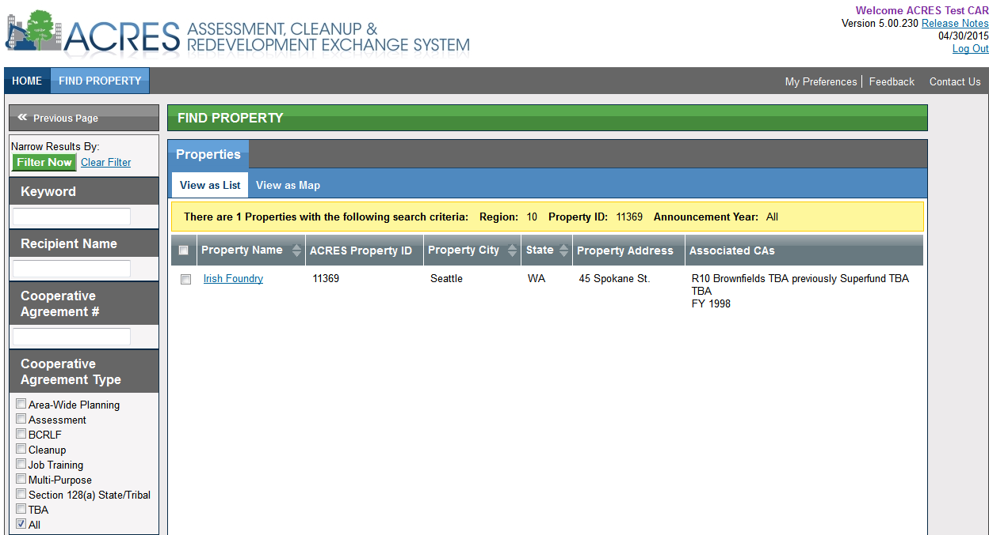
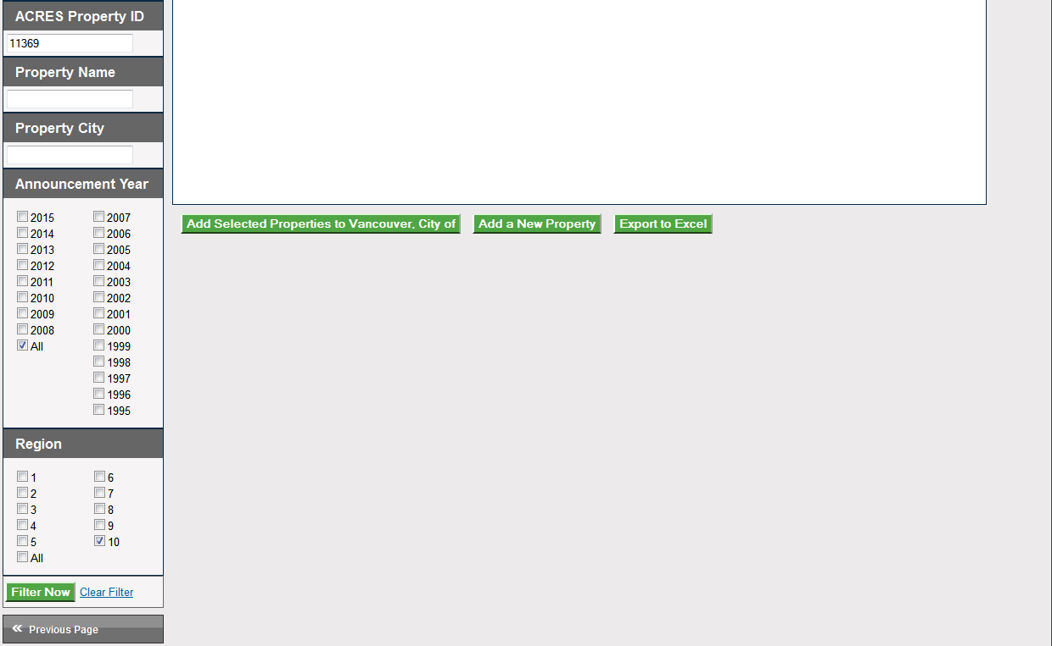
Associating a property to your AWP grant
Once directed back to the Find property screen, clear the current filters, and enter your ACRES Property ID in the property ID filter field; click Filter Now
Click the checkbox of the property you want to associate to your AWP grant
Click the green ‘Add Selected Properties to {AWP grant}’ button

Slide 12
Associating a property to your AWP grant
Once you have added the existing property to your AWP grant, you will asked to confirm the AWP/property association.

Slide 13
Adding leveraged funding your AWP grant
Leveraged funding for your AWP grant can be added on the CA home page.
CARs should capture investments within the AWP project area that are helping your community achieve specific & overarching revitalization goals that are part of your BF AWP project. (Discuss questions with your EPA PO)
You can see what funding has already been entered under the AWP grant and if needed, mark erroneous funding for deletion.

Slide 14
**ACRES Demonstration**

Slide 15
What if I Have Questions?
ACRES Help Desk
acres_help@epa.gov or (703)-284-8212
ACRES Information web page:
http://www.epa.gov/acres
Training Materials
Copies of Presentation
Quick Reference Guides
Release Notes
A link to this page is available at the bottom of every ACRES page including the Log In page.
Notes:
INSTRUCTOR NOTES
Help with questions or issues is almost as close as the press of a button.
ACRES Help Desk hours – M-F/9-5 – encourage people to ask any and all questions; we are here to help. Also encourage people to contact us with suggestions for improvement or enhancement. We want to hear from our users and do not consider ACRES a “final product.” We are always looking for ways to improve the application and make it as streamlined and useful as possible.
ACRES Information page – FAQs, QRGs and short (< 10 minutes each) training videos. Training schedule is available via link on this page. Training is available the first Tuesday of each month - 2 different classes which alternate months – 1) ACRES use for new users and 2) ACRES use for advanced users.
WE WANT PICTURES! Historical, before and during Brownfields activities, after reuse – all of it! The form is in the back of the room and posted on the ACRES Information page.

Slide 16
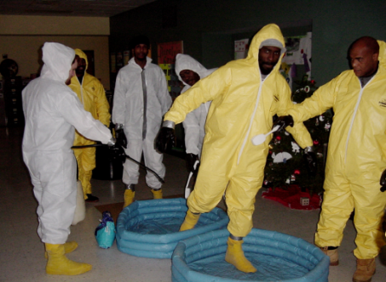
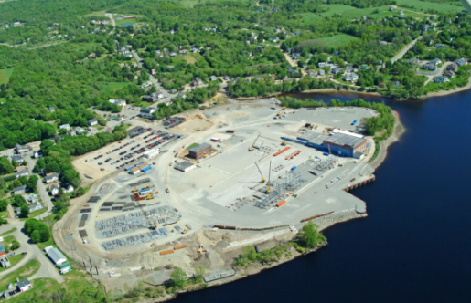
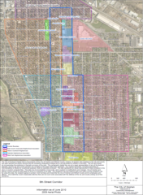
Questions?
Columbia, MO - Cleanup
Providence, RI – Job Training
Anaheim, CA – RLF
North Branch Works, IL - AWP
Brewer, ME - Assessment
Goshen, IN - AWP
Notes:
INSTRUCTOR NOTES
- Ask if anyone has any questions
- Remind everyone to turn in the course evaluation

