Slide 1
Indoor Air Institute Workshop:
SVOCs in the Indoor Environment
Brief Report
by
John Little
Virginia Tech

Slide 2
Motivation for SVOC Workshop
Semi-Volatile Organic Compounds (SVOCs) include:
  Plasticizers, flame retardants, pesticides, combustion products, anti-stain agents, heat transfer fluids
SVOCs are ubiquitous indoors, redistributing from their original sources to indoor air, and subsequently to all interior surfaces including airborne particles, dust, and human skin
Concern about exposure and health effects including endocrine disruption and asthma

Slide 3
“Pilot” SVOC Workshop at EPA
Organizational Sponsor
  Indoor Air Institute
Financial Sponsors
  EPA (NERL, HEASD – Roy Fortmann; NCCT – Robert Kavlock) and ACC LRI (Tina Bahadori)
Date
  August 17 to 19, 2009
Co-Chairs
  John Little and Elaine Cohen Hubal
Steering Committee
  Bill Fisk, Hal Levin, Tom McKone, Bill Nazaroff, Charlie Weschler
Invited Participants
  Harvey Clewell, Miriam Diamond, John Kissel, Vickie Wilson

Slide 4
SVOC Workshop Questions
Can we characterize the source-to-effect continuum for one class of SVOCs (phthalates)?
Can the overall mechanistic risk assessment approach be generalized to other SVOCs?
Can we identify screening-level, rapid exposure assessment approaches?

Slide 5
Series of Presentations
ToxCastTM and ExpoCastTM for prioritization and chemical evaluation
  Elaine Hubal, EPA, National Center for Computational Toxicology
Sources, emissions, transport, exposure and rapid screening for exposure
  John Little, Virginia Tech
The mismeasure of dermal absorption
  John Kissel, University of Washington
PBPK measurements, modeling, and metabolic reactions
  Harvey Clewell, The Hamner Institutes
Organ-specific toxic effects of phthalates
  Vickie Wilson, EPA, Reproductive Toxicology Division
Models in environmental regulatory decision making
  Tom McKone, UC Berkeley and LBNL

Slide 6
SVOC Workshop Questions
Can we characterize the source-to-effect continuum for one class of SVOCs (phthalates)?
Can the overall mechanistic risk assessment approach be generalized to other SVOCs?
Can we identify screening-level, rapid exposure assessment approaches?

Slide 7
SVOC Emissions model + particles
y_{in}= 0, TSP, Q
A_{i}
y(t), TSP, Q
…….
q = K_{s}y
…….
q_{p} = K_{p}yTSP
V
y(t)
…….
Particles
C₀ = Ky₀
h
A
x = L
C₀
D
x
x = 0
(Xu and Little, 2006 )

Slide 8
Emissions of DEHP from vinyl flooring
Xu et al., 2008

Slide 9
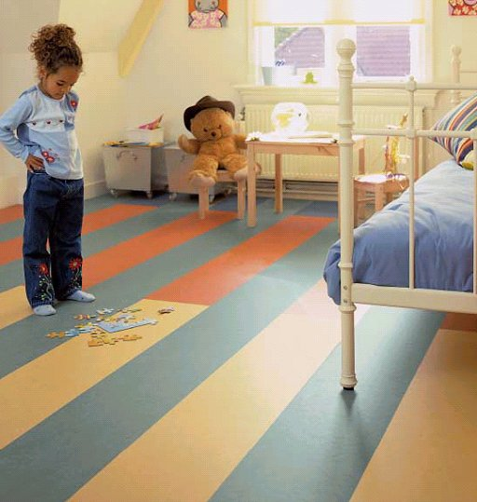
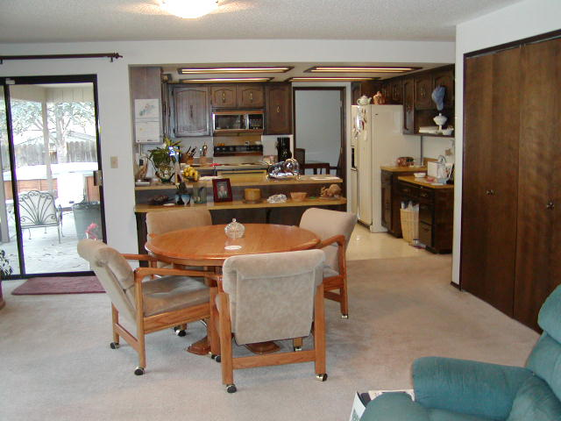
Make model more representative of real indoor environment

Slide 10
Two-Room Model

Slide 11
Partition coefficients for DEHP
Surface | Partition coefficient, K_{s}
Furniture, wall and ceiling | 2500 (m)
Carpet | 1700 (m)
Skin | 9500 (m)
Airborne Particles | 0.25 (m³/μg)

Slide 12
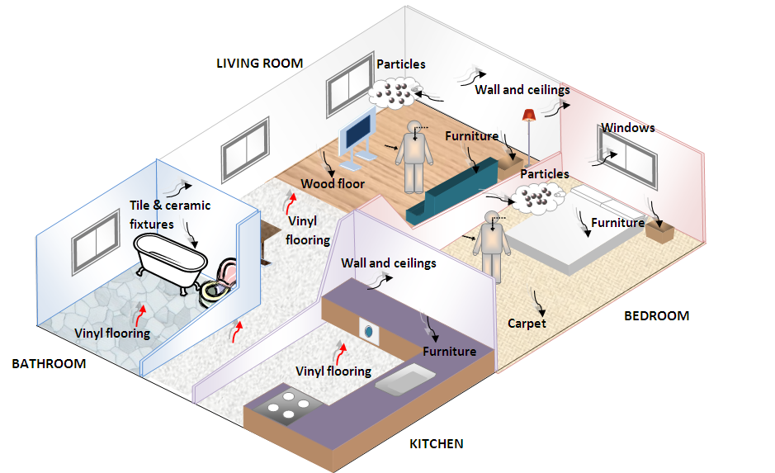
Residential Environment

Slide 13
Residential Environment
Compartment | Main house |  | Kitchen |  | Bathroom
Volume (m³) | 128 |  | 35 |  | 15
Flow rate (m³/h) | Q_{oa} | 65 | Q_{ok} | 12 | Q_{ob} | 1.1
 | Q_{ao} | 44 | Q_{ko} | 32 | Q_{bo} | 2.1
 |  |  | Q_{ak} | 44 | Q_{ab} | 14
 |  |  | Q_{ka} | 24 | Q_{ba} | 13
Surface area (m²)
Vinyl flooring | 19.2 |  | 14.4 |  | 6.20
Walls & Ceilings | 124 |  | 34.0 |  | 23.3
Carpet | 35.8 |  | -- |  | --
Wood floor | 32.0 |  | -- |  | --
Hard surface furniture | 61.4 |  | 12.6 |  | 5.40
Windows & mirrors | 5.12 |  | 1.75 |  | 1.05
Tile & ceramic fixtures | 5.12 |  | 3.50 |  | 16.5
TSP (μg/m³) | 20.0 |  | 20.0 |  | 20.0

Slide 14
Residential Model Predictions

Slide 15
Exposure for Child (2 to 3 yrs)

Slide 16
Source to Effect Continuum
Sources, emissions, transport, exposure and rapid screening for exposure
  John Little, Virginia Tech
Dermal absorption
  John Kissel, University of Washington
PBPK measurements, modeling, and metabolic reactions
  Harvey Clewell, The Hamner Institute
Organ-specific toxic effects of phthalates
  Vickie Wilson, EPA, Reproductive Toxicology Division

Slide 17
SVOC Workshop Questions
Can we characterize the source-to-effect continuum for one class of SVOCs (phthalates)?
Can the overall mechanistic risk assessment approach be generalized to other SVOCs?
Can we identify screening-level, rapid exposure assessment approaches?

Slide 18
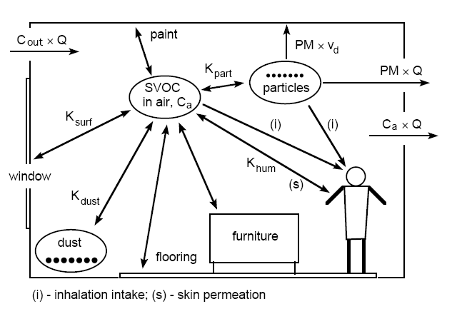
Indoor SVOC Dynamics
Weschler and Nazaroff, Atmos. Environ., 2008

Slide 19
Estimating physical properties with structure-activity relationships (SPARC)
Weschler & Nazaroff, Atmos. Environ., 2008

Slide 20
Measured vs. estimated [SVOCs] on hands
Weschler & Nazaroff, Atmos. Environ., 2008

Slide 21
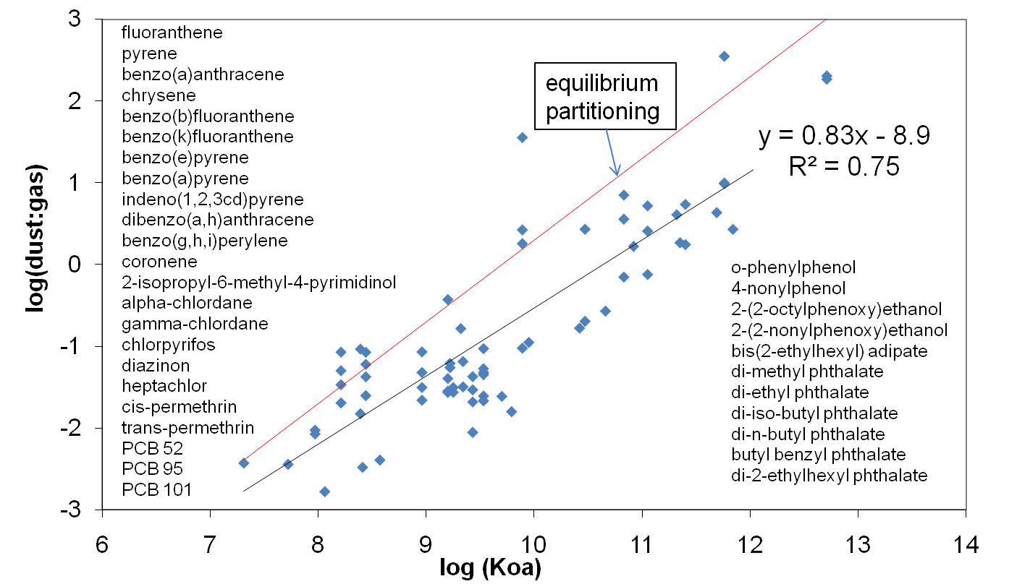
Measured vs. estimated [SVOCs] in dust
Nazaroff & Weschler, Healthy Buildings, 2009

Slide 22
SVOC Workshop Questions
Can we characterize the source-to-effect continuum for one class of SVOCs (phthalates)?
Can the overall mechanistic risk assessment approach be generalized to other SVOCs?
Can we identify screening-level, rapid exposure assessment approaches?

Slide 23
Zero-Order Exposure Screening
Excretion to production ratio (EPR):
  Ratio of the rate of excretion from humans (urine) to the rate of manufacture provides rough exposure indicator
  Dietary supplements or pharmaceuticals: EPR ~ 1.0
  Personal care products: EPR ~ 0.01 to 1
  Pesticides: EPR ~ 0.0001-0.01
  Additives in indoor products: EPRs ~ 0.1-100 ppm
Some estimated EPRs:
  Triclosan ~ 8000 ppm
  Pentachlorophenol ~ 500 ppm
  DEHP ~ 20 ppm

Slide 24
First-Order Exposure Screening
Exposure to additives (e.g., plasticizers and flame retardants):
  Steady state concentration y (and hence exposure) depends primarily on y₀, A and h
  y₀ may be roughly equal to vapor pressure

Slide 25
At Steady State
Q~normal(50,20)
K_{p}~normal(0.25,0.05)
TSP~normal(20,5)
h is correlated with Q
50000 random trials

Slide 26
Variability in Predicted Steady-State Gas-Phase Concentration

Slide 27
Rapid Exposure Screening
Zero-Order Screening
  Excretion to production ratio (EPR)
    Triclosan ~ 8000 ppm
    Pentachlorophenol ~ 500 ppm
    DEHP ~ 20 ppm
First-Order Screening
  Exposure to additives (e.g., plasticizers and flame retardants)

Slide 28
SVOC Workshop Outcomes
Can we characterize the source-to-effect continuum for phthalates? ~Yes
Can the overall mechanistic approach be generalized to other SVOCs? ~Yes
Can we identify screening-level, rapid exposure assessment approaches (and combine with info from ToxCastTM to estimate risk)? ~Yes
Summary paper being prepared for publication
SVOC Workshop 2 planned for end of 2010 or early 2011

