Slide 1
Chapter 3
Lead Dust Wipe Sampling

Slide 2
Objectives
Learn when and where to take a dust wipe sample
Learn how to take a dust wipe sample
Sample 3 surfaces where dust is collected
Learn the difference between single-surface and composite sampling

Slide 3
A Lead Dust Wipe Measures:
Total amount of lead dust on a specific surface area (lead loading)
The EPA lead dust clearance standards use this type of measurement.
Lead present at the time and location of sample collection
Does not tell you about past or future levels
Lead levels can change depending on the activity in the house or in different locations
Notes:
A dust wipe measures the total amount of lead dust on a specific surface area. This measurement is called lead “loading.” Lead loading is a good indicator of the amount of lead to which a child is exposed.
Dust wipes measure lead dust at a particular point in time.
Lead levels can change as the amount of lead dust on the surface changes.
Lead levels also can change depending on the activity in the house, including activities that disturb lead-based paint and the frequency of cleaning.
The measurement tells you how much lead existed when the sample was collected; it does not tell you about past or likely future lead levels.

Slide 4
Sampling Strategy
You must wait at least 1 hour after final cleanup is completed and visual inspection is passed before collecting samples to allow time for dust to settle out of the air and onto surfaces.
When choosing sampling locations, identify areas where the most dust was generated during the job.
Whenever possible sample hard floors, not carpets.
Make sure to follow the sampling requirements in the next slides or the Field Guide to select your final sample locations.
Notes:
You must wait a minimum of 1 hour after the final cleanup is completed before collecting dust wipe samples. This allows time for the dust to settle out of the air and onto surfaces.
Single-surface dust wipe samples contain one wipe from one surface.
– They measure lead dust from a specific surface, such as a floor or an interior windowsill.
– They measure the total lead in the surface area.
– They do not tell you about dust lead levels in other places on the same surface. Dust lead levels can vary substantially.
When planning a sampling strategy, consider your sample numbering scheme and prepare for the number of samples you expect to take. Try to capture the sampling locations near dust-generating tasks that occurred during the job.

Slide 5
Lead Dust Wipe Sampling Locations: EPA RRP Rule
If there is more than 1 room, hallway, or stairwell within the work area, take:
1 windowsill sample and 1 floor sample within each room, hallway, or stairwell (no more than 4 rooms, hallways, or stairwells need be sampled)
If the windows were not closed and covered with plastic during the renovation, also take 1 window trough sample in each room, hallway, or stairwell (no more than 4 need be sampled).
1 floor sample adjacent to the work area, but not in an area that has been cleaned
For Federally-assisted housing, take these samples if the work area is contained, otherwise, clear the whole unit, as discussed in the previous slide.
Notes:
Although cleaning verification is not performed on carpeted floors, dust clearance sampling is. LDSTs should not avoid sampling carpeted floors.
If the work area includes more than 4 rooms, hallways, or stairwells, only 4 must be sampled. A windowsill sample and a floor sample must be collected from each of 4 rooms, hallways, or stairways within the work area.
The RRP Rule requires all objects and surfaces, including floors, within 2 feet of the work area to be cleaned after the work has been completed. Floor samples required to be collected outside of the work area must be collected outside of the cleaned area surrounding the work area.
Window troughs may contain pre-existing dust lead hazards. If possible, LDSTs should discuss the window trough sampling requirements with the certified renovator before the renovation begins. If the windows in the work area remain closed and covered with plastic during the renovation, window trough sampling will not be necessary.
The next few slides on sampling apply to HUD as well.

Slide 6
Lead Dust Wipe Sampling Locations: EPA RRP Rule – (cont.)
If the work area is a single room, hallway, or stairwell, or a smaller area, take:
1 windowsill sample and 1 floor sample
If the windows were not closed and covered with plastic during the renovation, also take 1 window trough sample.
1 floor sample adjacent to the work area, but not in an area that has been cleaned.

Slide 7
HUD Clearance
HUD does not allow clearance to be performed on a work area alone that has not been adequately contained
HUD clearance can be done in several ways
Whole unit clearance in most cases
Worksite-only clearance in some cases
Clearance for interior work when containment is used
LDST should discuss sampling strategy with renovator prior to start of work
See HUD Sampling Appendix and optional HUD Sampling Exercise for detailed descriptions of HUD sampling strategies.
Notes:
HUD has different requirements than EPA for clearance. Although EPA’s post-renovation clearance protocol is similar to HUD’s allowed protocol for worksite-only clearance, HUD has additional requirements to use this sampling strategy. Although the sampling requirements are very important for Federally-funded renovation activity, these units will represent a relatively small percentage of all renovation projects performed nationwide. Because most of the renovation jobs that are expected to occur in U.S. housing will not be funded with Federal housing assistance, details on HUD sampling are provided attached to the curriculum in the optional sampling exercise for HUD-assisted work and in the HUD sampling appendix. All LDSTs should discuss sampling plans with the renovator before work begins; with particular attention to whether the project is receiving Federal housing assistance, so the proper sampling strategy can be used to comply with the Lead Safe Housing Rule.

Slide 8
Activity: Where To Take Samples
You are now going to practice sampling area strategies.
Your instructor will provide you with a hypothetical renovation scenario and diagram.
Read the scenario and mark the location(s) of where you think dust wipe samples should be taken.

Slide 9
Remember…
Be strategic about laying out sampling area to capture areas were the highest dust generating tasks occurred during the job.
Refer to the Field Guide or Chapter 3 to determine the appropriate places to take your samples.

Slide 10
How To Take Dust Wipe Samples
Now that you know where and when to sample, the next section will cover the most important part of the course: How to take dust wipe samples.
Regardless of the rule you are working under, the methods for taking and later analyzing dust wipe samples are identical.

Slide 11
Dust Wipe Sampling Materials
Wipes - Disposable individually packaged wipes. Check with you laboratory, they often provide these
Disposable gloves - Should be non-sterilized and non-powdered
Disposable shoe covers - Use of disposable shoe covers helps to minimize the transfer of settled dust from one location to another.
Containers - Centrifuge tubes or other hard plastic, non-glass containers. They should be non-sterilized, plastic tubes equipped with a sealable lid.
Reusable template - A 12” x 12” reusable template for floors.
Notes:
Key supplies are listed above. Check with your analytical lab, because they will often provide some of these materials.
Disposable lead dust wipes. Use individually packaged wipes (laboratories often provide these). The wipes should meet ASTM Standard E1792-03. Do not use any wipes that contain aloe or lanolin.
Disposable gloves. Gloves should be disposable. Non-sterilized and non-powdered gloves are recommended because powder on gloves may contaminate the sample (laboratories often provide them).
Disposable shoe covers. Use of disposable shoe covers between buildings and the removal of shoe covers before entering your vehicle can be helpful in minimizing the inadvertent transfer of settled dust from one location to another.
Centrifuge tubes or other hard plastic, non-glass container. They should be non-sterilized, plastic tubes equipped with a sealable lid.
Reusable templates. A 12”x12” reusable plastic or disposable cardboard template is best.

Slide 12
Dust Wipe Sampling Materials – (cont.)
Tape - Painter’s or masking tape works well
Ruler -To measure sampling areas if templates are not available
Sample collection forms and chain-of-custody forms
Labeling and cleanup supplies. Permanent markers, trash bags, labels, re-sealable storage bags, and sanitary wipes
Pen -To complete the sample collection form, label tubes, and write down notes
Calculator - To assist in the calculation of sampling area dimensions
Notes:
Key supplies are listed above. Check with your analytical lab, because they will often provide some of these materials.
Tape. Painter’s or masking tape works well. Tape is used to secure templates while taking dust samples and to outline sample areas when templates are not available.
Ruler. To measure sampling areas if templates are not available.
Sample collection forms and chain-of-custody forms. Laboratories will generally provide their own forms.
Labeling and cleanup supplies. Permanent markers, trash bags, labels, re-sealable storage bags, and sanitary wipes for face and hands if no access to warm and soapy water.
Pen. A pen should be used to complete the sample collection form, label tubes, and write down notes.
Calculator. A calculator should be used to assist in the calculation of sampling area dimensions.
Sanitary Wipes. To be used for cleanup if no access to warm, soapy water.

Slide 13
Blank Samples
A new, unused wipe that is tested at the laboratory to determine whether the sampling medium is contaminated.
Laboratory should not know they are blanks
Blanks should be assigned sample numbers and locations
Only your copy of the sample collection form should identify which samples are blanks.
One blank sample should be submitted
For each job tested
From each wipe lot
Notes:
Blank samples are new, unused wipes that are sent to the laboratory to determine whether the sampling media are contaminated by providing a “clean” (assumed lead-free) wipe for comparison. Because you should prepare blank samples on every job, you should factor the costs associated with these samples into your fee. Submitting blank samples is important to test the accuracy of your sampling techniques, the sampling media, and the laboratory’s analysis.
Preparing blank samples. You should prepare blank samples in the same manner as other dust wipes.
Prepare blank samples at the end of a job – after collecting all of your dust wipe samples.
Remove a new wipe from the container with a new glove, shake the wipe open, and refold it as you would if you were taking a dust sample.
Insert the unused wipe into a sampling container without touching any surfaces.
Labeling and submitting blank samples. Blank samples should be labeled so you can identify them, but the lab cannot. Do not label blank samples as “blank.”
Give the sample a fictitious number that looks like your other sample numbers and provide a fictitious sample location and measurements to the lab.
Keep notes in your records identifying the blank sample number.
Submit one blank sample for each unit sampled. Additionally, one blank should be included from each wipe lot used to ensure that the lots are not contaminated. The wipe lot number is usually found on the bottom of the wipe container.
It is improper to label blanks as such because of the unavoidable potential for biasing the laboratory analysts; it is poor practice to have all blanks at the same portion of each unit’s (and each wipe lot’s) samples.
Interpreting blank samples. If the laboratory detects more than 10 µg/wipe, one of three errors may have occurred:
The dust wipes were contaminated before you began using them;
You contaminated the wipes during your sampling; or
The laboratory contaminated them during the analysis.
If the blank sample is contaminated, then the data should not be used and the unit in question should be re-sampled.

Slide 14
How To Collect Samples
Step 1: Put on disposable shoe covers and lay out the sample area.
Step 2: Prepare the tubes.
Step 3: Put on clean gloves.
Step 4: Sample the selected area and place wipe in tube.
Step 5: Measure the sample area.
Step 6: Record sample area (dimensions) on forms.
Step 7: Clean up.
Notes:
This slide presents an overview of the dust sample collection process, which has seven key steps. Each of these steps is presented here and in more detail later in this training.
Step 1: Put on disposable shoe covers and lay out the sample area. Carefully outline the area you will sample using a template or tape.
Step 2: Prepare the tubes. Label the tubes and place partially opened tubes near the spot you will sample.
Step 3: Put on clean gloves. Put on clean gloves before collecting each sample. This helps minimize contamination.
Step 4: Wipe sample area. Wipe the entire area you laid out with disposable wipe for the sample. Fold the wipe and place it in the appropriate tube.
Step 5: Measure the sample area. Measure the area sampled.
Step 6: Record sample area on forms. Record measurement on sample collection form and chain-of-custody form.
Step 7: Clean up. Sampling materials must be cleaned or removed from the site because they may be contaminated.

Slide 15
Step 1: Put on Disposable Shoe Covers and Lay Out the Sample Area
Put on shoe covers.
Outline sample area with tape or a template.
Templates should be durable material.
Floor sample is generally 12” x 12”
Make sure you clean the template with a new wipe.
Tape can also be used to outline the sample area.
Lay out tape squarely so you can accurately measure the sample area later.
Do NOT touch area inside the sample area.
Notes:
Step 1: Put on Disposable Shoe Covers and Lay Out the Sample Area
The following describes how to lay out the sample area using a template. Whenever possible, use a template to avoid measurement errors. (*Make sure you clean the template before following sampling protocol.)
The templates will vary in their dimensions:
The floor template should have a 144-square inch or 1-square foot opening (12 inches = 1 foot) or an alternative area that has accurately known dimensions. A square foot is the basic measurement used by EPA-recommended guidance for lead dust clearance testing.
The interior windowsill or window trough template should have an opening of at least 16 square inches (approximately 2” x 8”). Interior sills can vary in width.
Tape the template to the appropriate surface (floor, interior sill, or interior trough) using masking or painter’s tape. Be careful to avoid placing your hands in the sample area, as this might remove or add lead dust and give you a misleading result.
If using tape, ensure that the tape is laid out squarely so that an accurate area can be determined for the sample size. It is very difficult to measure the area if the tape is not laid out in a square or rectangle.
Do not touch or otherwise disturb the area inside the measured sample area. This could remove or add lead dust and give you a misleading result. (You will measure the exact area of the sample area after collecting the dust sample.)

Slide 16
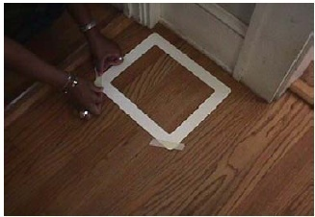
Taping Template to Floor
Notes:
Here is an example of how the sampling area is laid out when you have a template. Note how it is taped to the floor.
*Be sure to clean reusable templates. Tape corners at 45 degree angle away from the corner.
*Be sure not to touch the inside of the sample area.

Slide 17
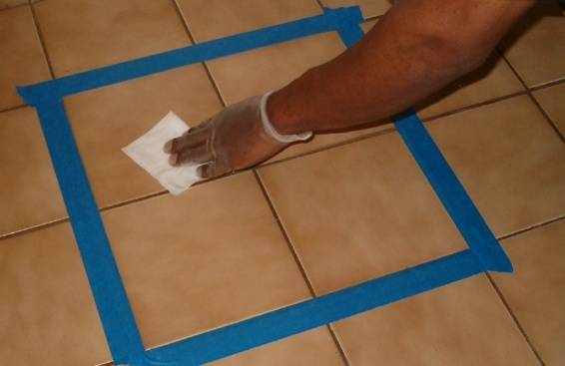
Outlining Sample Area with Tape
Notes:
Here is an example of using tape to outline the sample area on a floor when a template is not available. Make sure that the tape is laid at right angle to ensure a that the area outlined as close to a perfect square as possible. Doing so will make measure the area of the sample much easier and more accurate.

Slide 18
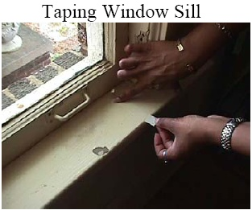
Taping Window Sill
Notes:
If a template for a sill or trough is not available, lay out the sampling area with painter’s tape. Place tape perpendicular to the edge of the sill or trough. The sample area will be calculated after taking the sample to avoid contaminating the area.
If the sill or trough is not taped, the width of the sample area varies from front-to-back when the ends of the sill or trough are not parallel straight lines, so the area of the sample will be difficult to determine.
Make sure the area you are sampling is at least 16 square inches. Try to sample at least 8” of sill width.

Slide 19
Step 2: Prepare the Tubes
Use clean, hard-sided tubes.
Make sure tube is labeled with an ID number.
Record ID number on sample collection form and chain-of-custody form.
Partially unscrew tube cap.
Place tube near sample area.
Notes:
Step 2: Prepare the Tubes
Tubes must be prepared so that they are properly labeled and are accessible to you when you are ready to put your samples in them.
Label each tube with an identification number.
Record the identification number on the sample collection form and chain-of-custody form.
Partially unscrew the cap on the tube to be sure you can open it easily.
Place the tube near the area you plan to sample. This avoids possible contamination of the wipe and loss of sampled dust between the time you collect the sample and place it in the tube.
Organizing tubes in a portable test tube rack may be helpful.

Slide 20
Step 3: Put on Clean Gloves
Use disposable gloves.
Use new gloves for each sample.
After putting on the gloves, do NOT touch anything else before you pick up the wipe.
Notes:
Step 3: Put on Clean Gloves
Wearing clean gloves avoids transferring lead dust from your hands to the wipe.
Use disposable gloves.
Use new gloves for each sample collected.
Do not put on the gloves until you are ready to take the sample. You can contaminate the gloves if you touch other surfaces, such as when measuring the sample area.
After putting on the gloves, do NOT touch anything else before you pick up the wipe.

Slide 21
Step 4: Wipe Sample Areas
The procedures for taking dust wipe samples from floors, windowsills, and troughs are listed on the following slides.
The procedure for sampling floors is different than the procedure for sampling windowsills and troughs.
Step 4 of lead dust wipe sampling is also described in the Lead Dust Sampling Technician Field Guide.

Slide 22
Step 4: Wipe Sample Area – Floors
Do not touch other objects. They can contaminate the wipe.
Press the wipe down firmly (with fingers, not the palm of the hand) at an upper corner of the sample area.
Make as many “S” like motions as needed to wipe the entire sample area, moving from side to side. Do not cross the outer border of the tape or template.
Fold the wipe in half, keeping the dirty side in, and repeat the wiping procedure (“S” like motion). Folding wipe carefully helps to prevent the loss of any collected dust.
Notes:
Step 4: Sampling Procedure for Floors
Do not touch other objects. They can contaminate the wipe.
Press the wipe down firmly (with fingers, not the palm of the hand) at an upper corner of the sample area.
Make as many “S”-like motions as needed to wipe the entire sample area, moving from side to side. Do not cross the outer border of the tape or template.
Fold the wipe in half, keeping the dirty side in, and repeat the wiping procedure (“S” motion). This helps to prevent the loss of any collected dust.

Slide 23
Step 4: Wipe Sample Area – Floors (cont.)
Fold the wipe in half again, keeping all the dust in the wipe, and repeat the wiping procedure one more time, concentrating on collecting dust from the corners within the selected surface area.
Wipes are folded to keep the collected dust within the wipe, avoid dust losses, and to expose a clean wipe surface for further collection.
Notes:
Step 4: Sampling Procedure for Floors
Fold the wipe in half again, keeping all the dust in the wipe, and repeat the wiping procedure one more time, concentrating on collecting dust from the corners within the selected surface area.
Wipes are folded to keep the collected dust within the wipe, avoid dust losses, and to expose a clean wipe surface for further collection.
Students should refer to Attachment 3-A: Sample Collection Form and Attachment 3-B: Completed Sample Collection Form. A checklist of the key steps involved in taking a dust sample can be found in Attachment 3-D: Lead Dust Wipe Checklist and the Lead Dust Sampling Technician Field Guide.

Slide 24
Step 4: Wipe Sample Area – Floors (cont.)
Fold the wipe again with the sample side folded in, and place the folded wipe into the sample tube. Avoid contact with other surfaces.
Cap the container. Discard the gloves into a trash bag.
Notes:
Step 4: Sampling Procedure for Floors
Fold the wipe again with the sample side folded in, and place the folded wipe into the sample tube. Avoid contact with other surfaces. Wipes should be stored only in their original container or in the tube. Do not use plastic bags or other items to hold wipes. Blank wipes should also be used. Blanks should be assigned sample numbers and locations so that the laboratory does not know they are blanks. Only your copy of the sample collection form should identify which samples are blanks
Cap the container. Discard the gloves into a trash bag.
Students should refer to Attachment 3-A: Sample Collection Form and Attachment 3-B: Completed Sample Collection Form. A checklist of the key steps involved in taking a dust sample can be found in Attachment 3-D: Lead Dust Wipe Checklist and the Lead Dust Sampling Technician Field Guide.

Slide 25
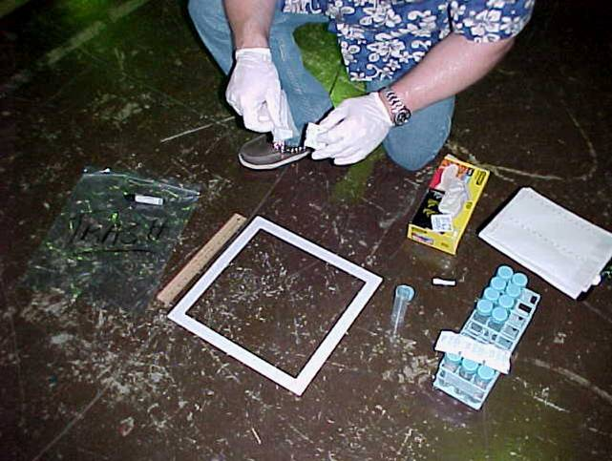
Floor Sampling

Slide 26
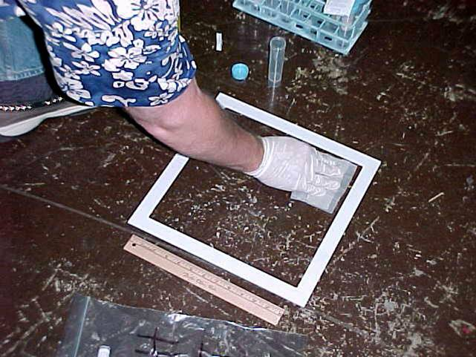
Floor Sampling

Slide 27
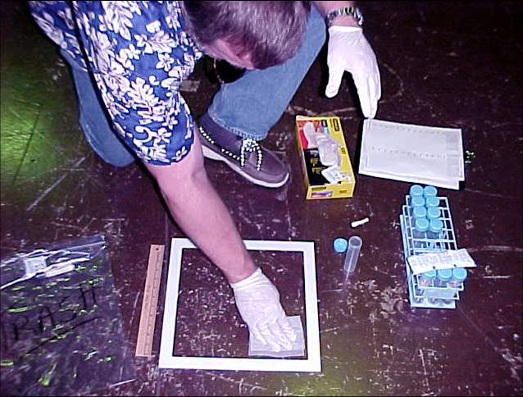
Floor Sampling

Slide 28
Step 4: Wipe Sample Area – Windowsills and Troughs
Sampling interior windowsills and troughs
Hold fingers together and flat against surface.
Wipe surface in a single pass while applying constant pressure.
Fold wipe in half with wiped side in and wipe in both directions.
Fold wipe in half again with wiped side in and concentrate on corners and edges.
Place the folded wipe in the tube.
Notes:
Special Considerations for Interior Windowsills and Troughs
Window troughs may contain pre-existing dust lead hazards. If possible, LDSTs should discuss the window trough sampling requirements with the certified renovator before the renovation begins. If the windows in the work area remain closed and covered with plastic during the renovation, window trough sampling will not be necessary.
Sampling Procedure for Windowsills and Troughs:
Holding the fingers together and flat against the selected surface area, wipe the measured surface in one direction in a single pass. Apply pressure to the fingers while wiping the surface. This will avoid overloading the wipe on the first pass.
Fold the wipe in half with the sample side folded in, and repeat the preceding wiping procedure in both directions within the selected surface area on one side of the folded wipe.
Fold the wipe in half with the sample side folded in, and repeat the preceding wiping procedure one more time, concentrating on collecting settled dust from the corners within the selected surface area.

Slide 29
Step 4: Wipe Sample Area – Windowsills and Troughs – (cont.)
Sampling interior windowsills and troughs
Cap the tube
Label the tube properly.
Measure and record the dimensions of the selected sampling area. Discard the gloves into a trash bag then close the bag.
Notes:
Special Considerations for Interior Windowsills and Troughs
Sampling Procedure for Windowsills and Troughs:
Fold the wipe again with the sample side folded in, and insert the folded wipe into the tube and cap it.
Label the tube with sufficient information to uniquely identify the sample.
Measure and record the dimensions of the selected sampling area (the area actually wiped during sample collection). Discard the gloves into a trash bag.

Slide 30
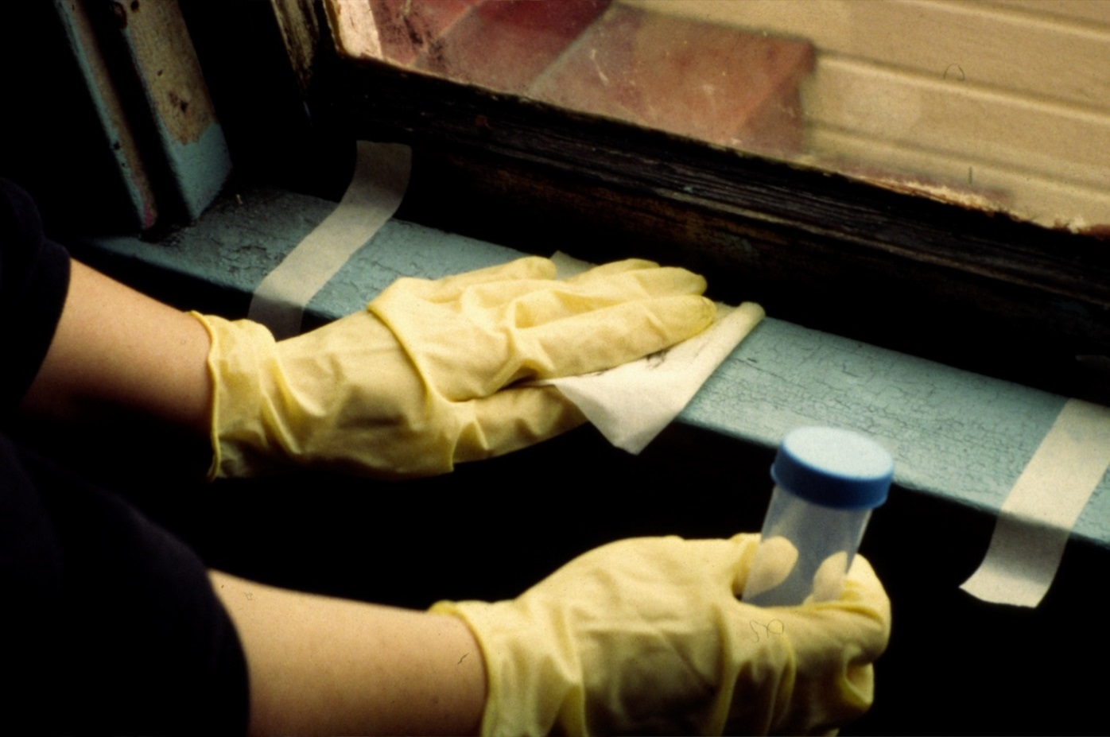
Sampling a Windowsill
Notes:
Note how the lead dust sampling technician is holding the wipe and moving across the windowsill.

Slide 31
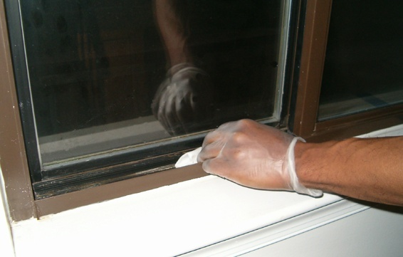
Sampling a Window Trough
Notes:
Here is an example of how to sample a window trough. The trough is not taped because its area is less than 16 inches, so sample the entire trough and determine its area. Measure carefully and down to 1/8 of an inch. Make sure the window trough has been adequately cleaned before sampling.

Slide 32
Step 5: Measure the Sample Area
Measure width and length (unless template was used). Area must be at least 16 square inches (2 inches by 8 inches). Measure to 1/8 inch.
Measure exact area after sample is taken.
Length of sill or trough between inside edges of tape
Tape across width of sill or trough (front to back)
Do not remove tape until after measurements are taken.
Notes:
Step 5: Measure the Sample Area
If a template was used, record the dimensions of the template on the lab collection form. If a template was not used, you must measure the sample area.
Measure the exact length and width of the sample area with a tape measure after the dust sample has been taken. This allows you to get an accurate measurement without contaminating the sample area.
Make sure you measure the area inside the tape, not the outside border.
Always measure to an eighth of an inch (1/8”). Sloppy measurement can produce inaccurate results.

Slide 33
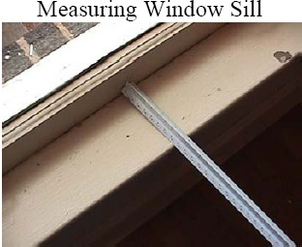
Measuring Window Sill
Notes:
When the wiping is done, measure the area wiped, unless you used a template and know the dimensions already. Measure the length and width of the area wiped.
Note: The ruler does not have additional space between where the measurements begin and the edge of the ruler.

Slide 34
Step 6: Record Sample Area on Forms
Record measurement on sample collection form and lab chain-of-custody form.
Calculate area outlined by the tape and record on the sample collection form and lab chain-of-custody form.
In some cases, conversion from inches to feet will be necessary. To make these calculations easier, measurements should always be converted from fractions to decimals (e.g., 0.5 rather than 1/2).
Check with analytical laboratory for additional recording requirements.
Notes:
See Attachment 3-A: Sample Collection Form and Attachment 3-B: Completed Sample Collection Form.
Instructors should pull out Attachment 3-C: Worksheet for Performing Mathematical Calculations from Fractions to Decimals and review with the class. A few simple calculations for the class may be very useful.

Slide 35
Step 7: Clean Up
Clean template with a clean sampling wipe; place template in a plastic bag for storage.
Remove materials from site:
Gloves, tape from floors and windows, used shoe covers
Put items in plastic bag, NOT in client’s containers
Clean clothing and remove shoe covers before leaving the work area.
Clean face and hands with warm, soapy water
Use sanitary wipes if no access to warm, soapy water
Notes:
Step 7: Clean Up
Sampling materials may be contaminated and therefore must be cleaned or removed from the site.
Clean the template with a clean wipe and place it in a re-sealable plastic bag for storage. This decontaminates the template between uses and helps avoid contamination when it is not being used. Throw wipe away in trash bag.
Be sure you have recorded the location and dimensions of the sample area before removing tape.
Remove gloves, tape, and shoe covers. Throw them away in trash bag.
Clean face and hands with warm, soapy water. (Use sanitary wipes if no access to warm, soapy water.)
Refer to the Lead Dust Sampling Technician Field Guide and Attachment 3-D: Lead Dust Wipe Checklist, which summarizes all the steps just described.

Slide 36
Hands-on Activity: Let’s Try It
You are now going to practice taking dust wipe samples.
Each individual must demonstrate proficiency.
Follow your instructor’s directions for taking samples.
You can refer to your Field Guide or Attachment 3-D for a list of key steps.
Notes:
Activity: Take samples on a variety of surfaces – windowsills, troughs, and floors.

Slide 37
Avoiding Common Mistakes
These common mistakes can give incorrect results:
Incorrect measurement
Contaminated wipe
Contaminated gloves
Sample area is disturbed
Sloppy recording
Notes:
If the lead dust sampling technician makes any of the following common mistakes, the technician could get incorrect results:
Incorrect measurement. Small mistakes in reading the tape measure can produce misleading results. Being off by half an inch can make the difference between passing or failing the EPA/HUD standards for lead in dust.
Wipe is contaminated. It is important that the wipe is clean before you collect the sample and that you do not lose any dust before putting the wipe in the tube. Common sources of contamination include the following:
Wipe touches the floor or window before you place it in the tube.
Wipe falls to the floor before wiping and you do not get a new one.
Wiping motions go beyond the template outline or taped area, collecting added dust or debris.
Wipe is placed on the floor or interior sill while unscrewing the tube cap, collecting dust.
Gloves are contaminated. The gloves can contaminate the sample if they are not clean.
Gloves are put on too early and you touch dust on other surfaces.
Gloves are not changed for each sample. Previously used gloves can carry lead dust from the previous sample.
Sample area is disturbed. Contamination may remove or add lead dust to sample area before you wipe the area. The lead dust sampling technician should select a new area to sample.
Place hand or tape measure inside sample area before you wipe it.
Place hand inside sample area while taping down template to the floor.
Slide template across sample area as you tape it down.
Use template that has not been cleaned.
Sample area is recorded incorrectly. To avoid errors:
Record measurements for interior sills and troughs immediately after measuring the area.
Review forms before you submit them to double-check measurements.

Slide 38
Composite Dust Wipe Sampling
In composite sampling, samples are collected from common components in different rooms and analyzed as one.
You may receive a request to take a composite sample during lead dust clearance testing.
Analytical laboratories often have difficulty processing composite samples. Contact your laboratory before taking any composite samples.
Notes:
EPA allows composite samples during lead dust clearance testing. You may receive a request to take a composite sample during lead dust clearance testing. HUD discourages composite sampling for clearance. Analytical laboratories often have difficulty processing composite samples. Contact your laboratory before taking any composite samples.
A composite is a sample that holds up to four dust wipes in one container. Each wipe is called a subsample.
A composite tells you the average amount of lead dust across all the areas you sampled. This provides a measure of average exposure. Subsamples need to be collected from areas of equal size for the results to be an average.
In contrast to single wipe samples, composite samples do not define the location of lead dust, if it exists. Rather, they simply identify that lead dust exists somewhere in the sampled area.

Slide 39
Rules for a Composite Sample
Measures average amount of lead dust on several surfaces (up to 4) of the same type.
Sample container holds up to 4 dust wipes
Do not use more than 4 wipes.
Do not mix samples from different types of surfaces.
Sample equal areas with each wipe, and use templates where possible.
Interior sills or troughs: use smallest sill or trough to set area
Notes:
Make sure the areas sampled for each of the subsamples are the same size. If you include wipes that collected dust from areas with varying sizes, you will not get an accurate reading of the average levels. This should not be a problem if templates are used.
Floors. Use a 12” x 12” sample area. Use a template or tape outline.
Interior windowsills and window troughs. Identify the smallest interior windowsill and/or trough you plan to sample. Measure the length and width after you lay down the template or tape and take the dust sample. Use these measurements to outline the same sample area for all of the other interior sills and/or troughs. This will guarantee that all the interior sills or troughs sampled are the same size.
Do not combine subsamples across units. A composite sample can only include dust wipes from a single unit. Do not use more than four wipes in a composite sample. It is difficult for labs to analyze composites holding more than four wipes. Check that your lab has experience analyzing composite wipes.

Slide 40
Composite Sampling Procedures
Outline all areas to wipe for composite before collecting sample.
Use a new wipe for each subsample.
Follow single wipe sampling procedures.
Use a separate chain of custody form for each composite sample.
It is not necessary to change gloves between subsamples.
Notes:
Whenever possible, use a template when collecting composite samples. If a template is not available, outline the areas you plan to wipe before collecting the subsamples. Remember that the sample size must be the same for all subsamples included in a composite sample.
Use a separate wipe for each subsample area wiped.
Follow the single-wipe sampling procedures.
You can use one set of gloves for all subsamples in the composite. However, if your glove touches an area outside the sample area, put on a new one.
After wiping each subsample area, carefully place the wipe into the tube.

Slide 41
Proper Hygiene After Completing Sampling Job
Hand washing
Face washing
Check your clothing and shoes (especially soles) before leaving work site

