Slide 1
Chapter 2 Visual Inspection

Slide 2
Objectives
Learn what a visual inspection is
Learn the steps for performing a visual inspection under both EPA’s and HUD’s regulations
Learn when to look for deteriorated paint, visible dust or debris, and paint chips
Record results on a visual inspection form
Notes:
This chapter will outline the steps a lead dust sampling technician must take to perform a visual inspection. A visual inspection is the first activity to perform on site for any lead dust clearance testing. This chapter will also highlight the differences in visual inspection between EPA’s RRP Rule and HUD’s LSHR.

Slide 3
Visual Inspection
Under both EPA’s and HUD’s rules, visual inspection is the first step in the clearance process.
The visual inspection determines whether the unit/work area (interior and exterior) is clear of visible conditions that can result in exposure to lead-based paint hazards:
Chips or debris
Visible dust
Notes:
The visual inspection determines whether the unit/work area is clear of conditions that can result in exposure to lead-based paint hazards, such as paint chips, debris, visible dust, and deteriorated paint. If these conditions are present, the unit does not meet EPA’s and HUD’s rules for lead dust clearance testing. HUD generally requires visual inspection and clearance of an entire unit, with worksite-only clearance allowable under certain conditions.

Slide 4
Visual Inspection – EPA RRP Lead Dust Clearance Testing
At the conclusion of the renovation, the certified renovator may have conducted a visual inspection to look for paint chips, dust, and debris.
The LDST must conduct a separate visual inspection of the work area to ensure that the area is free of debris and ready for lead dust sampling.
If any paint chips, dust, or debris are found, the renovation firm should re-clean these areas before the dust sampling technician begins to collect dust wipe samples.
Notes:
It is important for the lead dust sampling technician to understand that the renovation firm may perform his or her own preliminary visual inspection. The lead dust sampling technician should also perform a visual inspection of the work area. If the lead dust sampling technician observes paint chips, dust, or debris in the work area, these conditions must be brought to the attention of the certified renovator for re-cleaning.

Slide 5
Visual Inspection – HUD LSHR
HUD’s rule requires identification of deteriorated paint
Whole-unit clearance generally required unless worksite-only clearance is allowed.
Do not perform lead dust clearance testing if unit/work area does not pass visual inspection.
If deteriorated paint, dust, or debris is found, it must be eliminated before dust sampling may begin.
See Attachment 2-A and 2-B
Notes:
Why look for deteriorated paint?
In order to address lead dust in a housing unit, you need to address its sources, including deteriorated lead-based paint. If paint contains lead, deteriorated paint can create chips and dust, which can cause exposure to lead.
* NOTE: The LSHR refers to this process as a “visual assessment,” but for purposes of this curriculum, the term “visual inspection” is used.

Slide 6
Visual Inspection – HUD LSHR
Inspect exterior area if:
Exterior painted surfaces have been disturbed by renovation activity
Openings to exterior were not sealed during interior work
Inspect ground and outdoor living areas close to affected surfaces
Visible dust or debris must be removed
Deteriorated paint must be eliminated
Dust sampling is not performed for exterior work
Notes:
EXTERIOR VISUAL INSPECTION IS NOT REQUIRED IF ONLY INTERIOR WORK IS PERFORMED.
An independent third party is needed to do an exterior visual inspection if the exterior work was done under HUD’s LSHR. A certified dust sampling technician is qualified to perform this inspection.
For more information, see Appendix B or 24 CFR 35.1340.
HUD Note: HUD requires sampling technicians to verify with renovator that openings to the exterior are closed during interior work. If not closed, exterior visual inspection is required for interior work.
Dust sampling is not required for exterior work. There are no dust-lead clearance standards for porches, balconies, railings, or other horizontal exterior features.

Slide 7
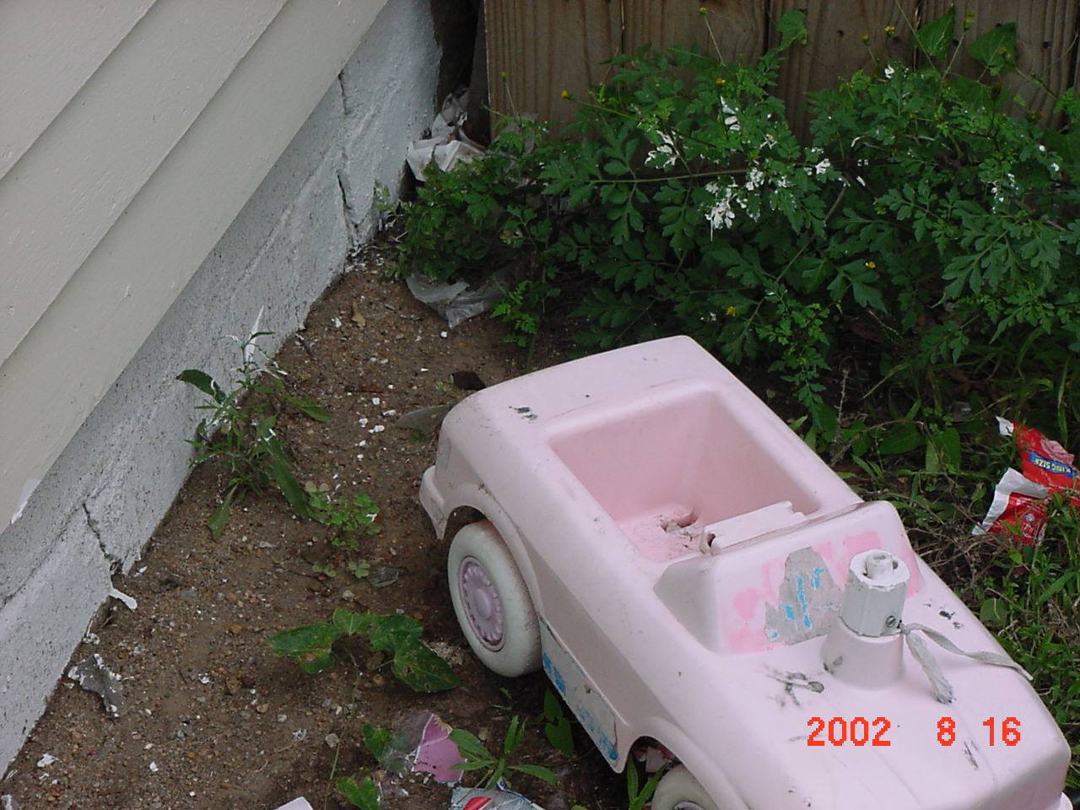
Exterior Debris

Slide 8
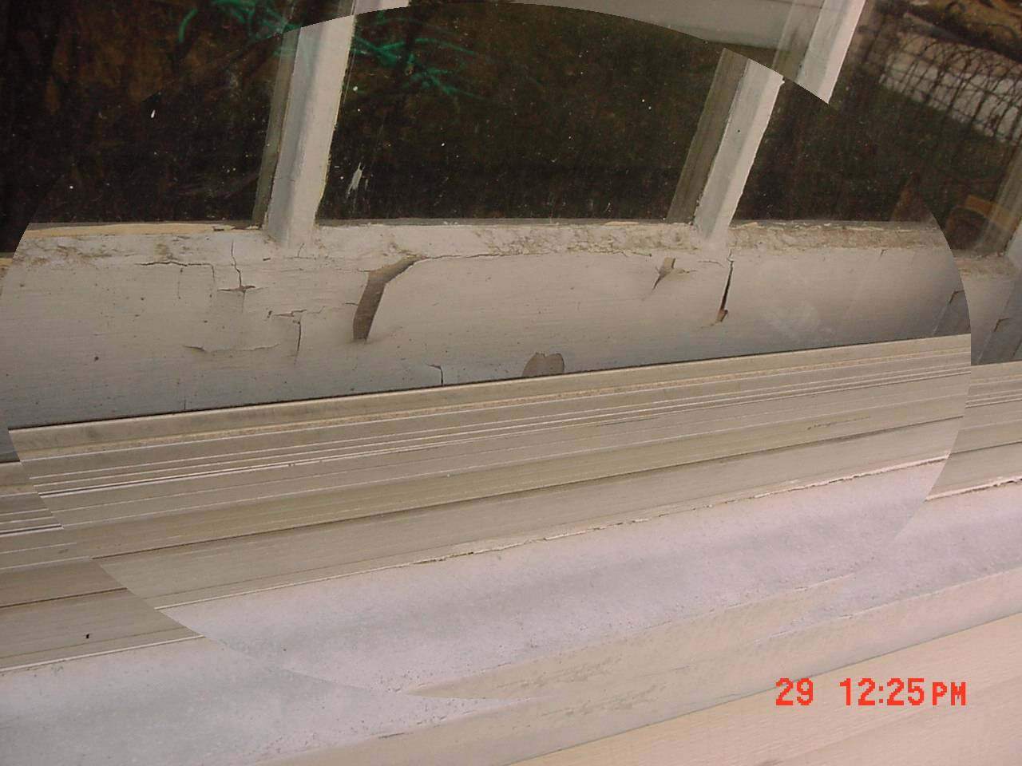
Visual Inspection – HUD LSHR
Identify any paint that is not intact:
Chipping
Peeling
Chalking
Cracking
Holes, moisture, and friction damage
Hairline cracks and nail holes are not considered deteriorated paint.
Notes:
Deteriorated paint is any paint that is not intact. It does not have to be peeling paint.
As seen in the following photographs, deteriorated paint can include:
Chipping paint on door and window trim
Peeling paint and flaking paint on walls and window sashes
Paint with small bubbles that look like blisters
Paint with lines and cracks that make it easy to peel the paint away
Paint that is “chalking” or creating chalk-like dust
Note: Hairline cracks and nail holes are not considered deteriorated paint.

Slide 9
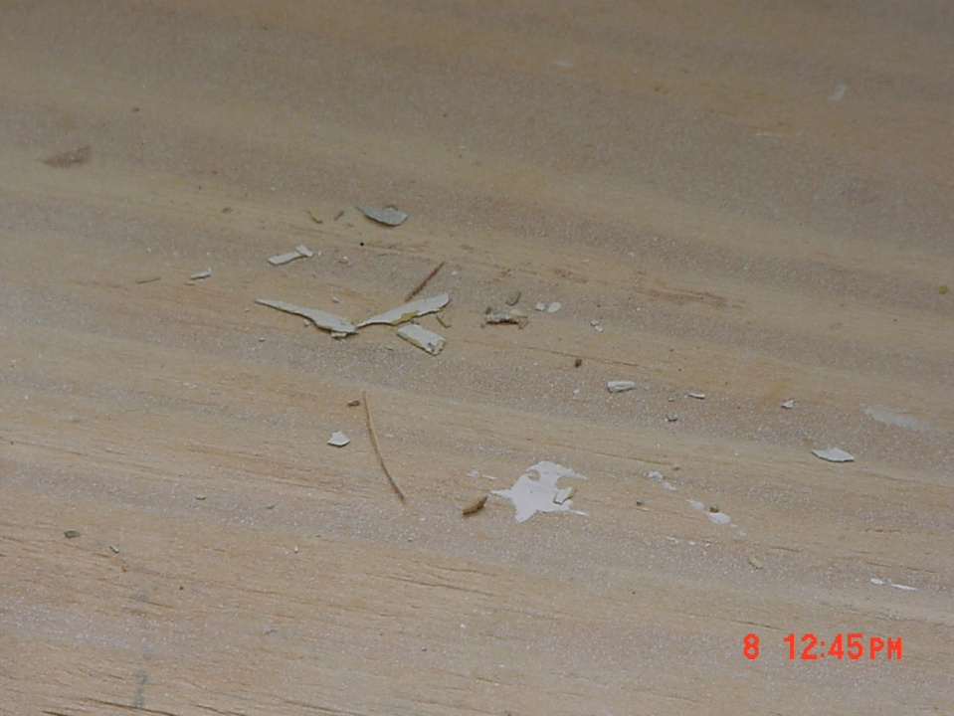
Visual Inspection – HUD LSHR
Dust
Dust you can see
Debris
Pieces of wood, bits of plaster, and various other building pieces covered in paint
Paint chips
Small pieces of paint
Notes:
What do visible dust, paint chips, and debris look like?
Visible dust is dust you can see.
Debris can be pieces of wood, bits of plaster, and various other building pieces covered with paint that are left in the room or near where the work was done.
Paint chips are little pieces of paint. Chips can be even smaller than your fingernail or larger than your hand. Look for paint chips on floors and windows.

Slide 10
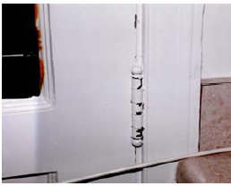
Visual Inspection – HUD LSHR
Chipping Paint

Slide 11
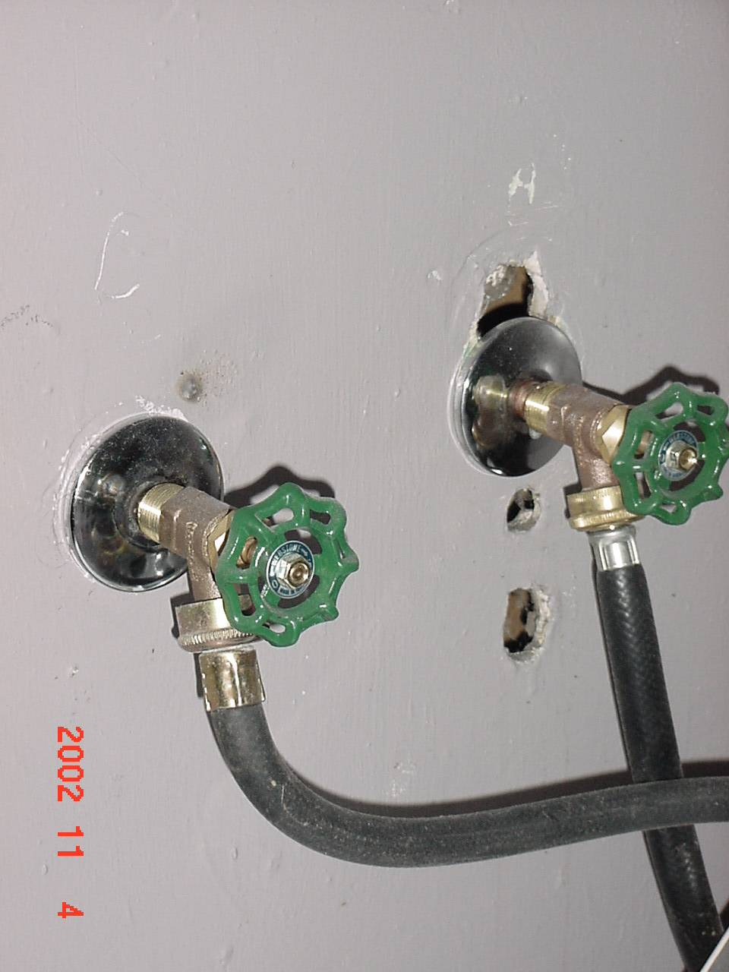
Visual Inspection – HUD LSHR
Holes in wall

Slide 12
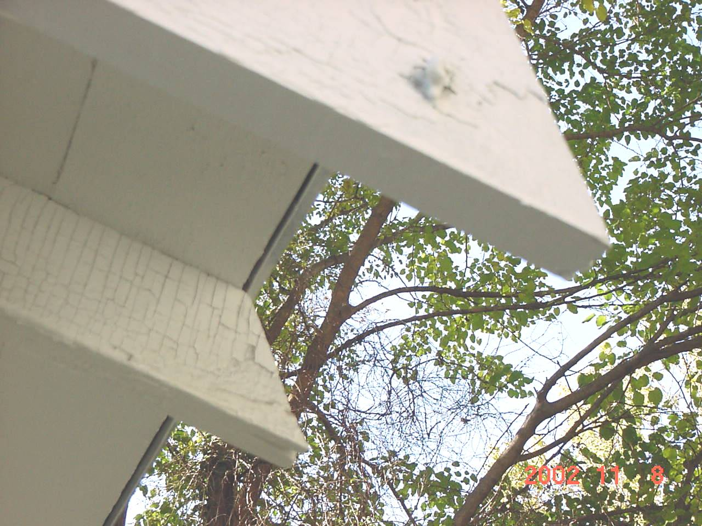
Visual Inspection – HUD LSHR
Deteriorated Paint

Slide 13
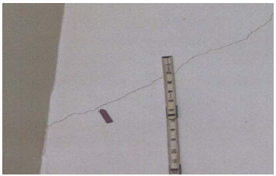
Visual Inspection – HUD LSHR
Cracking Paint
Notes:
The arrow here points to a crack in the paint.

Slide 14
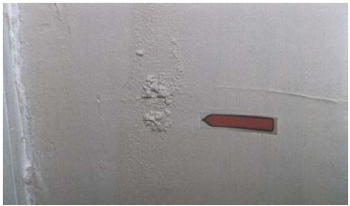
Visual Inspection – HUD LSHR
Moisture Damage
Notes:
Moisture can be the cause of many paint problems. In this case, it is causing the paint to bubble.

Slide 15
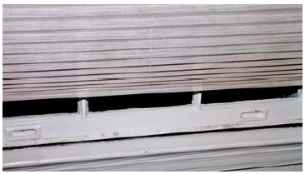
Visual Inspection – HUD LSHR
Friction Damage

Slide 16
Visual Inspection – HUD LSHR
Be precise about locations.
Write down results as you go.
Write down other information, indicating source.
See sample visual inspection form. (Attachment 2-B)
Notes:
When recording the results of a visual inspection, take the following steps:
Be precise about locations (e.g., room descriptions and/or specific areas in room) where visible dust, debris, paint chips, and deteriorated paint were found.
Write down results as you go along.
Write down other information the client provides about the surface in question.
See Completed Sample Visual Inspection Form in Attachment 2-B.

Slide 17
Review
Visual inspection is the first step to clearance.
EPA’s visual inspection determines that the area is free of dust and debris before dust clearance testing can begin.
HUD’s visual inspection also checks for deteriorated paint and generally covers the entire unit unless worksite-only clearance is allowed.
Visual inspection as part of clearance is the responsibility of the dust sampling technician.
Recordkeeping should be methodical.
Notes:
See Slides 2-3 through 2-16 for information and answers.
See Slide 2-3 for information and answers.
See Slides 2-3 through 2-9 for information and answers.

